Slide 1

CEIS110 - Programming with Data
Presented by: Kaila Hamaday

Slide 2
This project is a compilation of all the work I've completed as part of CEIS110 – Intro to Programming
The purpose of the project was to plan and create a program that takes temperature data and stores it in a local database to review and analyze the data using graphs.
Introduction

Slide 3
Software Inventory

Slide 4
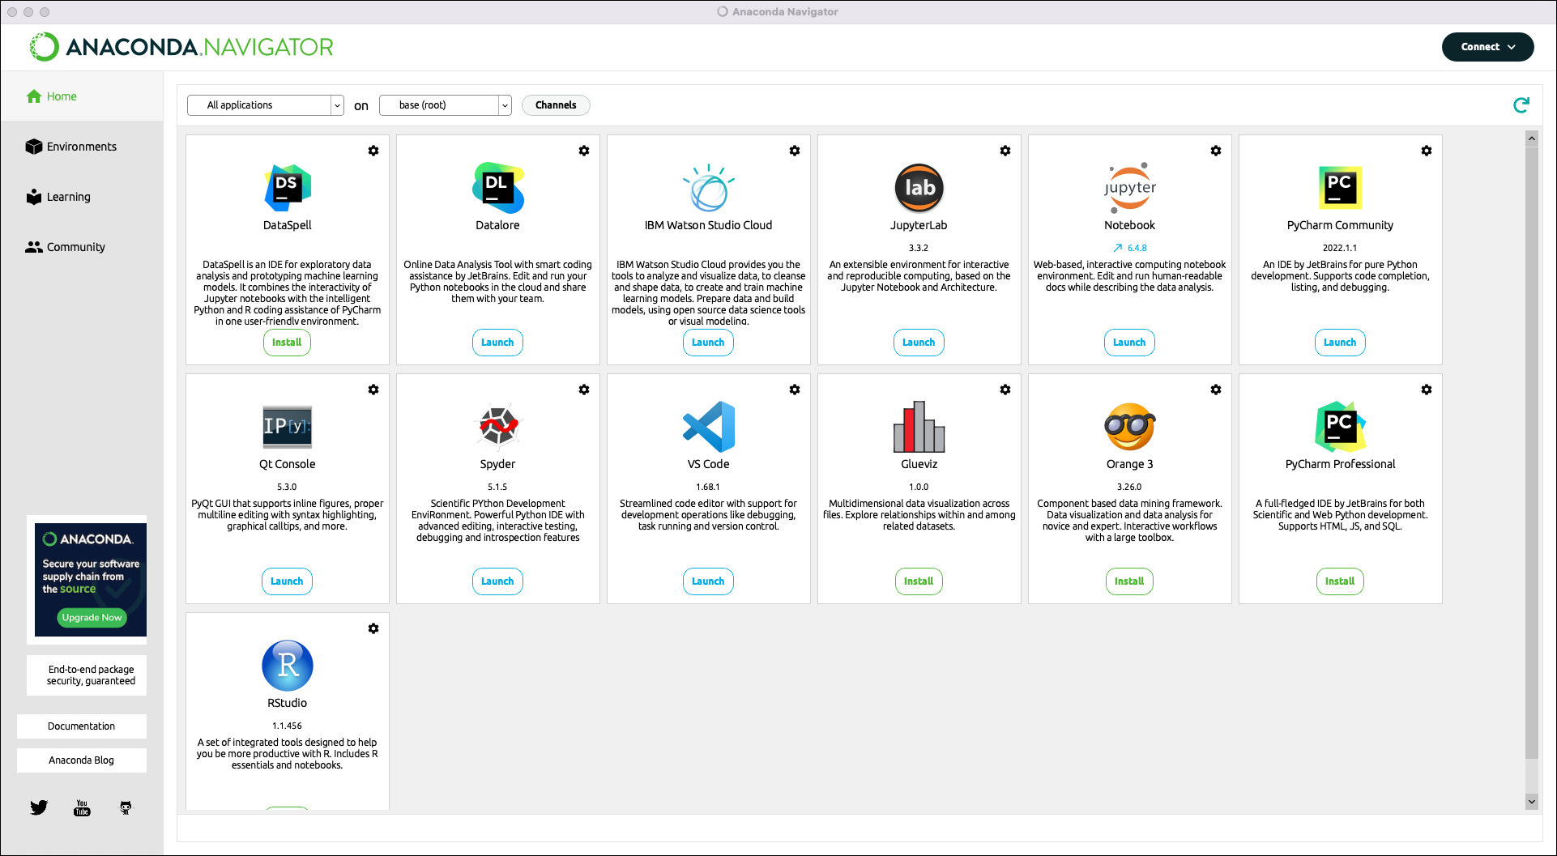
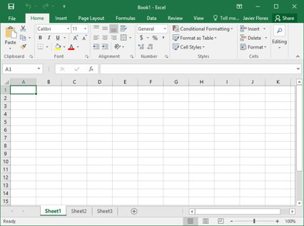
Software
The software needed for this project includes:
Microsoft Excel
Anaconda Navigator and Spyder

Slide 5
Planning and Design
After inventorying the software needed to complete the project, a plan was created for the temperature data project
A flow chart was used to design the project
Planning and design is a crucial step in any development process

Slide 6
Flowcharts are a representation of processes or workflows. It's developed to illustrate the process of the output of this project.
What are Flowcharts?

Slide 7
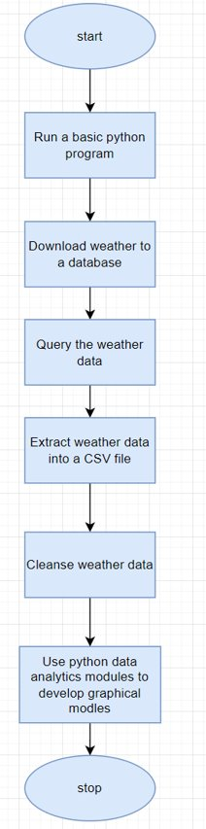
Flow Chart
Install Python
Download weather data to a database
Extract weather data from database into a comma separated file with python
Cleanse the weather data
Use Excel to manipulate data
Use python data analytics modules to develop graphical models

Slide 8
Python is a popular programming language used in business, data analytics, web development, program development, etc. This program illustrates a control structure in python.
What is Python?

Slide 9
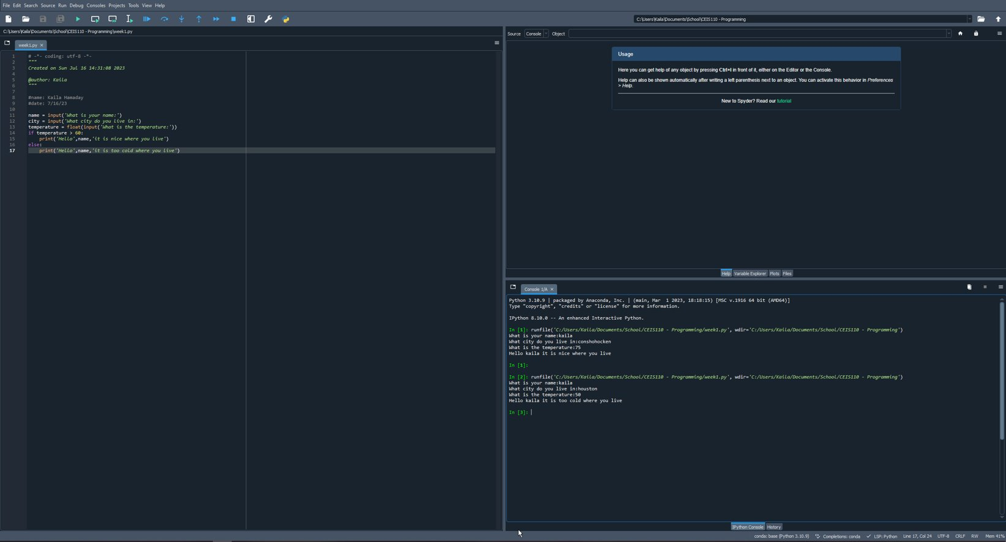
Python Program

Slide 10
Downloading Weather Data

Slide 11
After planning and design, the code was used to develop weather observations
This data was stored on a local database in an excel table for later analysis.
Gathering Temperature and Humidity Data

Slide 12
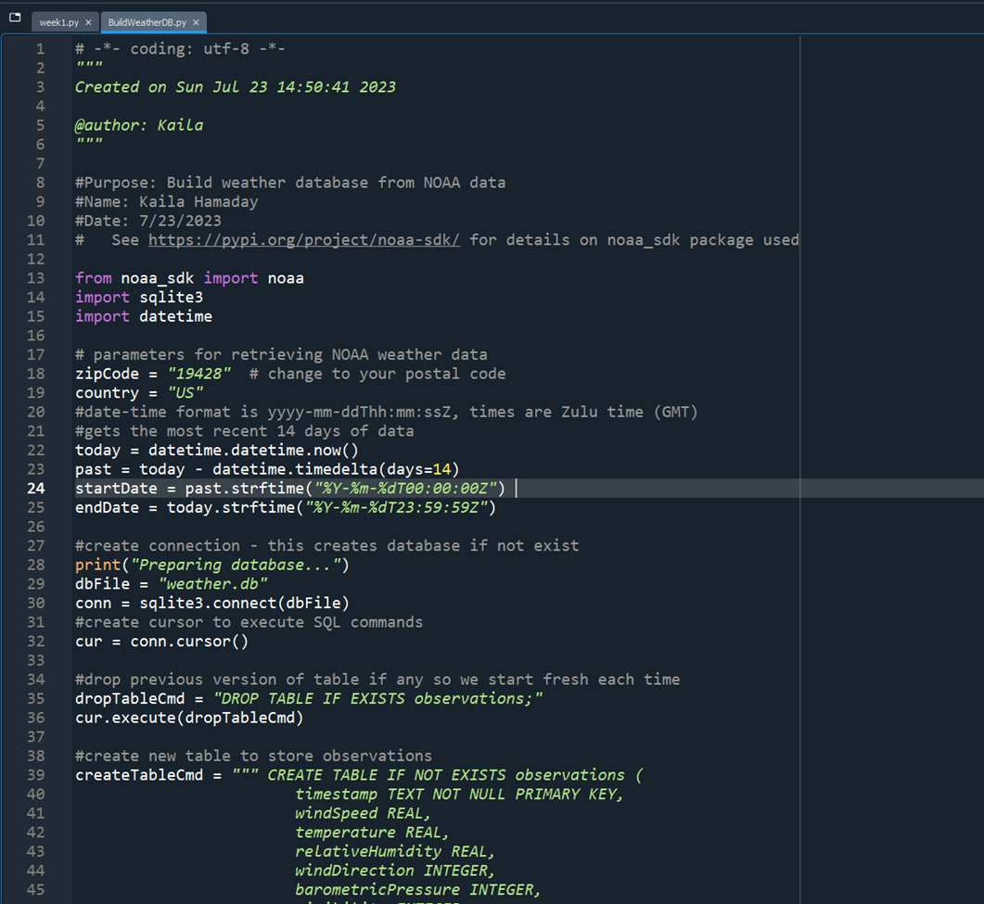
BuildWeather.Db PY Code
Screenshot of database code in python.

Slide 13
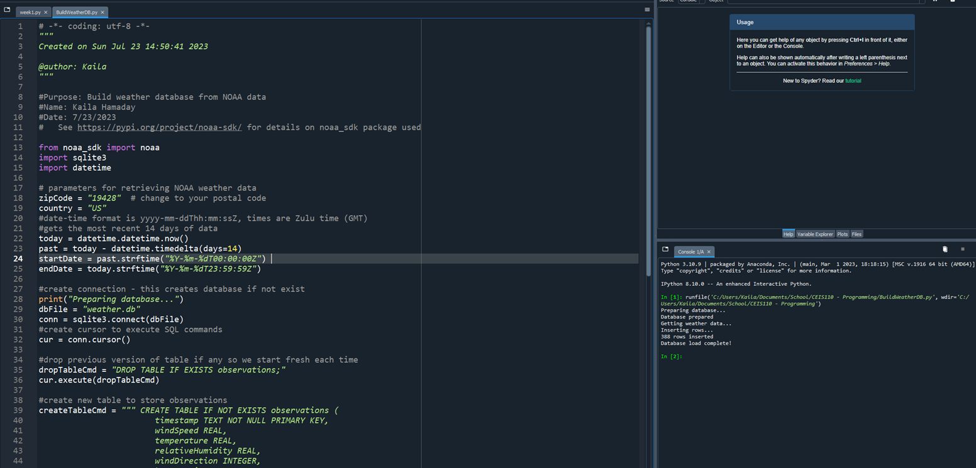
Python Console
Screenshot of program output in Python console showing program executed successfully

Slide 14
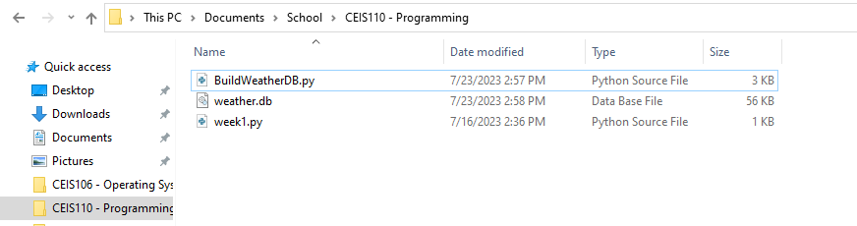
Weather.db file
Screenshot of Windows Explorer showing database file Weather.db was created

Slide 15
Querying the Database with SQL

Slide 16
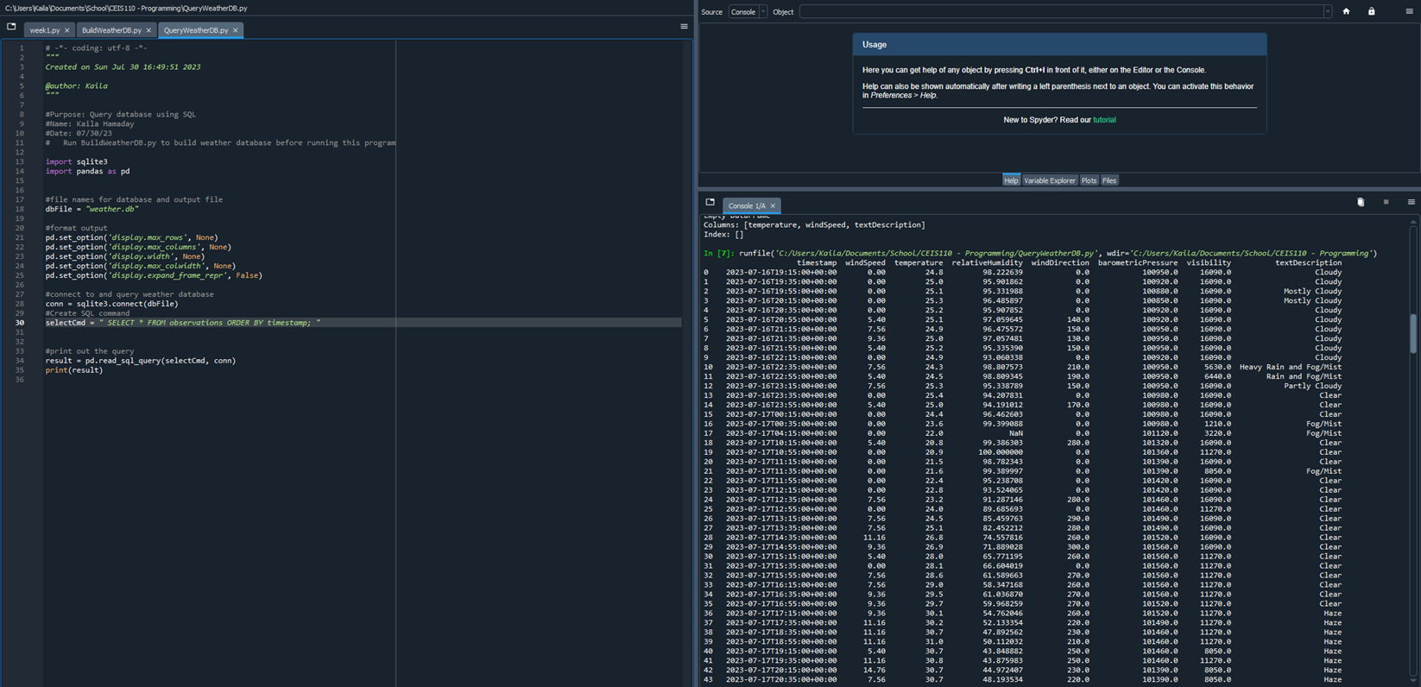
Query to Retrieve all Columns and all Rows
Screenshot of SQL query command and results

Slide 17
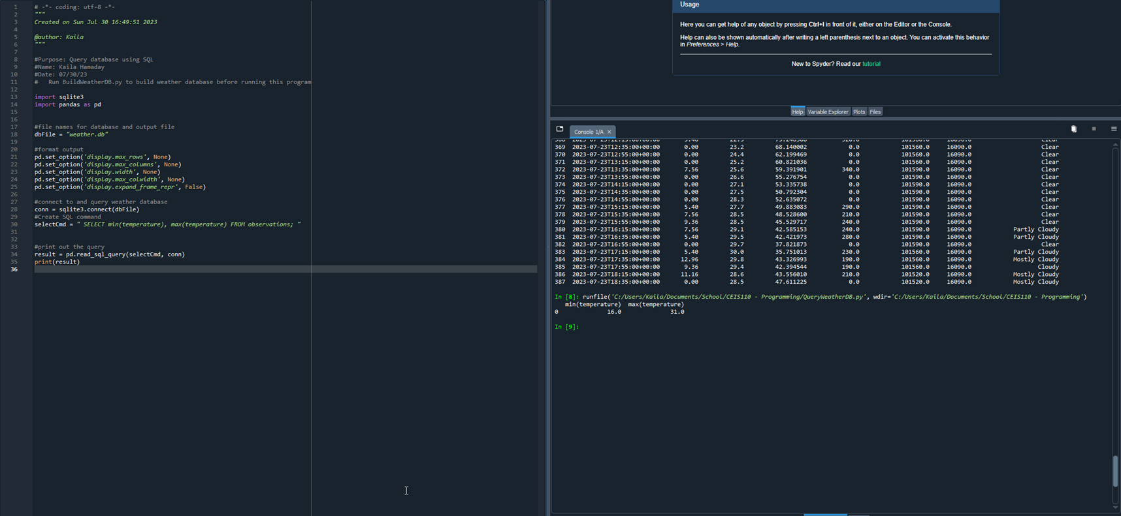
Query to Retrieve Lowest and Highest Temperatures
Screenshot of SQL query command and results

Slide 18
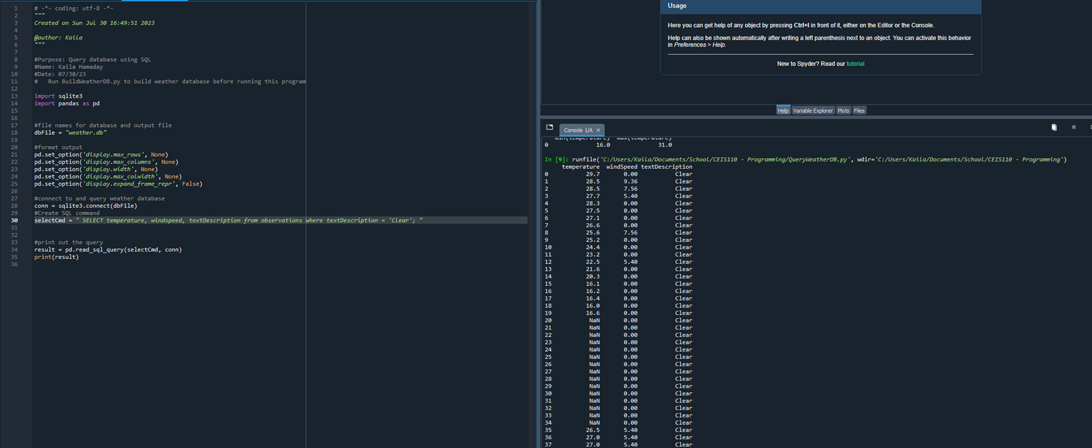
Query to Retrieve all Clear Days
Screenshot of SQL query command and results

Slide 19
Querying and Manipulating Data with SQL and Python

Slide 20
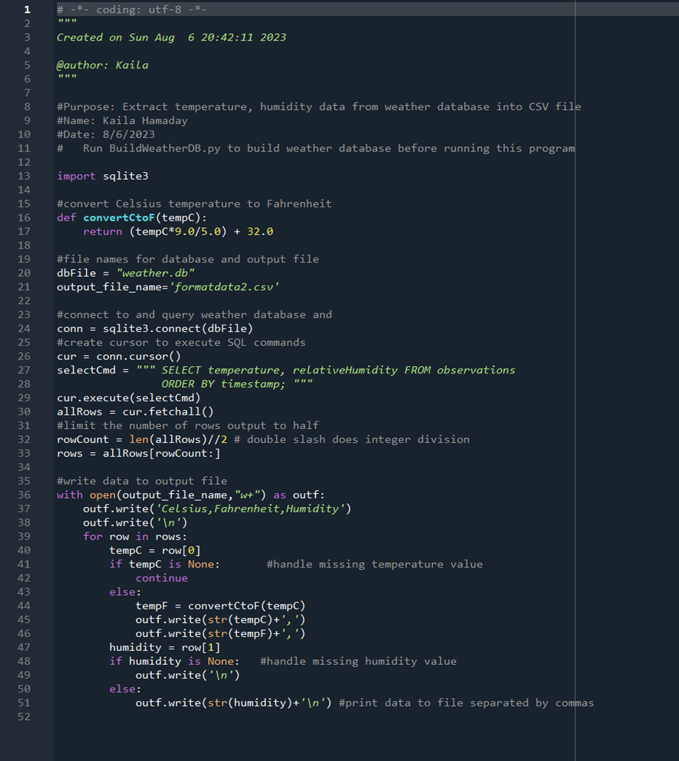
Python Code
ExtractTempHumidity.py Python code with your name and date in comments

Slide 21
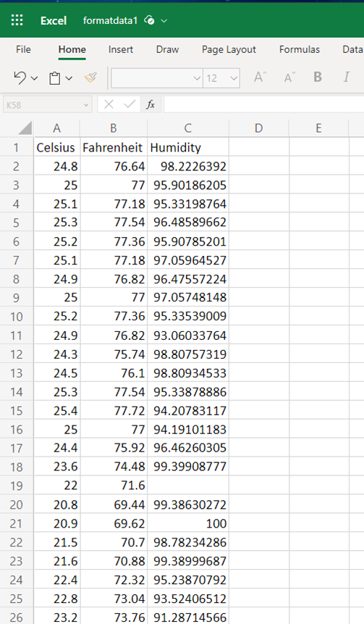
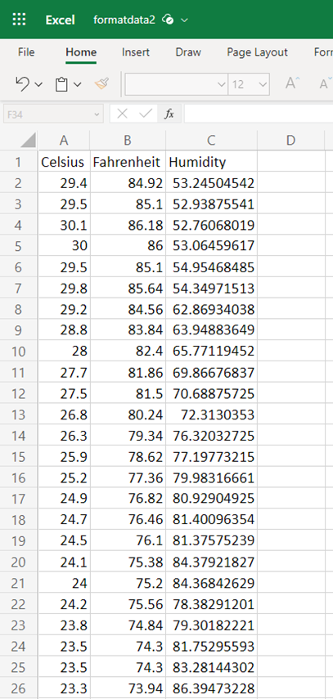
Retrieve and Convert Data to CSV
Format data file open in Excel showing 3 columns of data

Slide 22
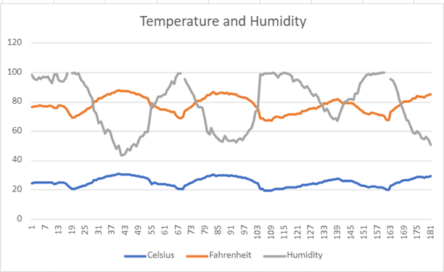
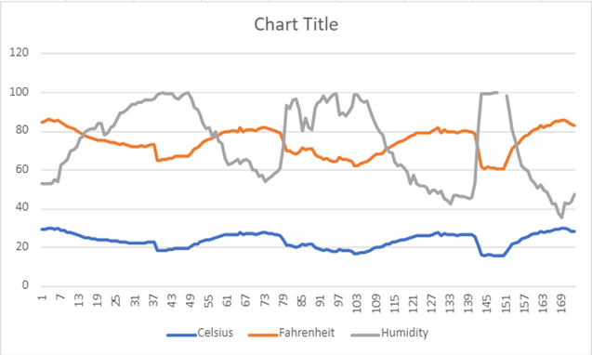
Temperature and Humidity Chart (Graph)
Excel chart based on temperature and humidity data from database
Format Data 1
Format Data 2

Slide 23
Develop Graphical Models and Interpret the Results

Slide 24
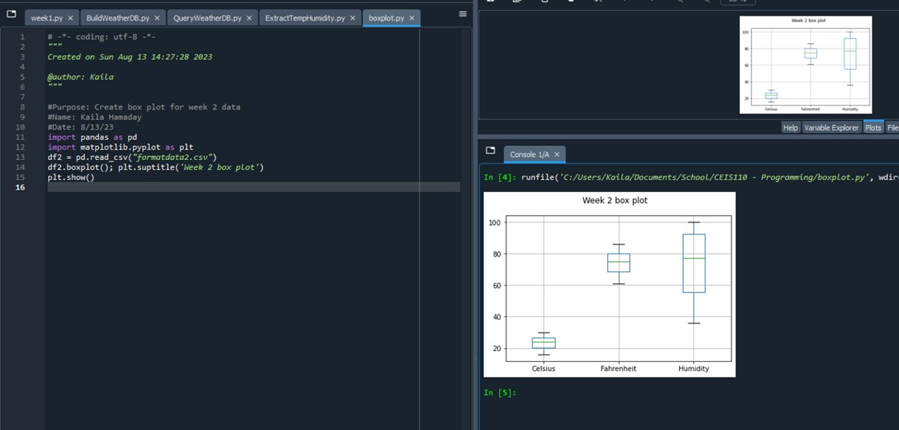
Plot 1: Box Plot of Week 2

Slide 25
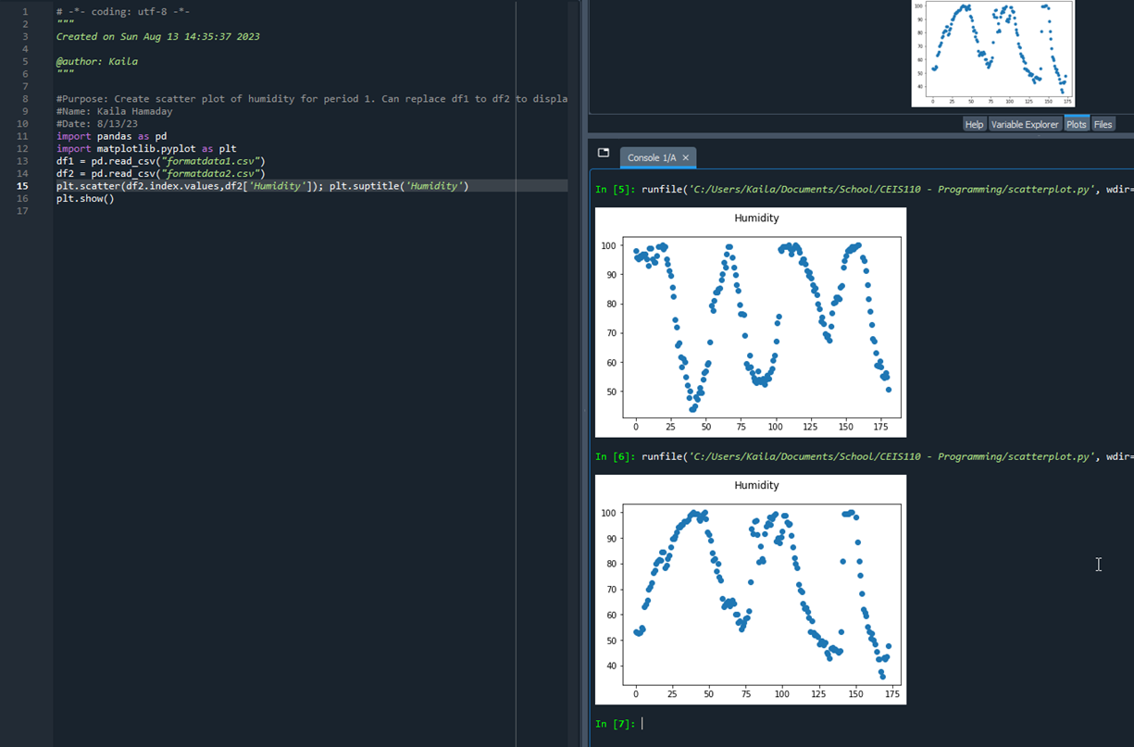
Plot 2: Scatter Plot week 1 & week 2

Slide 26
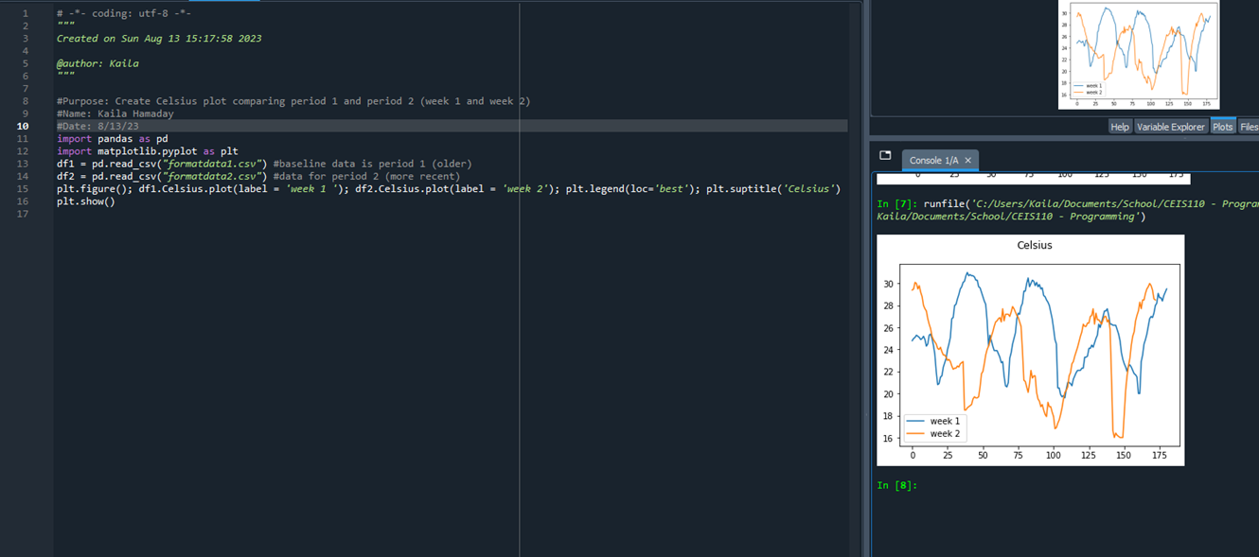
Analysis: Create your own plot

Slide 27
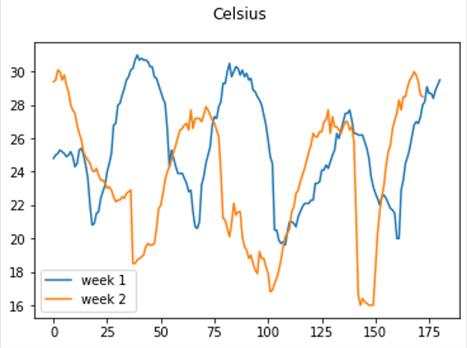
Analysis:
Think of your own question and create a chart/graph to answer it
Your own question:
Were there higher daily peak temperatures in week 1 or week 2?
Answer supported by Chart: Week 1 had higher daily peak temperatures than week 2.
Prediction:
Based off the data collected, week 1 generally has higher daily peak temperatures, however week 2 seemed to have a sudden rise. I would predict the temperature would continue to rise and then drop.

Slide 28
Some of the challenges I faced were:
A few times I mistyped the code and nothing would run. So, I would have to go back and re-read what I typed to make sure I spelled everything correctly.
Also when creating the plot charts using Spyder, I couldn't figure out where the chart showed up at. I had to search it on Google, and there was a setting that wasn't enabled. I enabled the setting and the chart showed up!
Challenges

Slide 29
Python Programming
Creating a flow chart
Understanding of the different consoles used for programming (Anaconda, Replit, Spyder, etc.)
Data Analysis
Creating a Database
Career Skills Acquired

Slide 30
I was really excited about this project. I have very basic knowledge of programming, so this was something I felt would help home in those skills. Using python to create and analyze data was so much fun and I look forward to using this more.
We had to follow many steps to design, create and analyze a database of temperature data.
I've had very little previous experience with python, however I did have knowledge of other programming languages and have used them in my life. I felt this class and project were a great introduction to python. Specifically what python is and how to build off the basics.
Project Conclusion

