Slide 1

NETW191
Final Project
Presented By: Kaila Hamaday

Slide 2
Introduction
The purpose of this project was to use a virtual machine environment to create the connection between hosts and servers. Where we would use LINUX terminals to ping and establish the connection between the SOHO Router, create loopback interfaces and learn about securing a network.

Slide 3
IPv4 Addressing
The overall purpose of this project module was to be able to access the IPv4 address, identify it and then assign a new one to the SOHO Router, then reestablish the IPv4 address.
The steps to complete this were the following:
Access the IP address in the command terminal on the machine
Connect to the router's interface using 192.168.1.1
Change the assigned IP address in the network interfaces option to 192.168.105.1
Relaunch Firefox with the new IP and confirm the change has been made

Slide 4
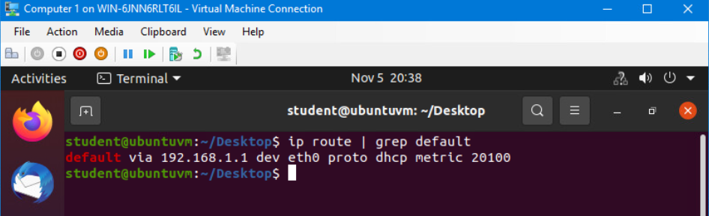
Preparation
This screenshot should include the terminal window that shows the default gateway IP address.
This screenshot should also show the date/time information on top of the Terminal window.

Slide 5
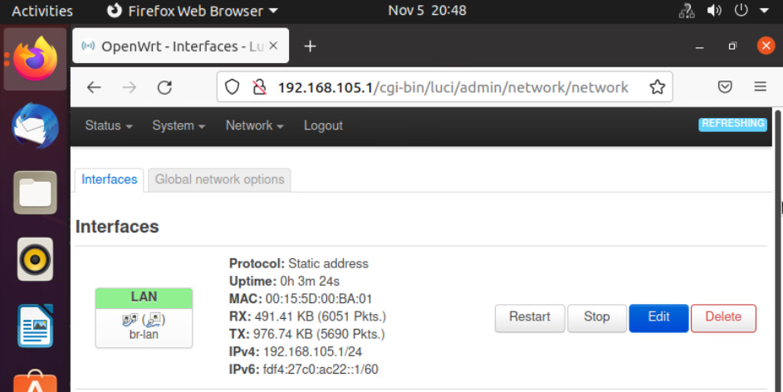
IPv4 Address Assignment
This screenshot should include the Interfaces page that shows the new IPv4 address on the LAN interface.
This screenshot should also show the date/time information next to the Firefox Web Browser tab.

Slide 6
Connectivity Testing
The overall purpose of this project module was to be able to access the IPv4 address on the VM machine 1 and 2 and ping the router and VM from each machine.
The steps to complete this were the following:
Access the IP addresses for each machine in the command terminal on the machine
On each machine, ping the router's IP address and then the opposing machine's IP address to ensure there was a connection.

Slide 7
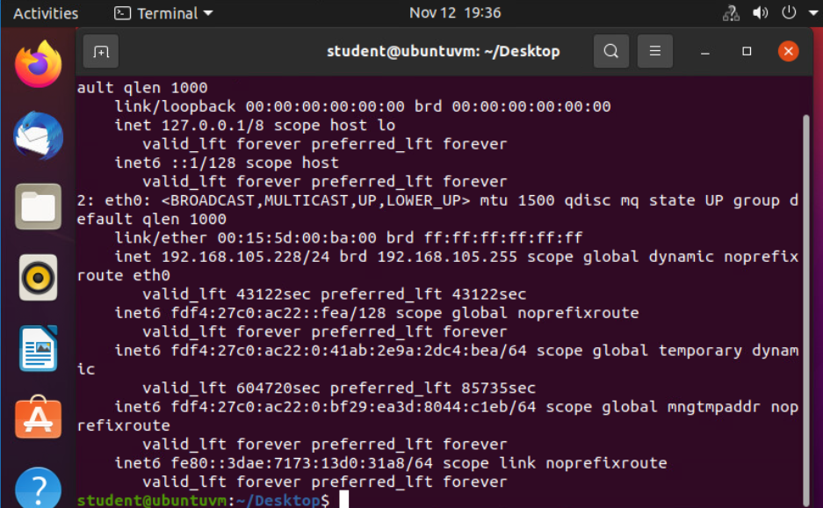
Dynamic IP Address Assignment
Take a screenshot of the Terminal window.
This screenshot should show the IPv4 address of the Computer 1 VM.
This screenshot should also show the date/time information on top of the Terminal window.

Slide 8
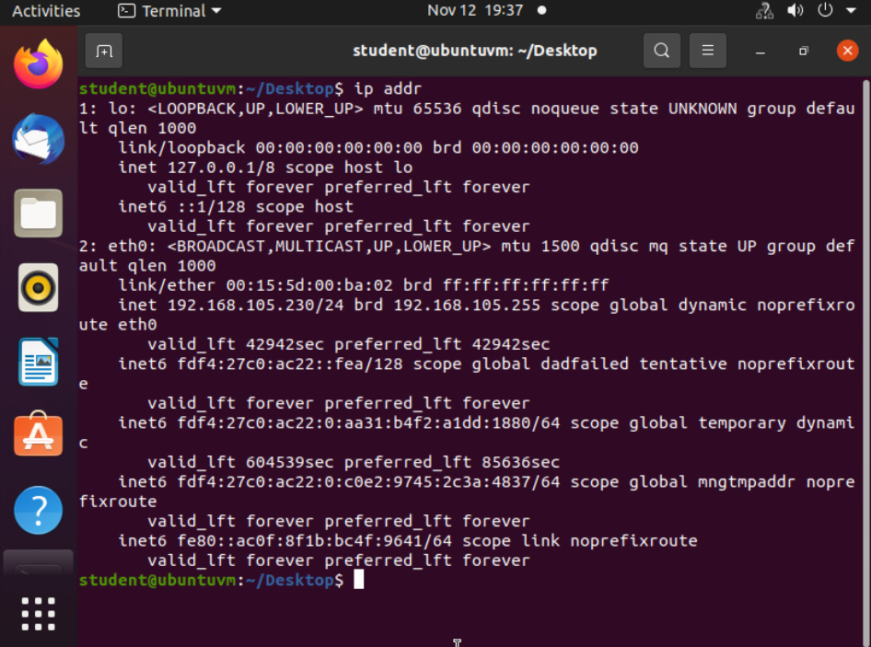
Dynamic IP Address Assignment
Take a screenshot of the Terminal window.
This screenshot should show the IPv4 address of the Computer 2 VM.
This screenshot should also show the date/time information on top of the Terminal window.

Slide 9
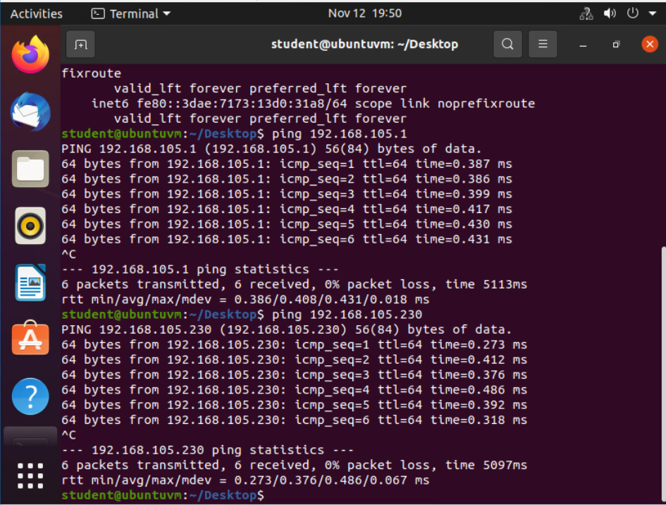
Connectivity Test
Take a screenshot of the Terminal window.
This screenshot should show 1) the connectivity test FROM the Computer 1 VM TO the SOHO Router VM, and 2) the connectivity test FROM the Computer 1 VM TO the Computer 2 VM.
This screenshot should also show the date/time information on top of the Terminal window.

Slide 10
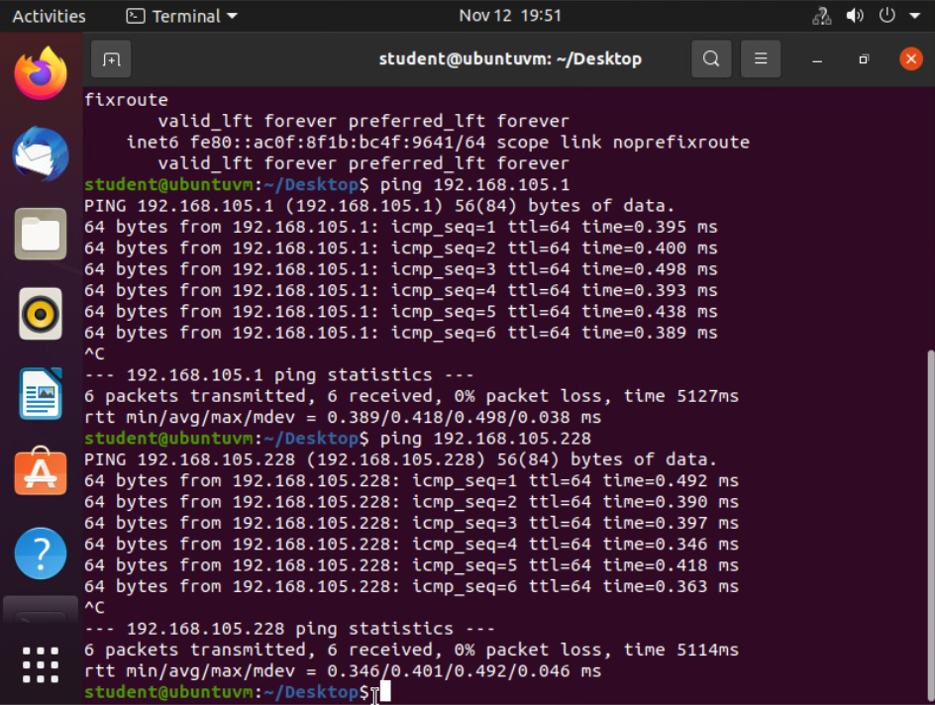
Connectivity Test
Take a screenshot of the Terminal window.
This screenshot should show 1) the connectivity test FROM the Computer 2 VM TO the SOHO Router VM, and 2) the connectivity test FROM the Computer 2 VM TO the Computer 1 VM.
This screenshot should also show the date/time information on top of the Terminal window.

Slide 11
IP Subnetting & Loopback Interfaces
The overall purpose of this project module was to be able to add multiple loopbacks to the network interface, find their IPv4 addresses, and then ping the loopbacks.
The steps to complete this were the following:
Add the loopbacks to the network interface
In the terminal, ping each loopbacks IP address for confirmation

Slide 12
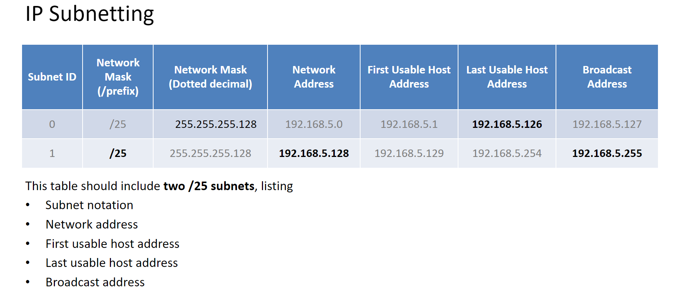

Slide 13
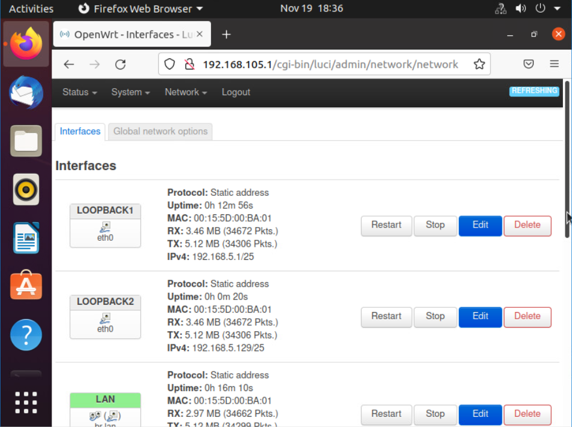
Loopback Interfaces
This screenshot should show both Loopback1 and Loopback2 interfaces and their correct IPv4 addresses.
This screenshot should also show the date/time information on top of the desktop window.

Slide 14
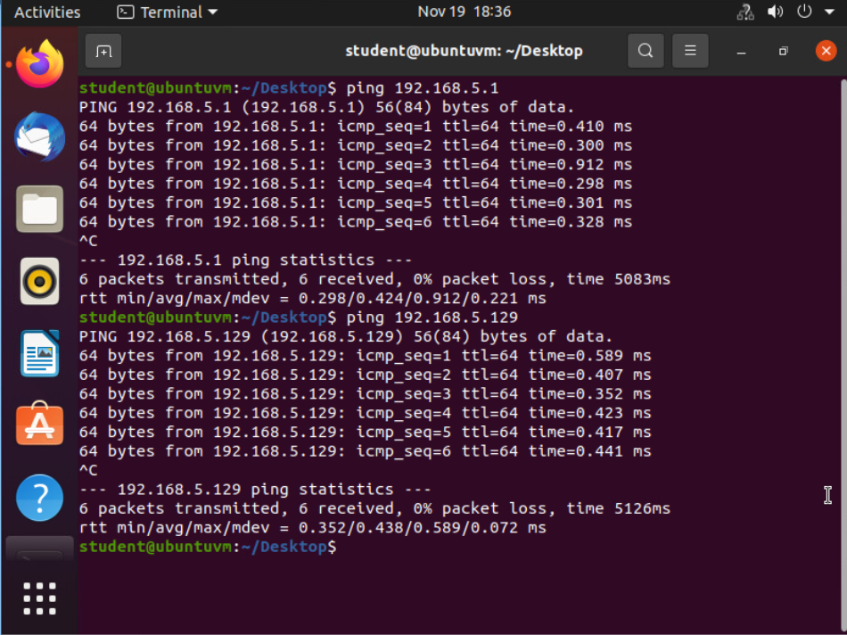
Connectivity Tests
This screenshot should show two successful ping tests:
from the Computer 1 VM to the Loopback 1 interface
from the Computer 1 VM to the Loopback 2 interface
This screenshot should also show the date/time information on top of the desktop window.

Slide 15
Visio Network Diagram
The overall purpose of this project module was to be able to create a network topology in Microsoft Visio and provide the IP addresses and subnet masks.
The steps to complete this were the following:
Download Microsoft Visio
Add the SOHO Router, Switch and VM 1 & 2 and connect them
Label the components and list the IP address and subnet masks

Slide 16
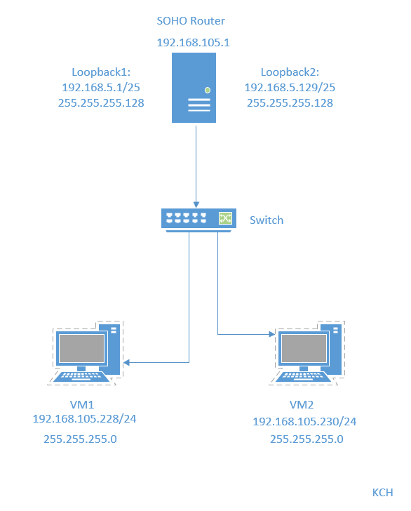
Microsoft Visio Network Diagram
This diagram should illustrate the interconnection of the Computer 1 VM, the Computer 2 VM, and the SOHO Router VM along with proper IP addresses and labeling.
This diagram should also show your initials in the bottom right corner.

Slide 17
SOHO Wireless Network Security
The overall purpose of this project module was to view security options of the SOHO router and provide conclusions and reflections of the information available.
The steps to complete this were the following:
Use the project guide to visit the website - https://www.tp-link.com/us/support/emulators
Select the TL-WR902AC V3 Router
View the security settings
  Static and Dynamic IP Assignments
  MAC Filtering
  Wi-Fi Security Protocols

Slide 18


SOHO Wireless Network Security 1 of 3
1. What are the factory default username and password of a TP-Link router? Why is it important to change the default username and password of a SOHO router?
Answer:
Default User Name - admin
Default Password - admin
It is important to change the default username and password because people can login to your router and make changes to your network
2. To protect a SOHO wireless network with a small number of devices, which address management method provides more control, configuring the device IP addresses manually (static IP) or using a DHCP server (dynamic IP)? Why?
Answer: The Static IP address option would provide more control over address management. This is because the user would need to know their IP address to access your network, and you would need to provide permission for the IP address to access the network. DHCP would allow any user to connect with the username and password.

Slide 19
SOHO Wireless Network Security 2 of 3
3. What does MAC filtering do? If needed, when would you use deny filtering rules and when would you use allow filtering rules? What happens to devices that want to connect, if the “Allow the stations specified by any enabled entries in the list to access” function is enabled but there are no entries in the list?
Answer: Mac filtering is a way to limit network access to only users who have had their Mac address added in the router settings. You would use 'deny filtering' when wanting to allow devices to connect to the network by default. All other devices are denied access. You would use the 'allow filtering' when you want to allow access to the users listed in the filter to connect to the network. All other devices will automatically be denied. If the “Allow the stations specified by any enabled entries in the list to access” is selected and there are no entries in the list, then no devices will be allowed access to the network.
4. What wireless security settings are displayed on the Wireless Security page? Which one is recommended by the vendor? Why?
Answer: The options for security listed are as follows:
Disable Wireless Security - The wireless security function can be enabled or disabled. If disabled, the wireless stations will be able to connect the device without encryption. It is recommended strongly that you choose one of following options to enable security.
WPA/WPA2 - Personal - Select WPA based on pre-shared passphrase.
WPA/WPA2 - Enterprise - Select WPA based on Radius Server.
WEP - Select 802.11 WEP security.
The notice for the vendor is - "it is strongly recommended to enable wireless security and select WPA2-PSK AES encryption". Because this is the strongest form of encryption that can be enabled on your router.

Slide 20
SOHO Wireless Network Security 3 of 3
5. Among the configurations you explored in this module, which one is a true security function? Why?
Answer: Among the options discussed in this module, I believe WPA2-PSK AES Encryption is the truest form of security. WPA2-PSK AES is currently believed to be the strongest method of security. There are multiple levels with this encryption WPA2 PSK and AES. WPA2 (Wireless Protected Access 2), provides strong encryption over the network, while PSK (pre-shared key), is a password used to login. AES (Advanced Encryption Standard), which is widely used for securing sensitive data. Having all 3 options, allows for a stronger level of security.
6. What would you do to protect your wireless network at home? Why?
Answer: If I were protecting my home network, I would use the mentioned above WPA2-PSK AES. At the very least I would use WPA2-PSK. Again, this is listed as the most secure option, so it would be the best option. However, just using WPA2-PSK still provides a multilayer option. If I wanted to add more layers of security, I would add Mac Address Filtering on top of WPA2-PSK.

Slide 21
Challenges
The only challenge I really faced with this project was the Visio Network Diagram. I switched the loopback interfaces and didn't label the IP addresses correctly at first.

Slide 22
Career Skills
Networking / Connectivity Knowledge
Network Diagrams
Securing Networks
Network Terminology

Slide 23
Conclusion
I had a very basic understanding of networking as a whole when I started this class. The NETW191 class was a great introduction to the underlying network, how to secure and diagnose issues. As well as prepare us for the CompTIA Network+ test. I also used previous knowledge of LINUX when completing some of the tasks for this project, which was helpful in gaining an understanding of what was transpiring.

Slide 24

References
Infosec Learning lab - https://lab.infoseclearning.com/course/NMMQQFKYZF/lab/TJWARTLHFQ?check_logged_in=1
Tech Pub, May 18th, 2019, Visio 2019 Basic Network Creation. Retrieved from https://www.youtube.com/watch?v=IzLc5UPUPF0&ab_channel=TechPub
Bellingham IT, 2023, Are you using the right WiFi Security? WPA, WPA2-AES, WPA2-TKIP, What does it all mean?, Retrieved from - https://bellinghamit.com/blog/using-right-wifi-security-wpa-wpa2-aes-wpa2-tkip-mean
Module Guides 2-7

