Slide 1

SEC285 Fundamentals of Information System Security Course Project
By: Kaila Hamaday

Slide 2
Introduction
The purpose of this project was to develop a general understanding of threat actors, encryption, vulnerability assessments, writing a bring your own device policy and handling firewalls.

Slide 3

Asymmetric Key Encryption Submission

Slide 4
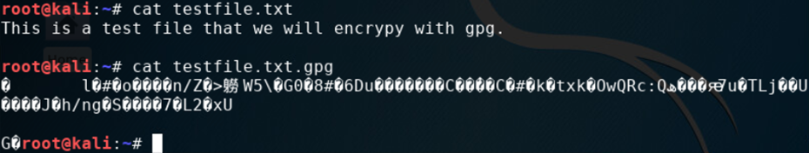
File Encryption
This screenshot should show the following.
Content of the plaintext file
Content of the encrypted file

Slide 5
File Decryption
This screenshot should show the following.
The encrypted file being listed by itself
The decrypting process
Both the encrypted file and the original plaintext file being listed

Slide 6

Stateful Firewall

Slide 7
Question
What effect does the sudo iptables --policy INPUT DROP command have on the access to computing resources?
Answer here:
Sudo iptables –policy INPUT DROP – drops all incoming connections to the linux server.
References:
1. Infosec Learning Lab - https://lab.infoseclearning.com/course/BPUUGYUWOV/lab/GUOQVNKMKT?check_logged_in=1

Slide 8
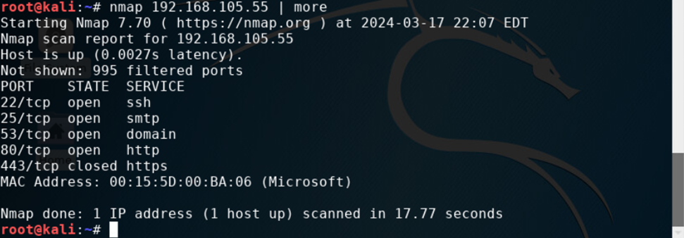
Nmap Scan
This screenshot should show the Nmap scan result of the Linux Server VM.

Slide 9

Bring Your Own Device(BYOD) Policy

Slide 10
Bring Your Own Device Policy
1.Overview:
This Bring Your Own Device (BYOD) policy is to outline the guidelines and procedures for an employee wanting to bring their own personal devices to use to access company networks and information. This is to allow employee integration with company data while maintaining compliance and operating within the company’s IT infrastructure.
•Some risks include the following: unauthorized access, phishing attacks, jailbreaking/rooting devices, and malware/viruses.
2. Purpose:
The purpose of this policy is to maintain the balance between employee productivity and flexibility while maintaining the highest level of security compliance. This policy aims to maintain a safeguard over company data and eliminate vulnerabilities.
BYOD Document

Slide 11
Bring Your Own Device Policy​ Cont.
3. Scope:
This policy applies to all employees, contractors, and third parties who connect their personal devices to the organization’s network or access company information remotely. All employees, contractors, and third parties must receive written consent from the IT Department.
4. Policy:
Please note all personal devices that receive written permission to access company data and networks are subject to a security assessment before acceptance to ABC Corporation’s Network. Devices may also be subject to assessment upon request for renewal
Only approved personal devices that meet the organization's security requirements are allowed to access the network. The device must be up to date on the latest OS and must have an antivirus installed.
Employees must obtain formal approval from the IT Department before connecting their personal devices to the organization’s network. The request for approval must include device details, such as make, model, operating system version, and security features.
All devices that fall into non-compliance will be allowed remediation. The user or the IT Department can complete this. Once the remediation has been completed, a recheck will be performed and the IT Department will allow the user access.

Slide 12
Bring Your Own Device Policy​ Cont.​
5. Policy Compliance:
The InfoSec team will verify compliance to this policy through various methods, including but not limited to, periodic walk-through, video monitoring, intrusion detection tools, business tool reports, internal and external audits, and feedback to the policy owner.
Unauthorized devices or policy violations will be investigated, and appropriate action will be taken, which may include revoking network access privileges or disciplinary measures. Employees with 3 or more violations will not be granted permission to utilize the BYOD policy.
6. Related Standards, Policies, and Processes:
Other documents like - ISO 27001 (Information Security Management), NIST SP 800-171 (Protecting Controlled Unclassified Information), can be linked to this policy. It ensures alignment with recognized best practices and compliance with industry-specific security requirements

Slide 13
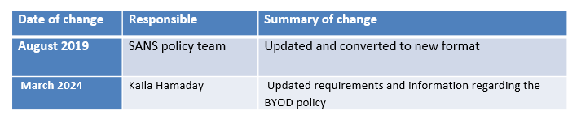
Bring Your Own Device Policy​ Cont.​​
7. Definitions and Terms:
- Personal Device: A privately owned device used by an employee for work-related purposes, including but not limited to smartphones, tablets, and laptops.
- Approved Device: A personal device that meets the organization's security requirements and has been granted permission to connect to the organization's network.
- IT Department: The department responsible for managing and enforcing IT policies, procedures, and security measures within the organization.
8. Revision History:

Slide 14

Multi Factor Authentication (MFA)

Slide 15
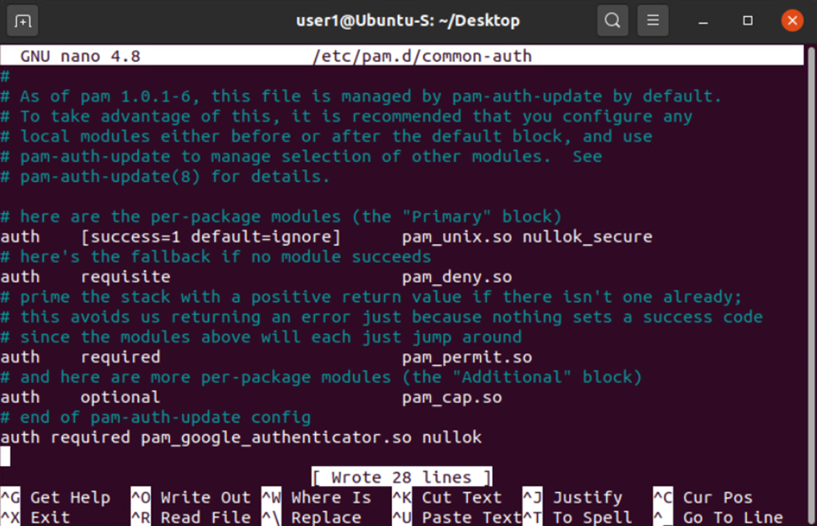
Common-auth Configuration File
This screenshot should show the entry that indicates the use of the Google Authenticator module.

Slide 16
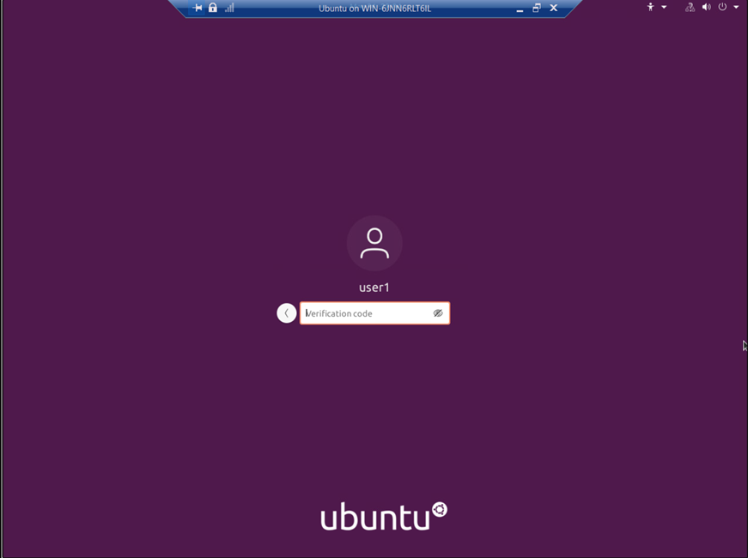
MFA Logon Screen
This screenshot should show the logon screen where a verification code is required.

Slide 17

Vulnerability Assessment

Slide 18
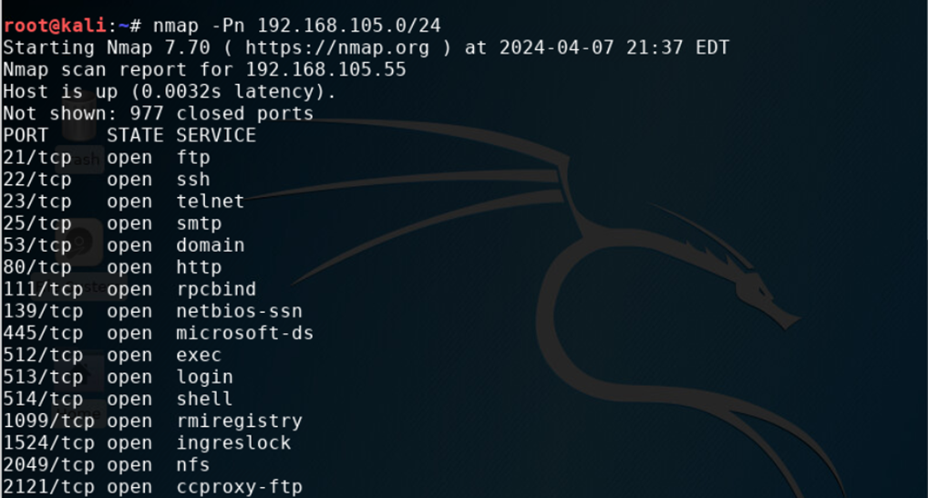
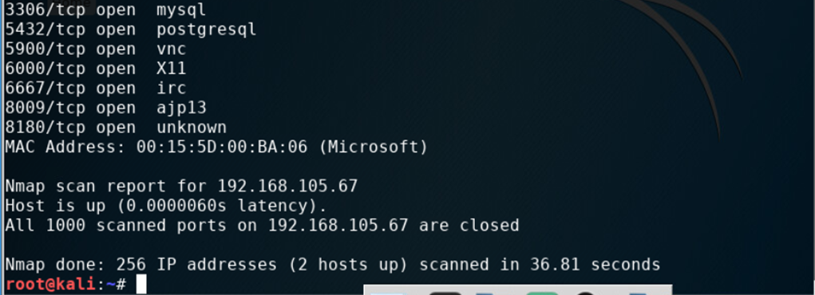
Nmap
This screenshot should include the scan result showing both the Kali and Linux Server VMs.

Slide 19
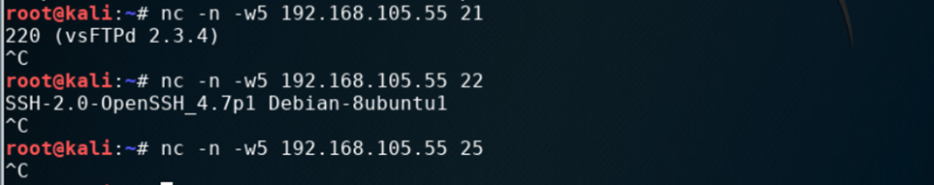
NetCat
This screenshot should include the scan result showing both the Kali and Linux Server VMs.

Slide 20
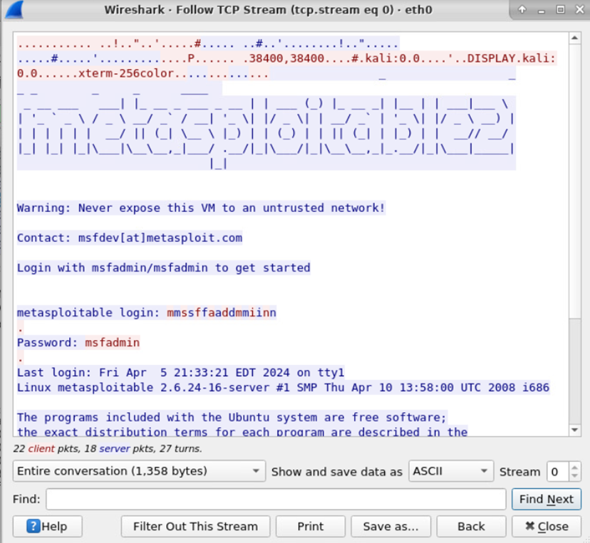
Wireshark
This screenshot should include the Wireshark—Follow TCP Steam window showing the Telnet username and password.

Slide 21
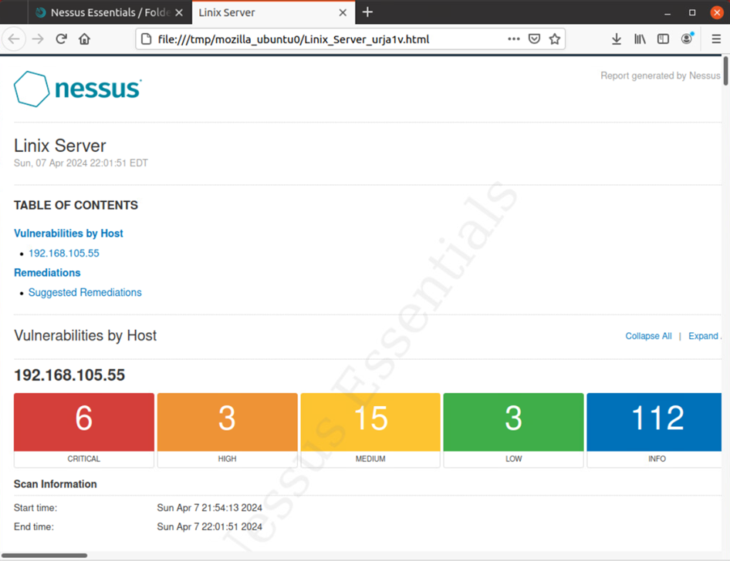
Nessus
This screenshot should include the high-level view of the Nessus vulnerability scan report (showing categories of vulnerability in different colors).

Slide 22
Challenges
The instructions and instructional videos for this project were straight forward, so I didn't really have any issues. The only issue encountered was on week 6, when I was pulling information through wireshark, I had a typo, so I started over to ensure I didn't miss anything.

Slide 23
Career Skills Acquired
Security Awareness
Multifactor Authentication
Wireshark
Vulnerability Scans
Creating Policies

Slide 24
Project Conclusion
In this project, we had to follow many steps to learn about encryption and decryption, risk and vulnerabilities, MFA and policy creation.
I learned a lot about the security processes and policies.

Slide 25
Sources
SEC285 Project Guides

