Slide 1

SEC290 Fundamentals of Infrastructure Security Course Project
By: Kaila Hamaday

Slide 2
Introduction
The purpose of this project was to develop a general understanding of infrastructure security, vulnerability scans, the use of Wireshark and analysis.

Slide 3

Intrusion Analysis using Wireshark
Intrusion Analysis using Wireshark

Slide 4
Basic attack analysis
Look at captures no. 20 and 22. (You can use the “Go” link at the top of the Wireshark screen to quickly go to a specific capture) Both packets are ICMP traffic but there are subtle differences between them. Compare the time-to-live and data field sizes in the two packets. What differences do you see?
  Packet 20's time to live is 64 and Packet 22's time to live is 128.
  Packet 20 is going to 192.168.25.50 and Packet 22 is going to 192.168.25.1
Do a little Internet research to discover which operating systems use the specific values in their ping commands. What operating system generated the echo request in capture 20?
Linux uses a TTL value of 64 and Windows uses a TTL value of 128, so with that being said; Linux generated the echo request.
Review packet no. 37 and beyond, what do you think is taking place here? ____start of an attack.______
Look at capture 22846. What is suspicious about the flag settings in this packet? All of the options say 'not set' except fin and the TCP Flag is set to 'F'.
What is the IP address of the host being targeted? 192.168.25.1

Slide 5

Open SSL

Slide 6
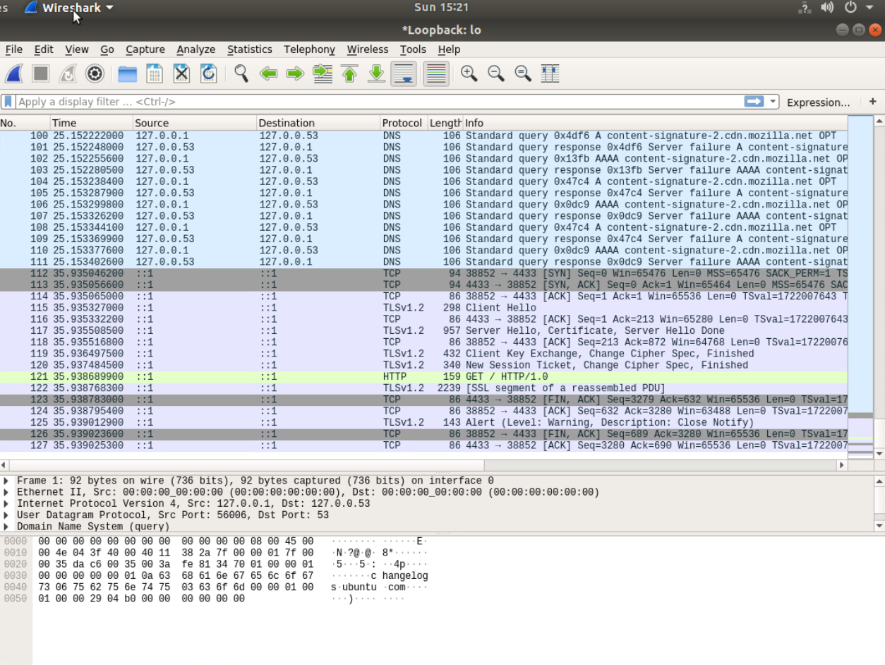
Creating and testing an SSL/TLS file
Take a screenshot of the output in Step 20.
It should show the GET request in the Info column.

Slide 7
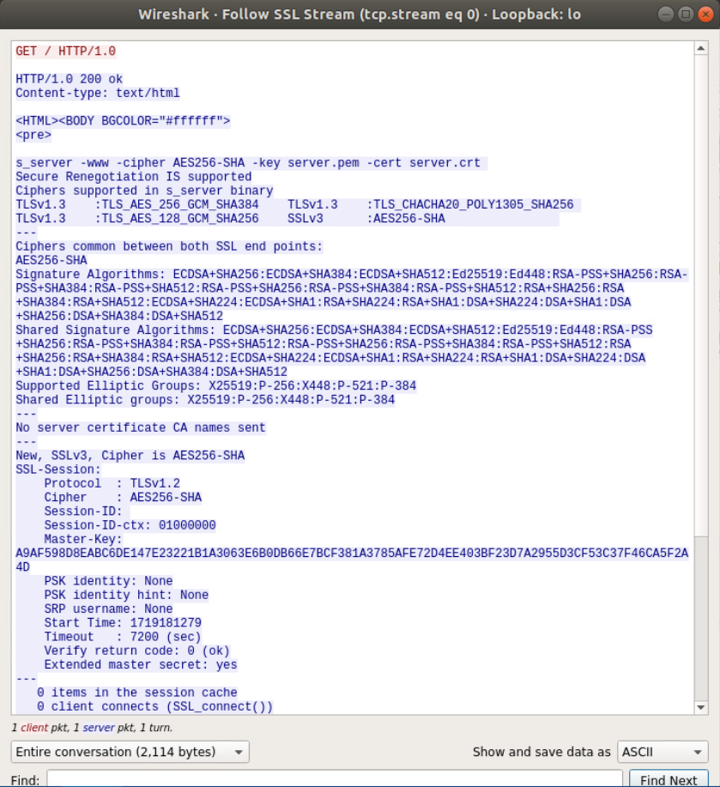
Creating and testing an SSL/TLS file cont’d
Take a screenshot of the output in Step 22.
It should show the decrypted SSL stream.

Slide 8

SNORT

Slide 9
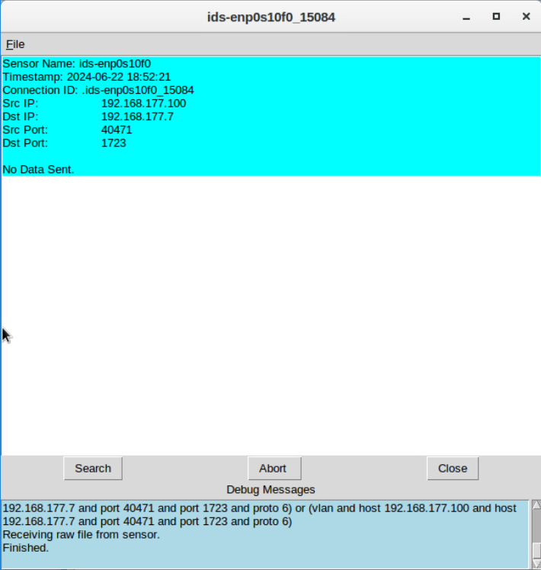
Testing Snort rules
Take a screenshot of the output in Part 1 Step 17.
It should show the transcript of the XMAS scan alert.

Slide 10
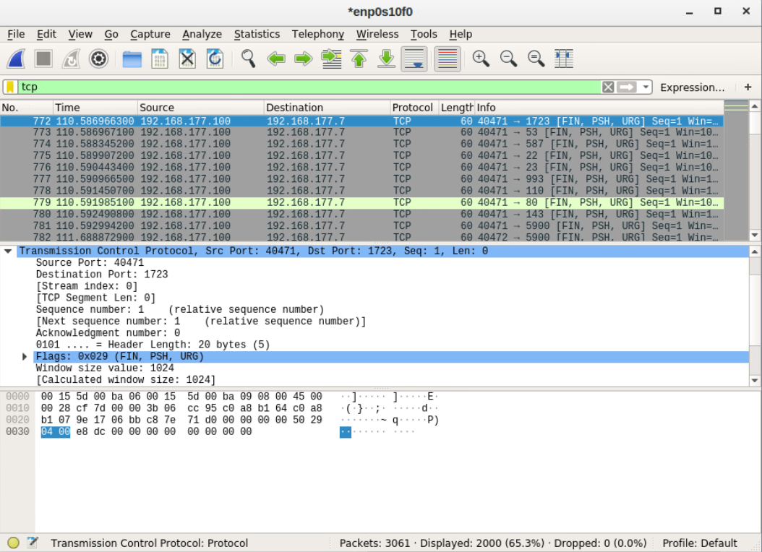
Testing Snort rules cont’d
Take a screenshot of the output in Part 1 Step 20.
It should show the TCP packets generated by the XMAS scan.

Slide 11
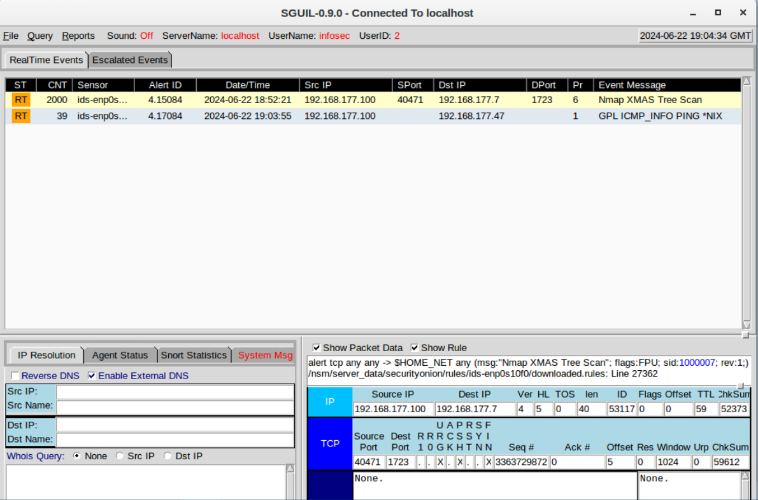
Creating Snort rules
Take a screenshot of the output in Part 2 Step 7.
It should show the ping activity alert.

Slide 12
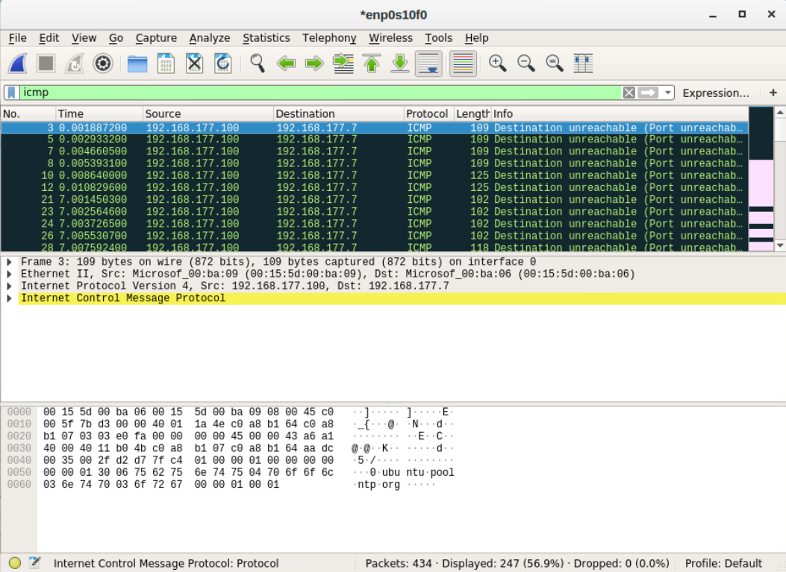
Creating Snort rules cont’d
Take a screenshot of the output in Part 2 Step 8.
It should show the ICMP packets generated by the ping activity.

Slide 13

Live Memory Analysis

Slide 14
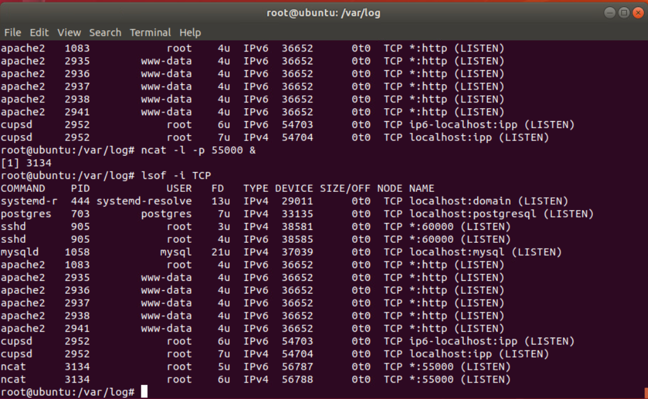
Linux Processes
Take a screenshot of the output in Part 1, Step 16.
It should show port 55000 open for both IPv4 and IPv6.

Slide 15
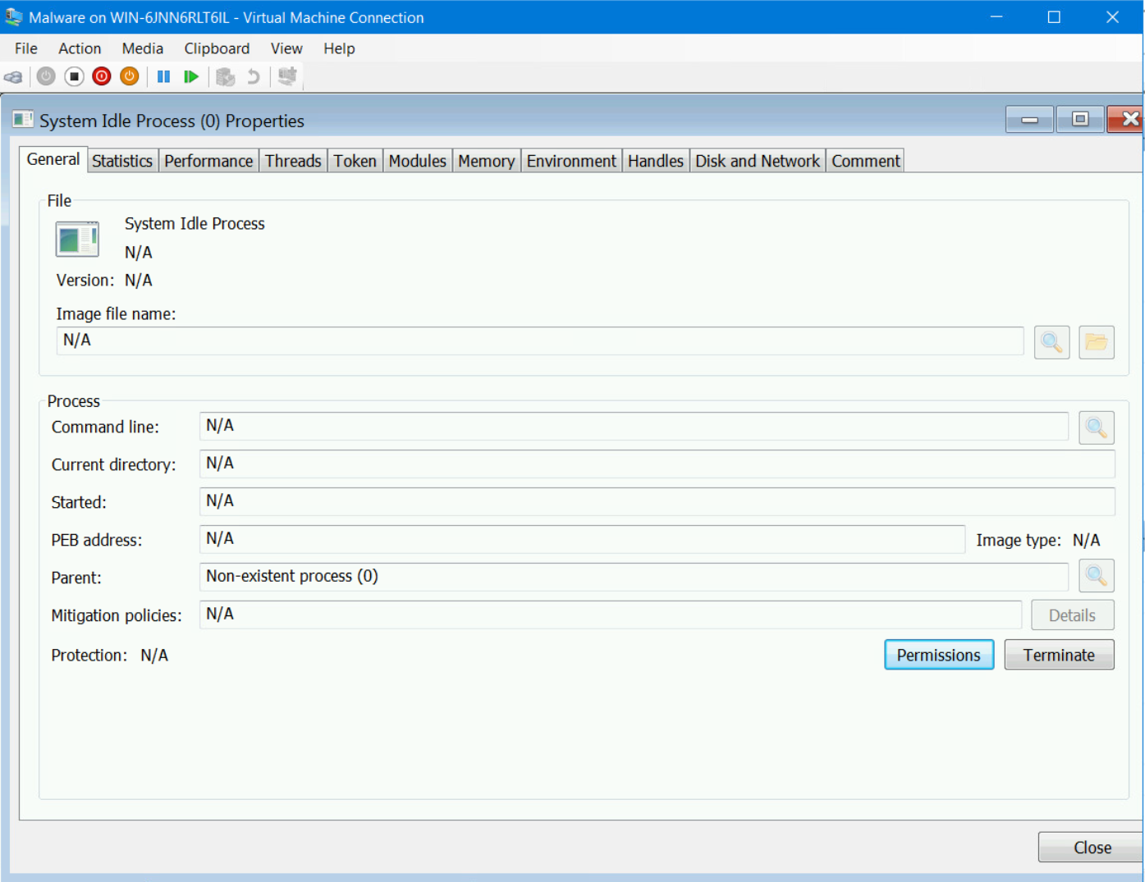
Process Hacker
Take a screenshot of the output in Part 2, Step 5.
It should show properties of a chosen process.

Slide 16
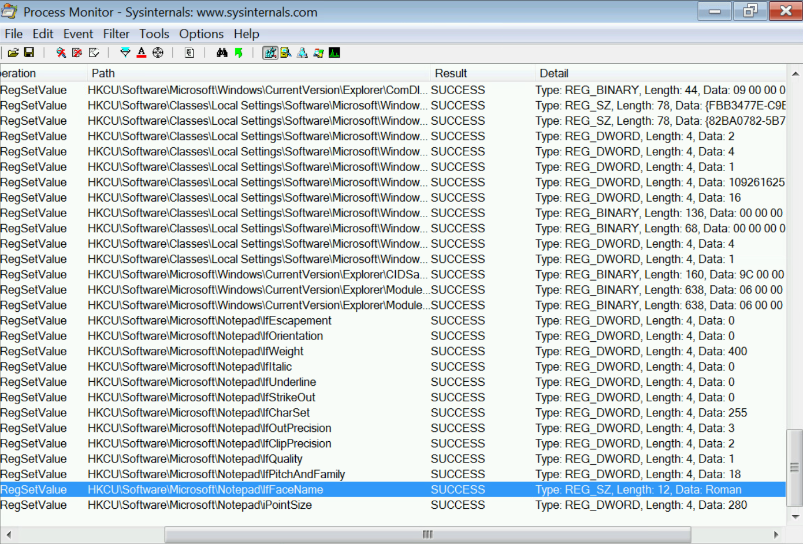
Process Monitor
Take a screenshot of the output in Part 3, Step 13.
It should show ifFaceName in the Path column and Data: Roman in the Detail column.

Slide 17

Firewall

Slide 18
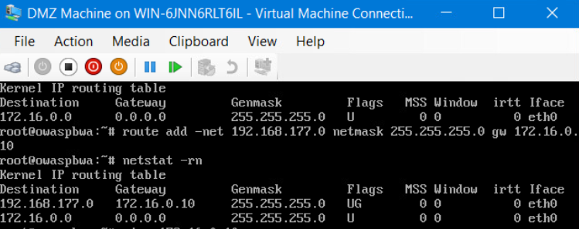
Time-based Access
Take a screenshot of the output in Part 1 Step 21.
It should show the output of the DMZ Route Table.

Slide 19
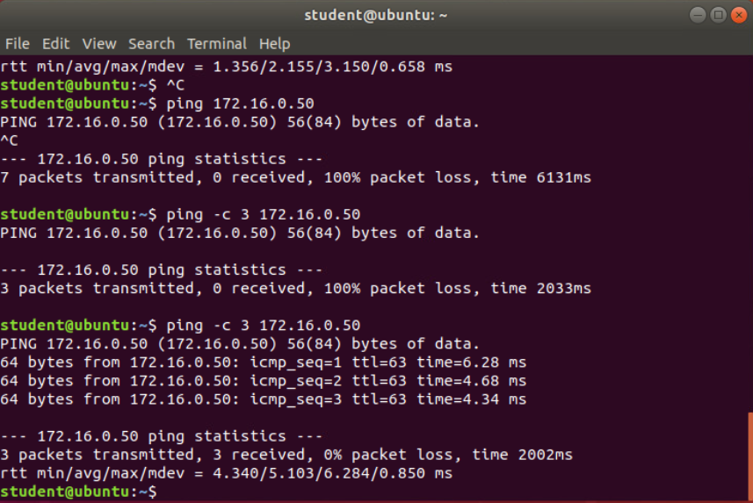
Time-based Access
Take a screenshot of the output in Part 1 Step 26.
It should show a successful ping from the Ubuntu Web VM and the DMZ VM.

Slide 20
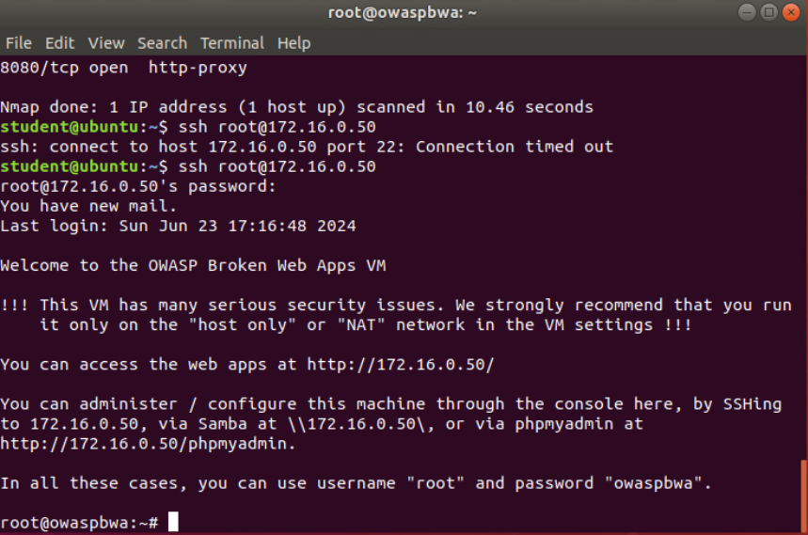
Time-based Access
Take a screenshot of the output in Part 1 Step 34.
It should show two time-based access rules in the FORWARD chain

Slide 21
Challenges
The instructions and instructional videos for this project were straight forward, however, I did encounter issues where I would type the wrong command in the terminal and I had to start over. I also completed the time-based access project on a day that was not set in the terminal, so I had to figure out how to change it from Mon-Fri to include Sun. I was able to figure it out and therefore completed the project.

Slide 22
Career Skills Acquired
Security Awareness
Firewalls
Wireshark
Vulnerability Scans
Creating Policies

Slide 23
Project Conclusion
In this project, we had to follow many steps to learn about using Wireshark, firewalls and analysis.
I learned a lot about using firewalls, Wireshark, creating snort rules and SSL certificates.

Slide 24
Sources
SEC90 Project Guides
Infosec lab instructions

