Slide 1
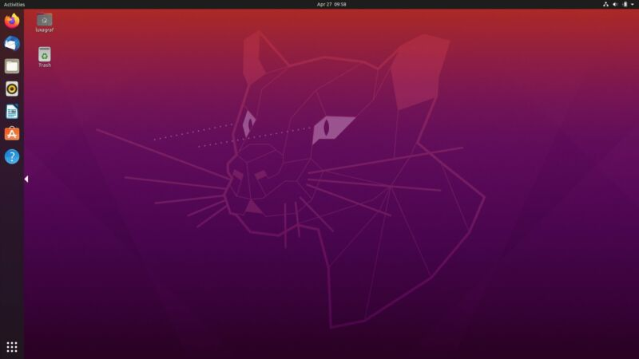
CEIS106 – Operating Systems Final Project
Presented By: Kaila Hamaday

Slide 2
Introduction:
This project is a compilation of all the work I've completed as part of CEIS106 – Intro to Operating Systems.
The purpose of the project was to encompass a general understanding of on navigating a Linux system, add and remove permissions, add and remove users, monitor system performance and networking.

Slide 3
Linux Filesystem Hierarchy

Slide 4
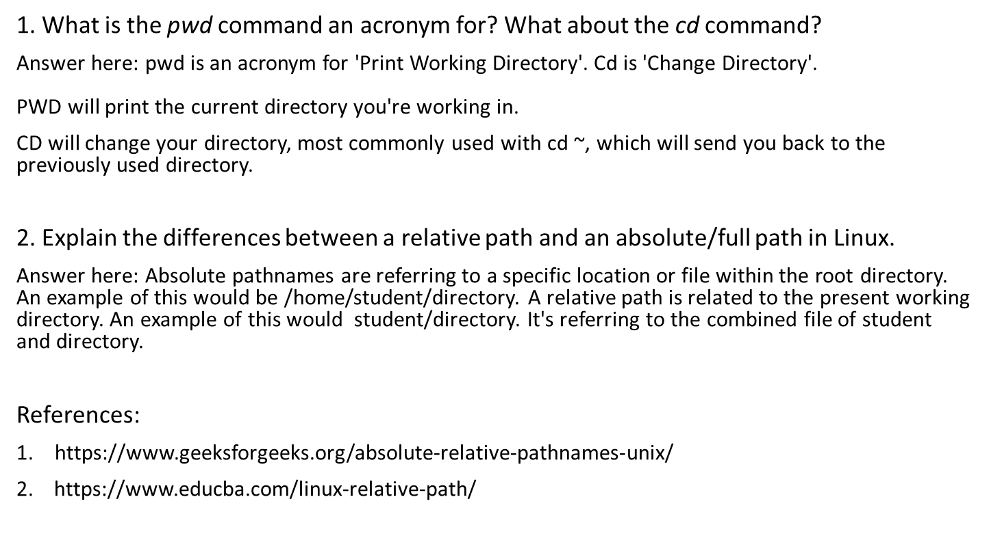
Navigate the Linux filesystem tree

Slide 5
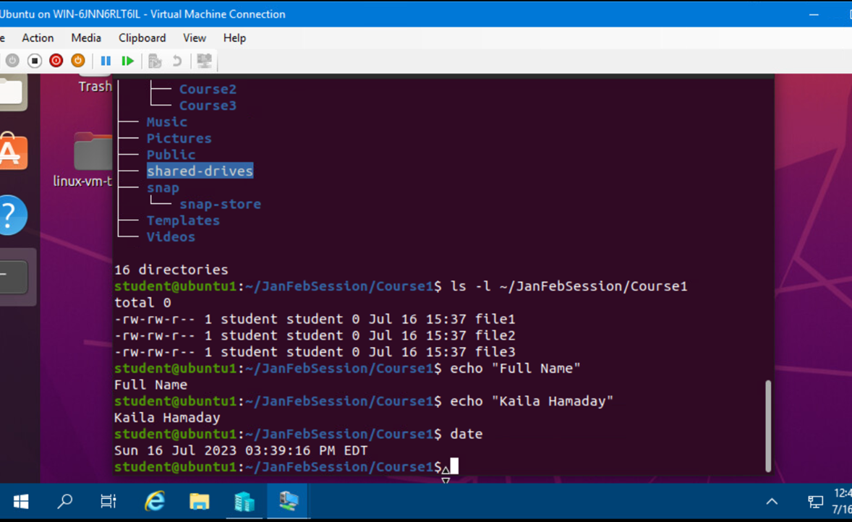
Create Directories and Files

Slide 6
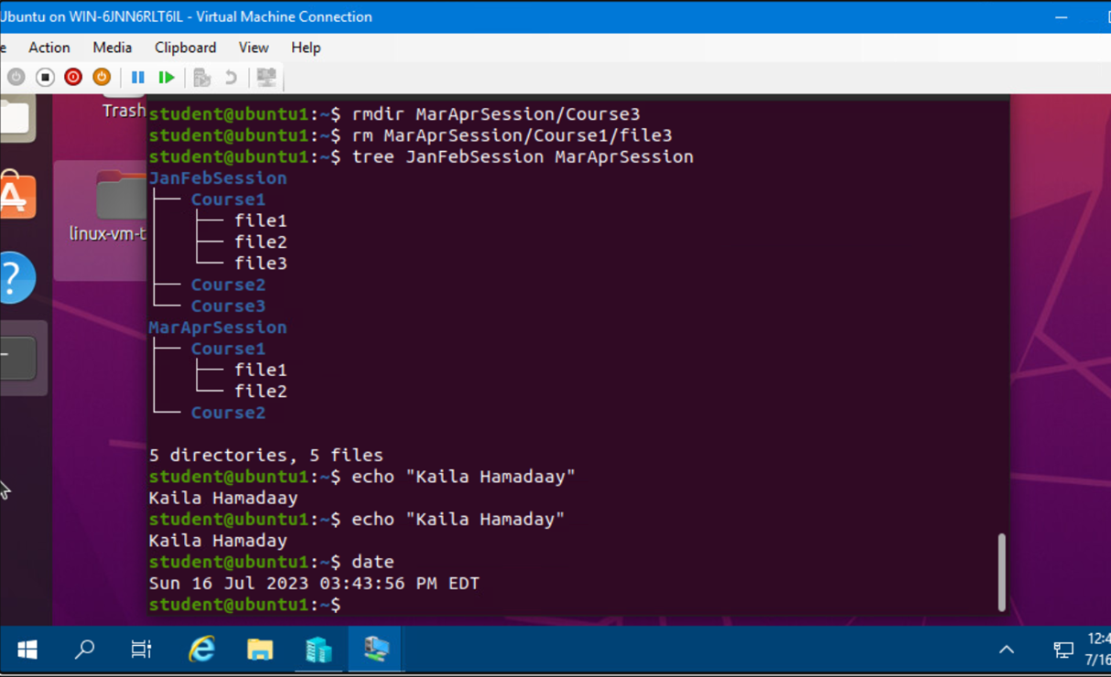
Copy and Remove Directories and Files

Slide 7
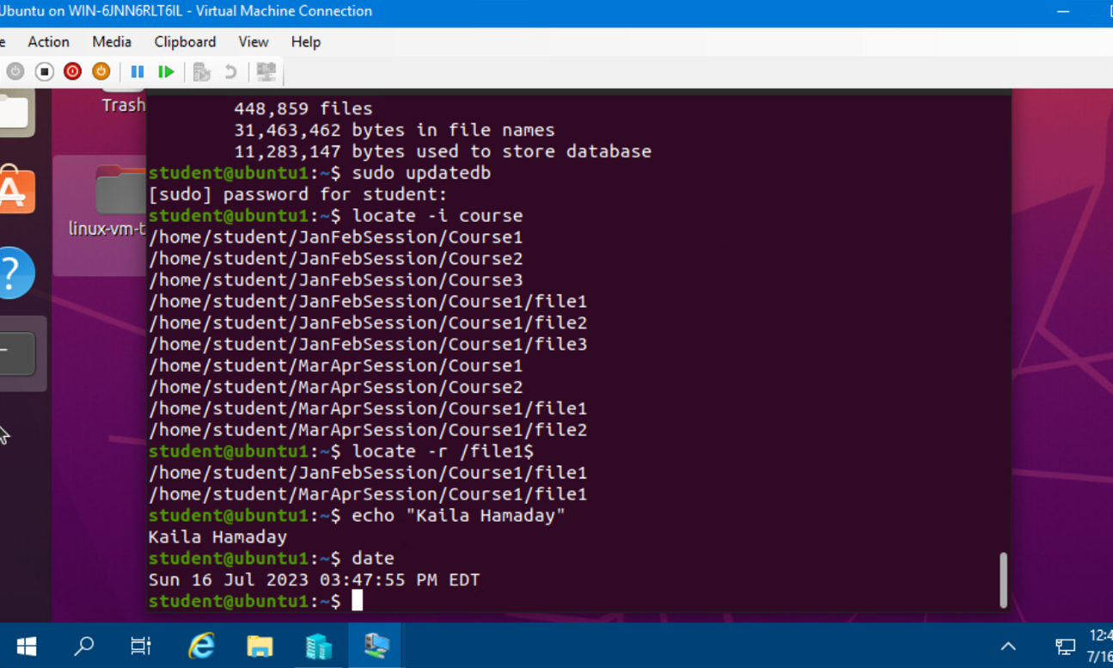
Locate Directories and Files

Slide 8
Linux Shell Scripts

Slide 9
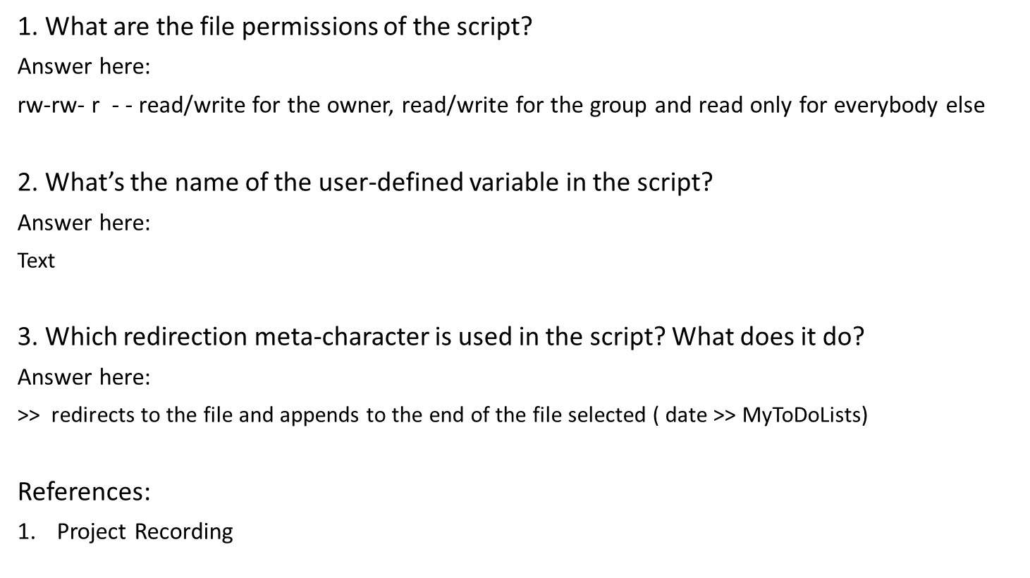
Create a Shell Script

Slide 10
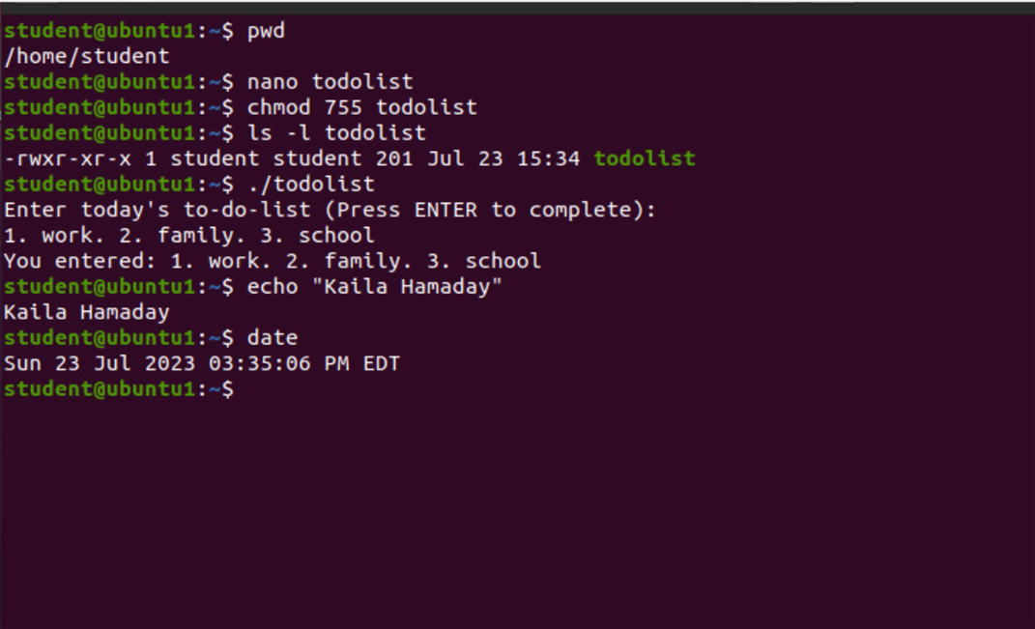
Change Script File Permissions

Slide 11
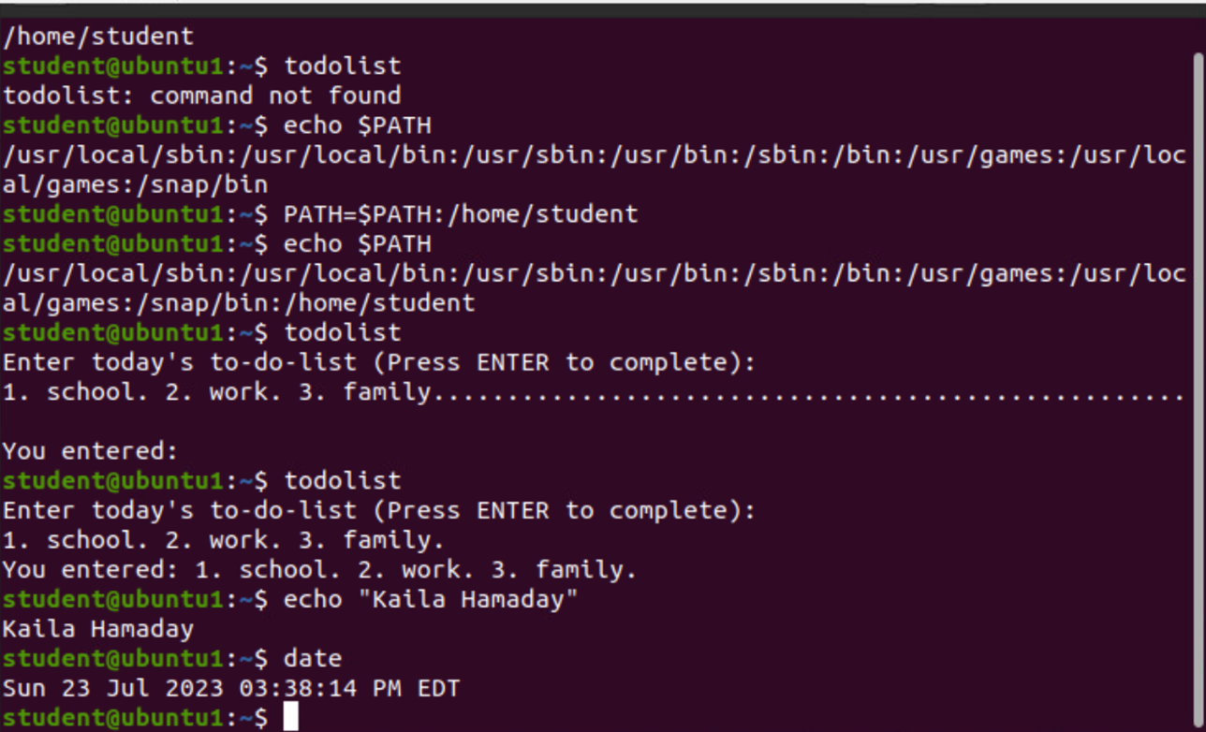
Set the PATH Variable

Slide 12
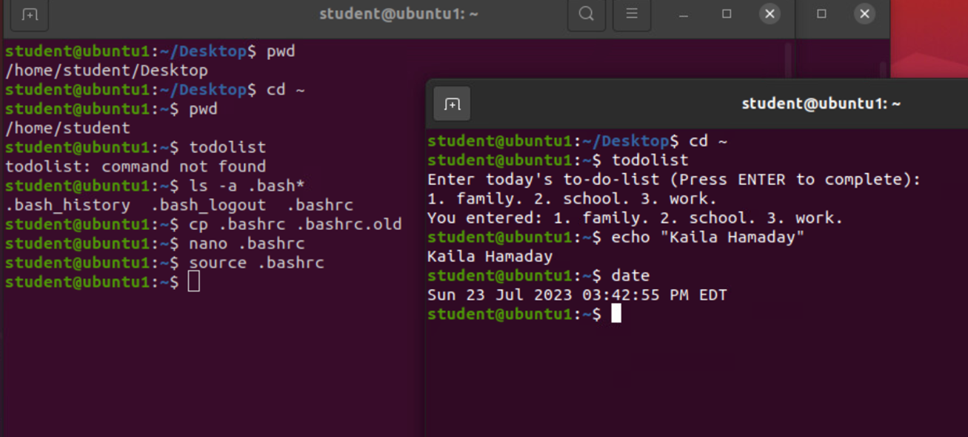
Make the PATH Variable Permanent

Slide 13
User and Group Management

Slide 14
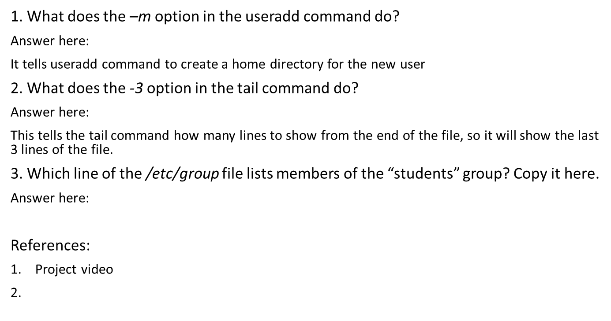
Add Users and Groups in CLI

Slide 15
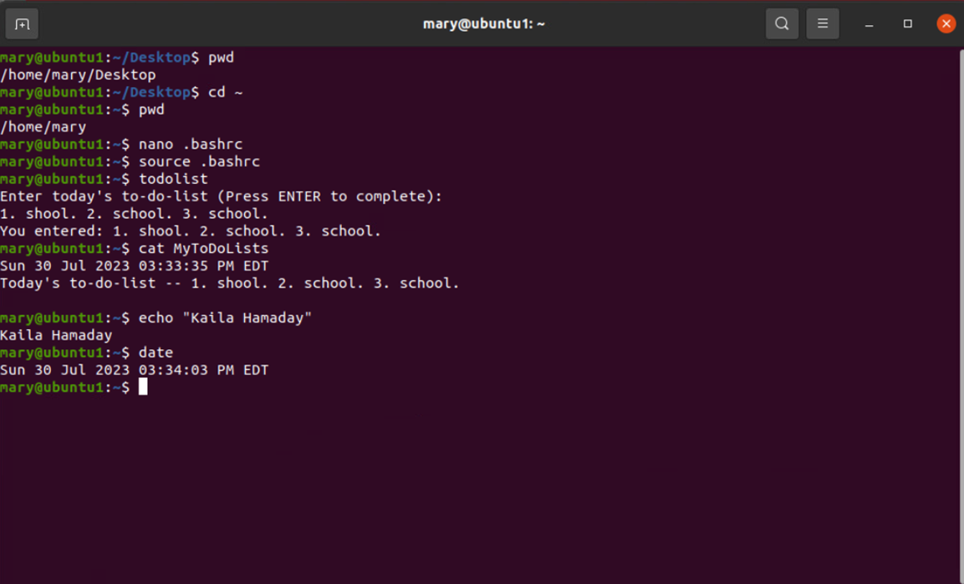
Test User and Group Settings

Slide 16
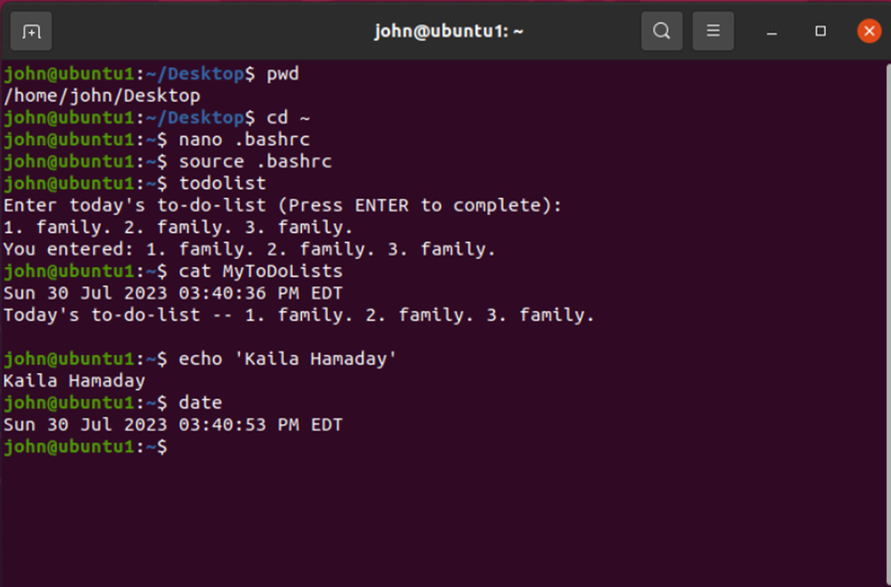
Add Users in GUI

Slide 17
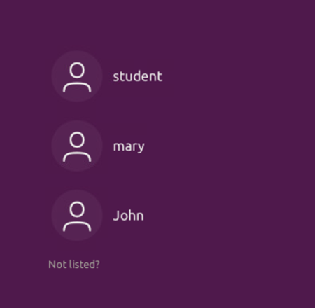
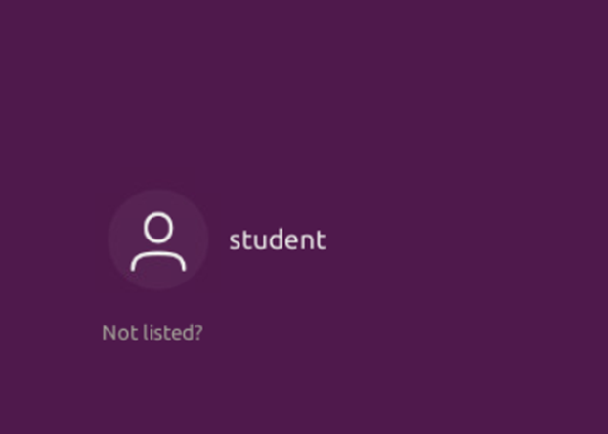
Remove Users and Groups

Slide 18
Network Configuration

Slide 19
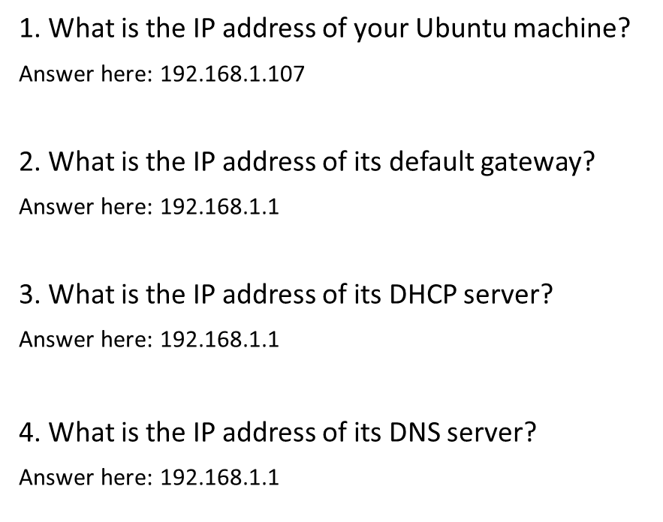
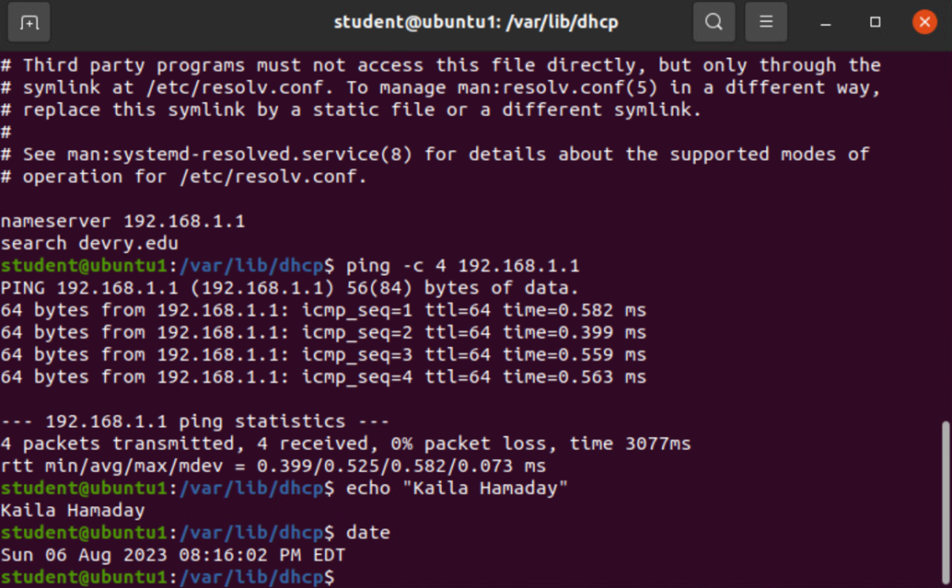
Discover Host IP Configurations

Slide 20
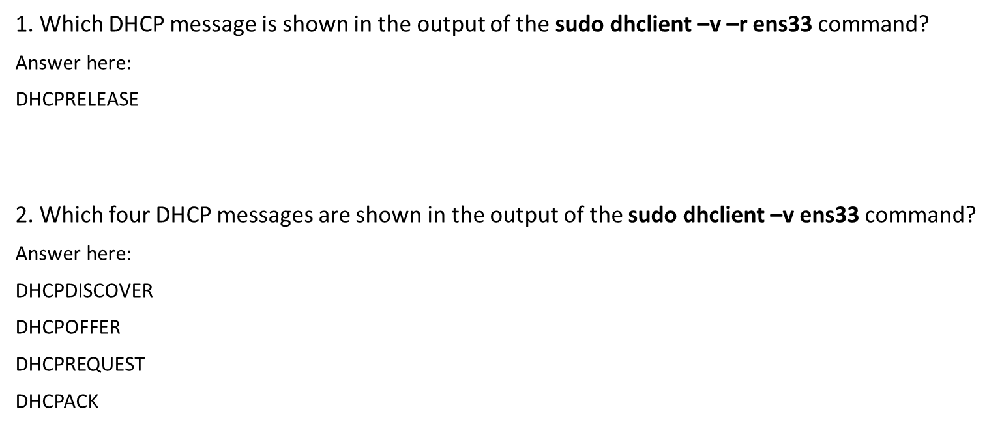
Manage Network Interfaces

Slide 21
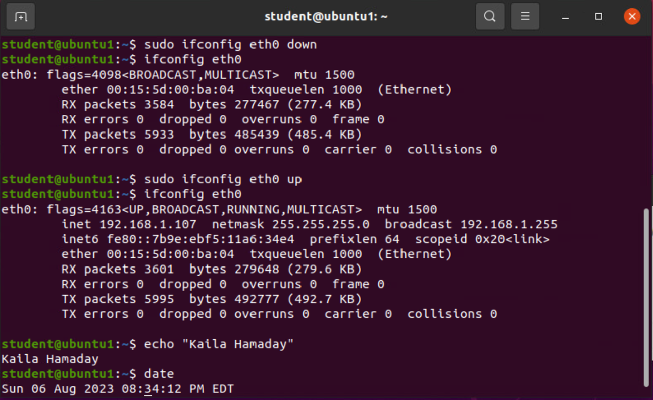
Use Network Utilities

Slide 22
System Performance Monitoring

Slide 23
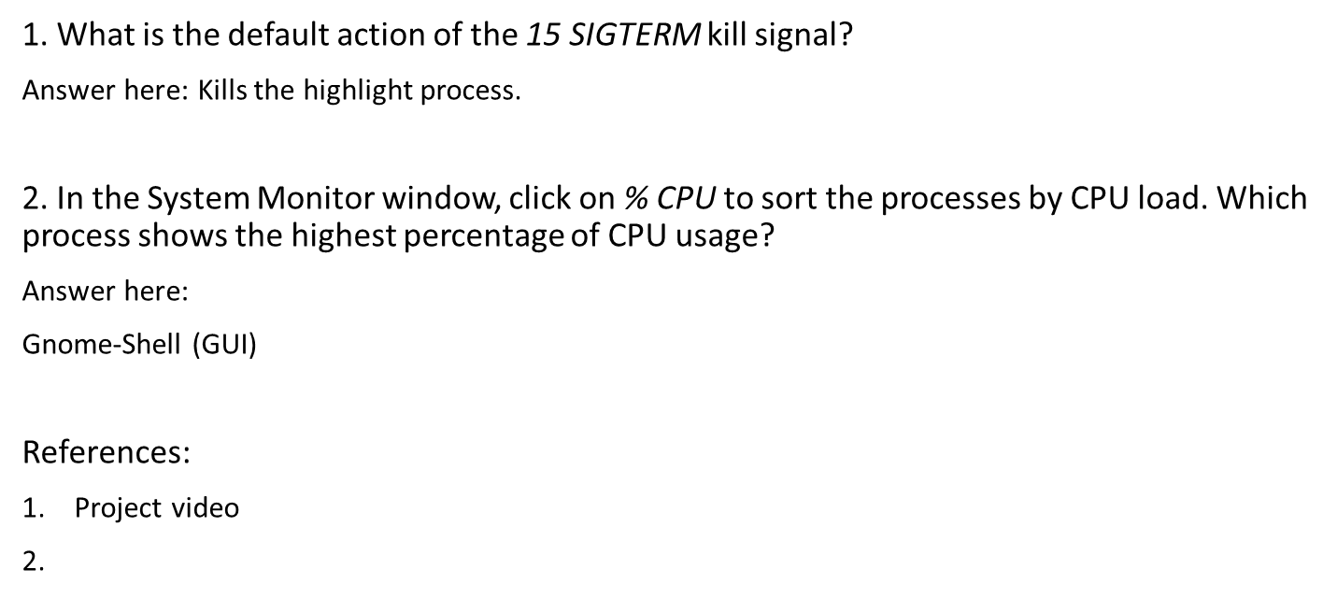
Monitor Linux Processes

Slide 24
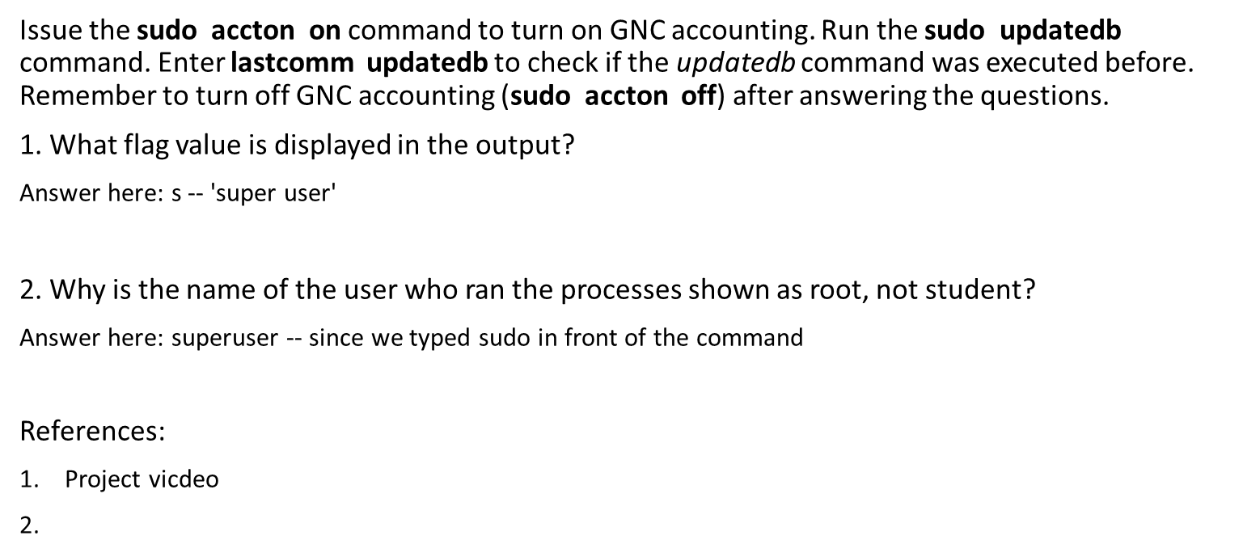
Monitor User Activities

Slide 25
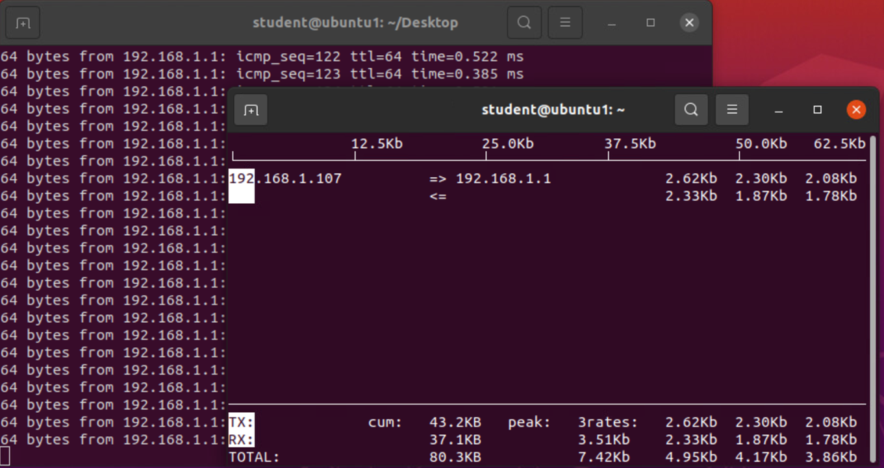
Monitor Network Bandwidth Usage

Slide 26
Challenges:
Some of the challenges I faced were:
A few times I mistyped the command and nothing would run. So, I would have to go back and re-read what I typed to make sure I spelled everything correctly.
Not being able to see the password when having to enter it also caused an issue once or twice.

Slide 27
Career Skills Acquired:
Adding / Removing Users and Groups
Adding / Removing Permissions
General Understanding of Linux Systems
Security Awareness for OS
Power Shell Scripts

Slide 28
Project Conclusion:
At first I was nervous about this project. I knew what Linux was, but I didn't understand how it worked, and I thought I could never learn how to use another operating system. This was a great introductory project on an overview of Linux and absolutely helped me gain that general knowledge.
We had to follow many steps to go from file systems hierarchy, users, networking to monitoring performance.
I never previously worked with Linux, so I learned a lot! Specifically what Linux is and how it's used. How to add and remove users and update permissions, monitor networks and run system performance checks.

