Slide 1
CEIS101C Course Project
Smart Home Automation & Security System
Presented by: Kaila Hamaday

Slide 2

Introduction
The purpose of this project was to develop a smart home automation and security system. We designed the prototype in tinkercard, and then built the system with our IoT Tech Core Kit and programming with the Arduino IDE.
The smart home system will encompass multiple devices to monitor the home:
Door sensor to check whether the door is open
Distance sensor to check for a possible intruder
Automated LED lights

Slide 3
Circuit Simulation tinkercad

Slide 4
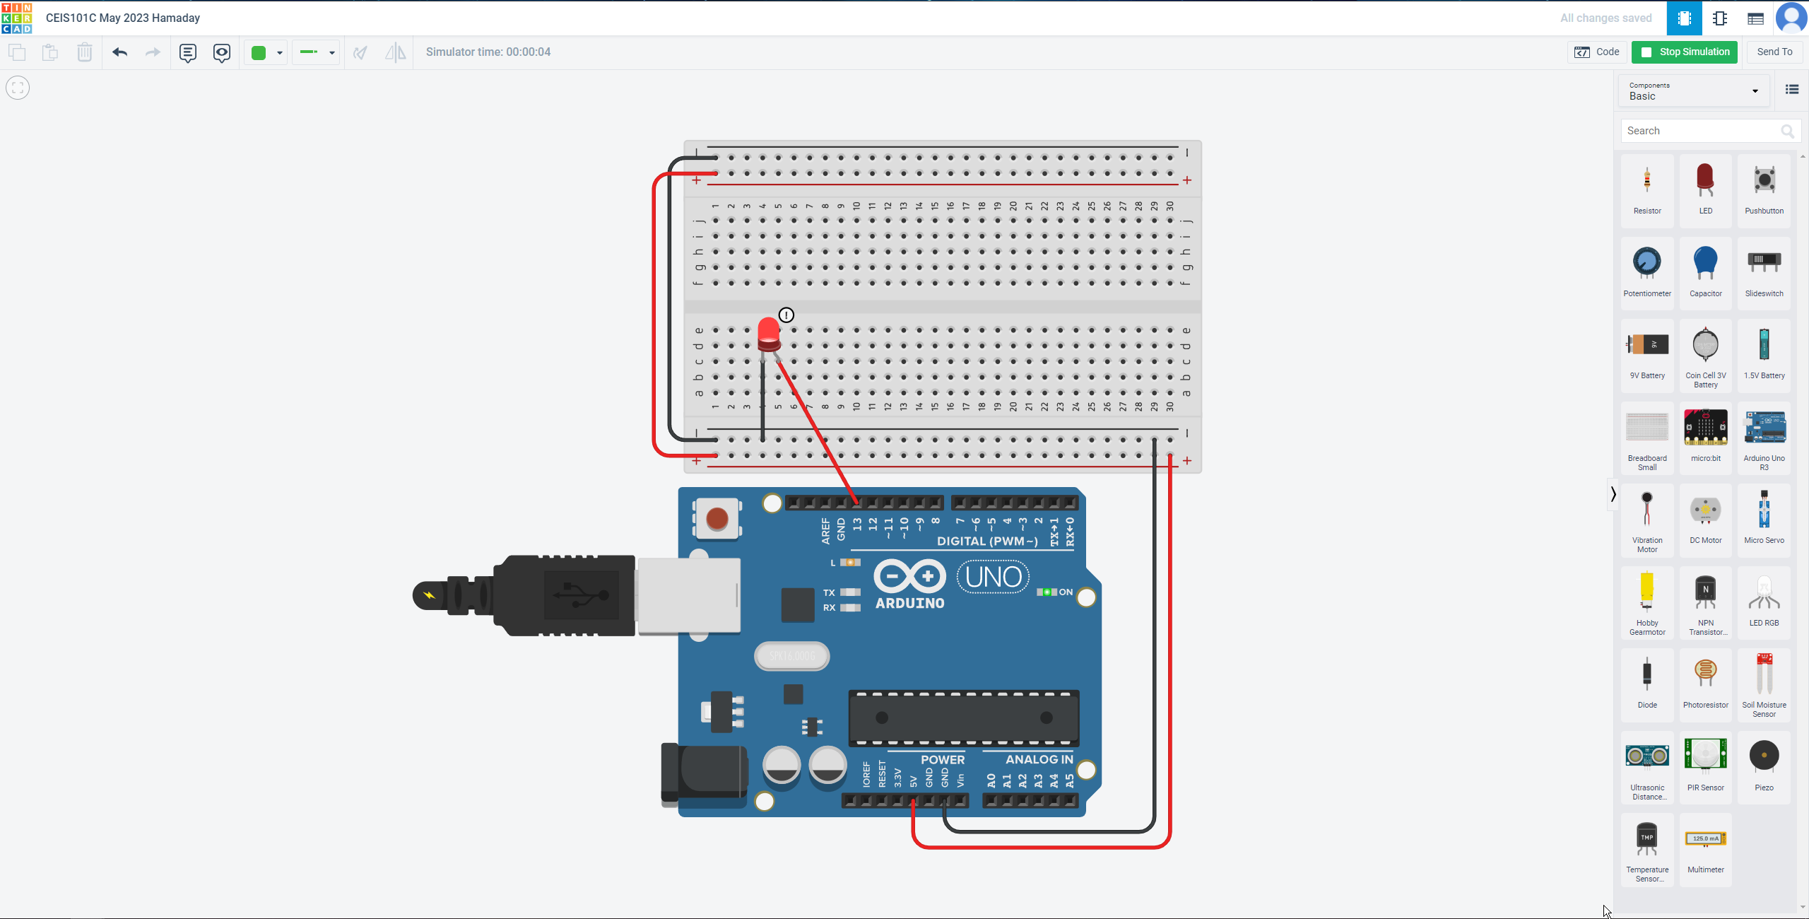
Circuit (screenshot)

Slide 5
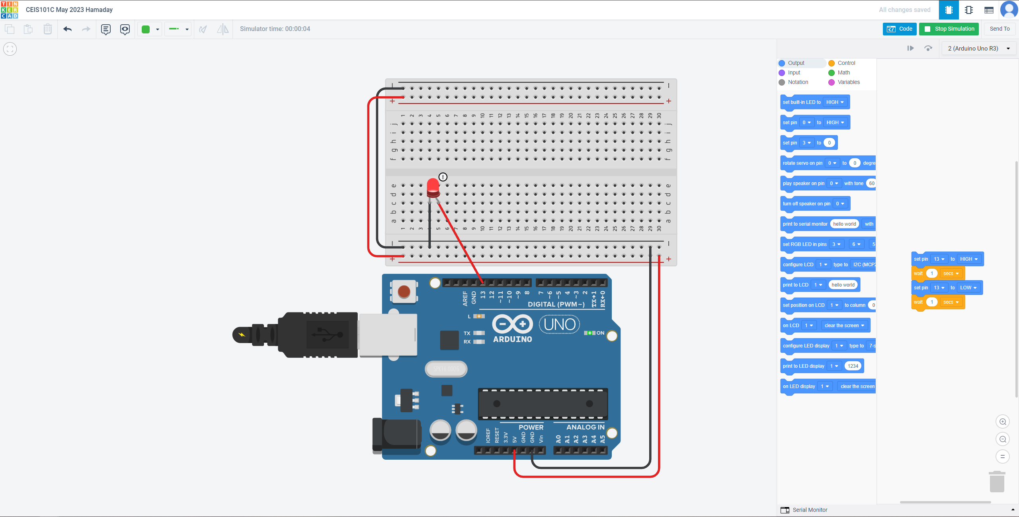
Code (screenshot)

Slide 6
Inventory of parts, circuit building, and displaying messages

Slide 7
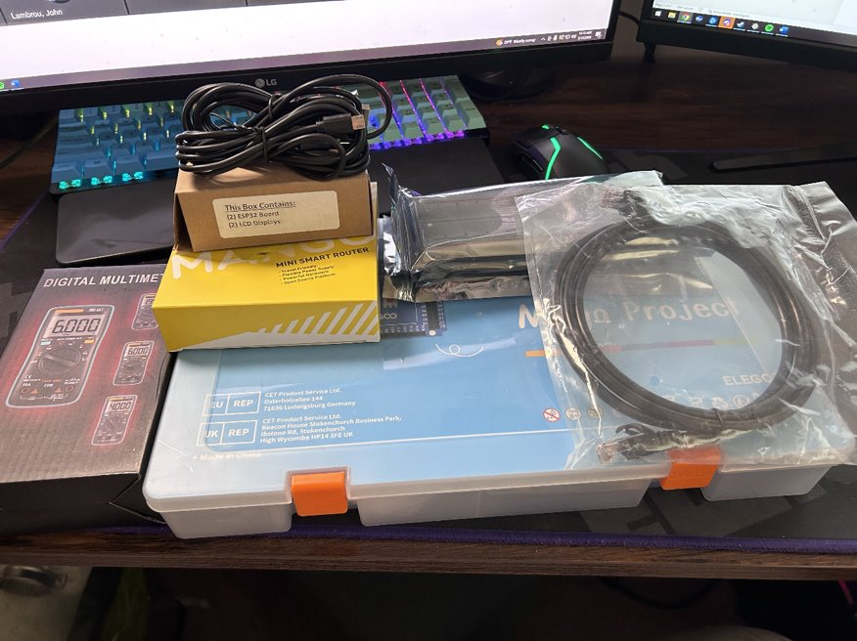
Inventory of IoT Kit (picture)
UCTRONICS Kit​
ESP32 (2) ​
LCD Modules (2)​
Breadboards (3) ​
Mini Router ​
Patch Cable ​
Digital Multi Meter ​
USB to Micro USB (2)​

Slide 8
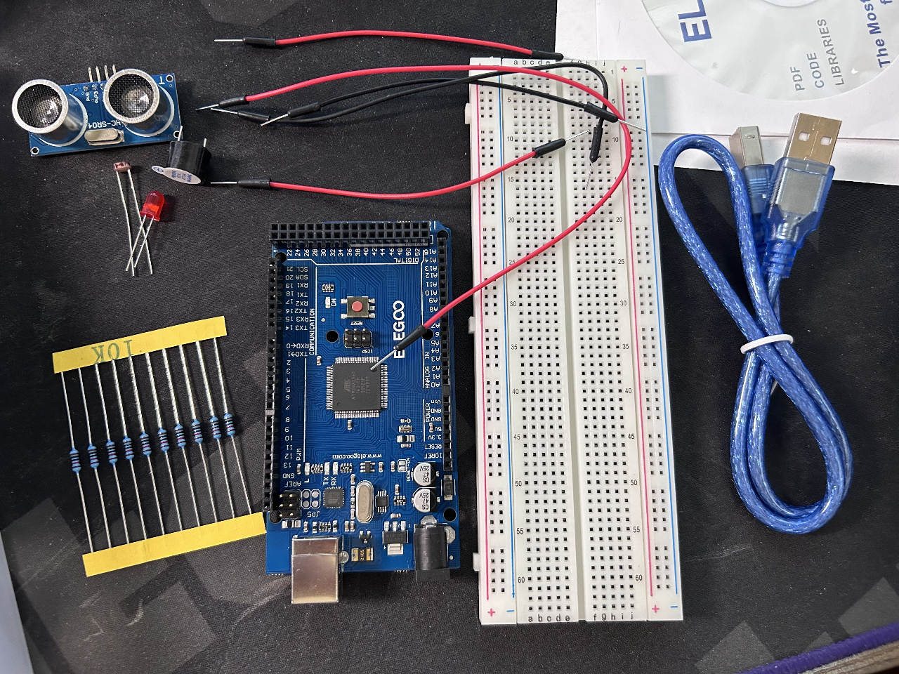
Organization of Project Components (picture)​
Arduino Mega 2560​
Breadboard​
Resistor 10kΩ​
LEDs​
Ultrasonic Sensor ​
Active Buzzer​
Photoresistor​
Wires​
USB Type B cable

Slide 9
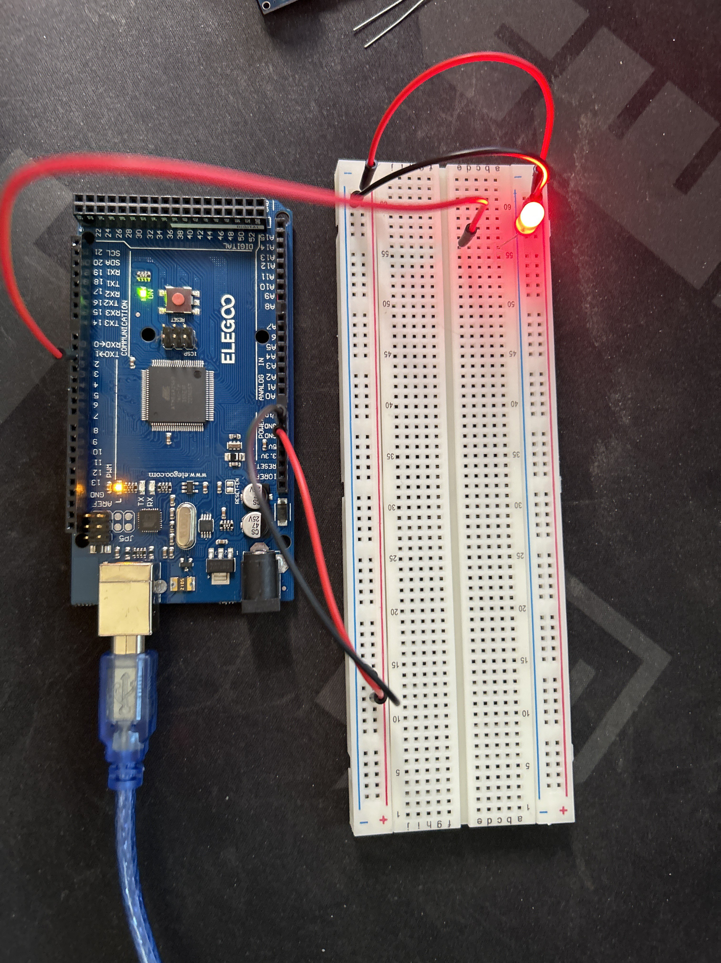
Circuit with red LED on (picture)​

Slide 10
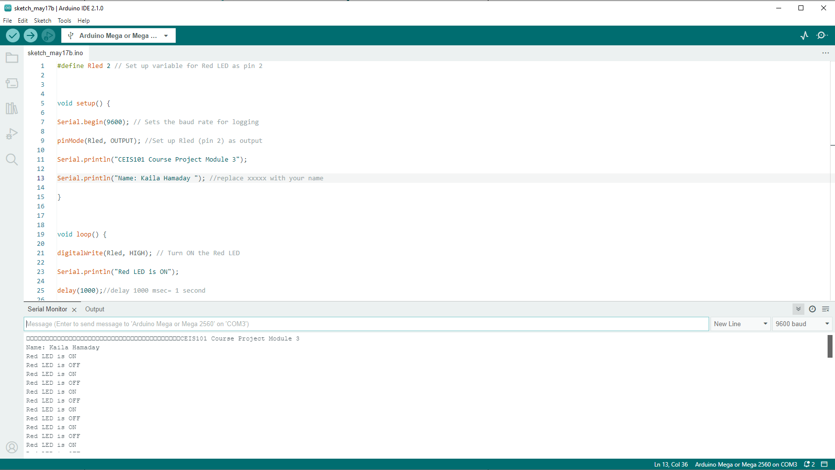
Serial Monitor (screenshot)

Slide 11
Adding door sensor to smart home system

Slide 12
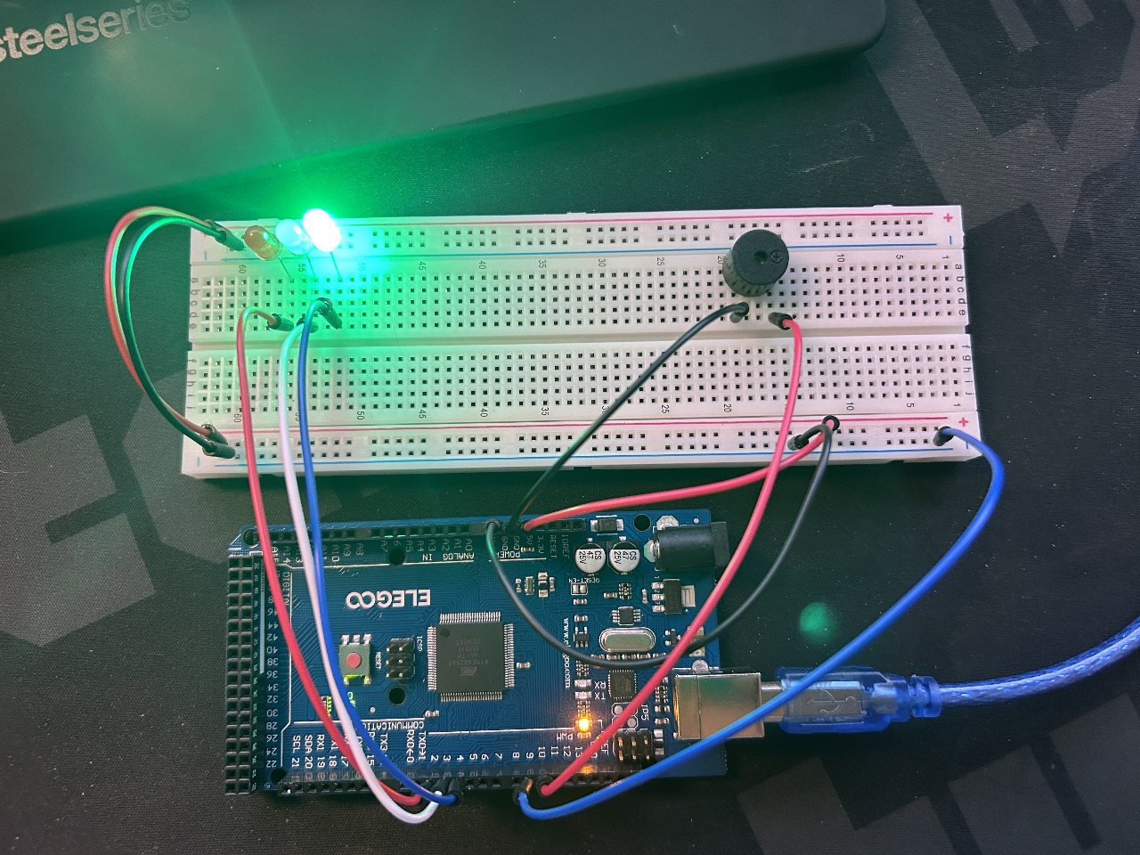
Circuit of door closed with Green LED ON (picture)

Slide 13
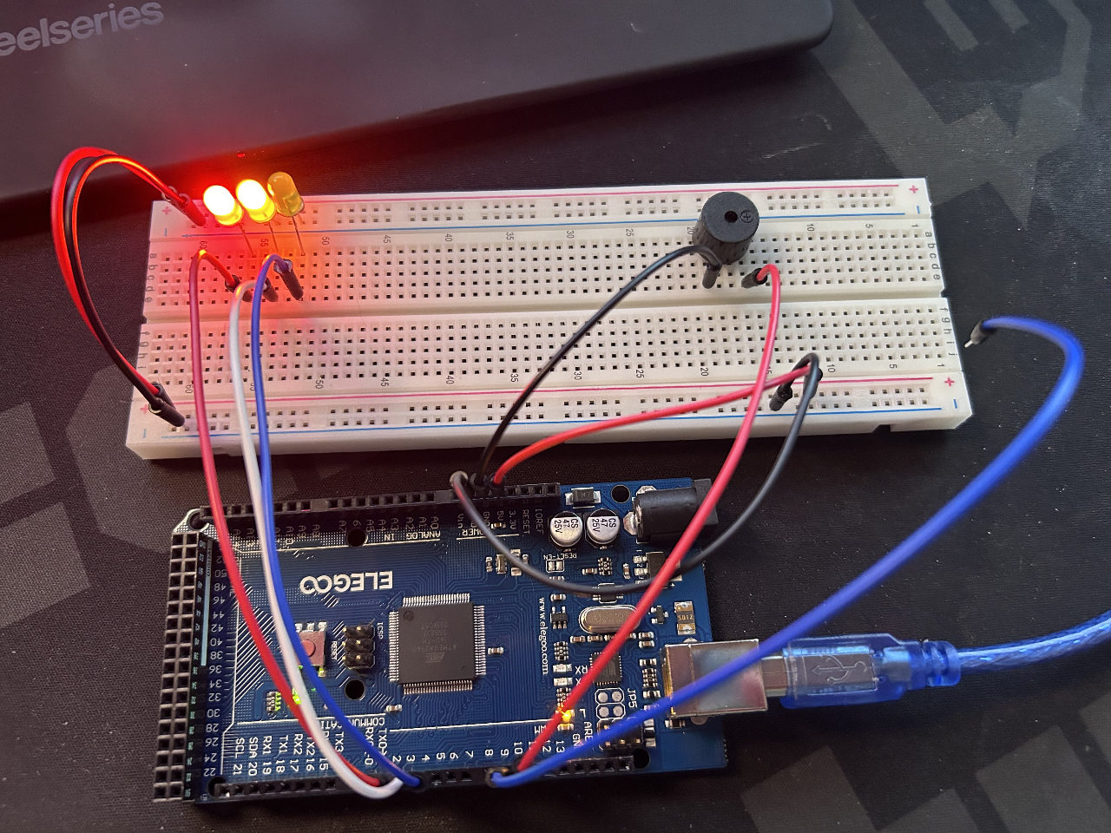
Circuit of door open with Green LED OFF (picture)

Slide 14
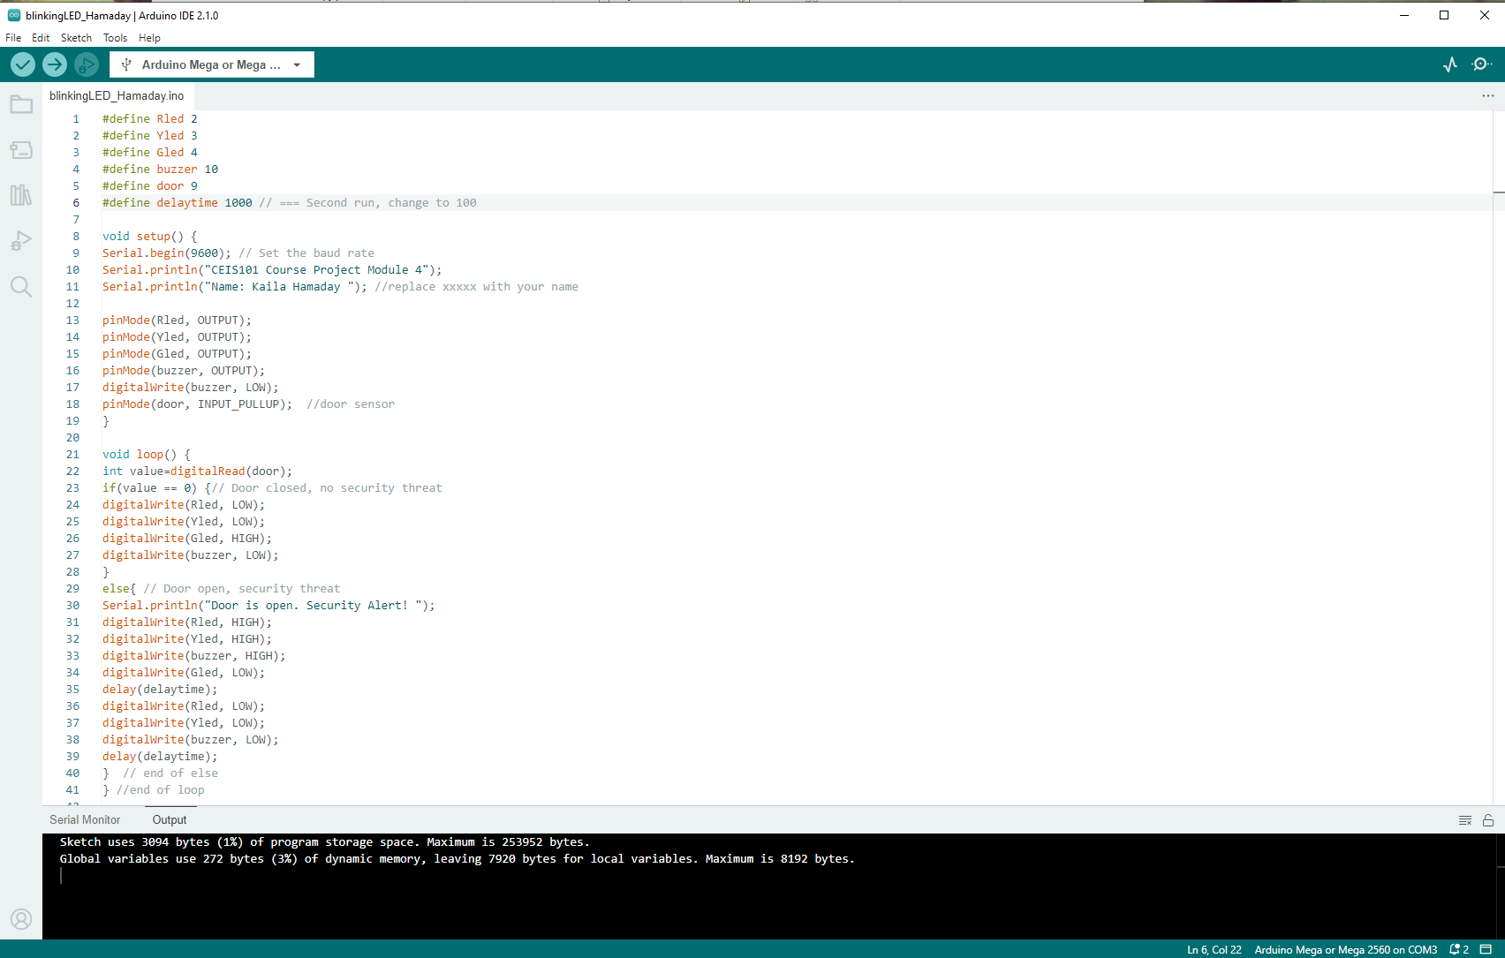
Arduino Code (screenshot)​

Slide 15
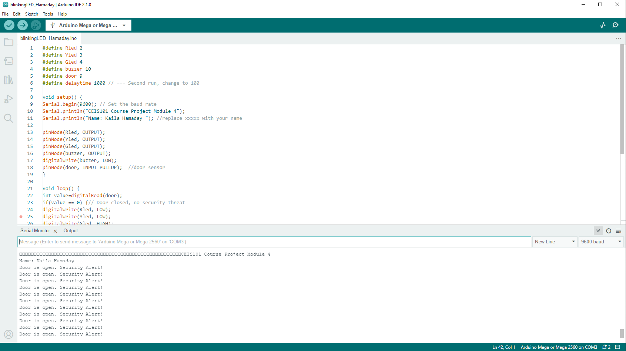
Serial Monitor (screenshot)​

Slide 16
Adding distance sensor to smart home system and conducting analysis

Slide 17
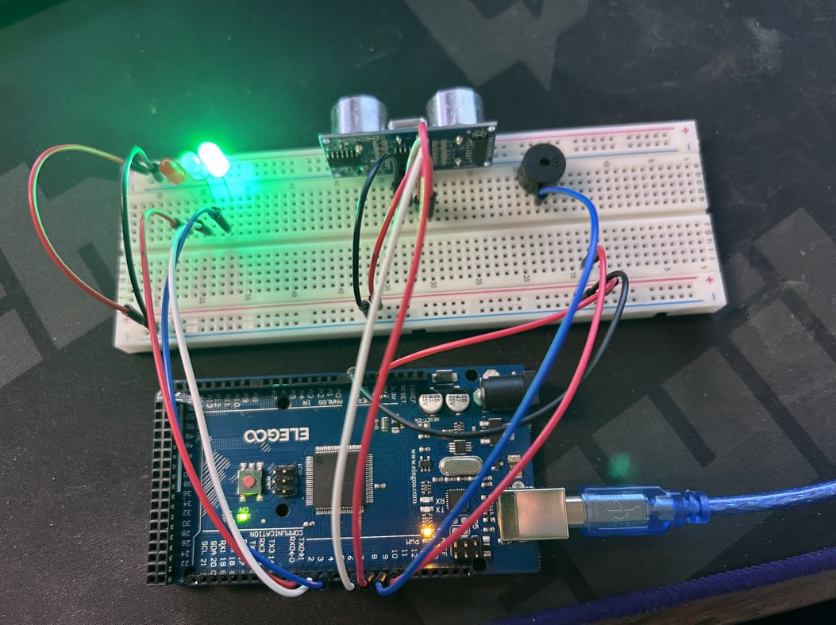
Circuit with green LED on (picture)​

Slide 18
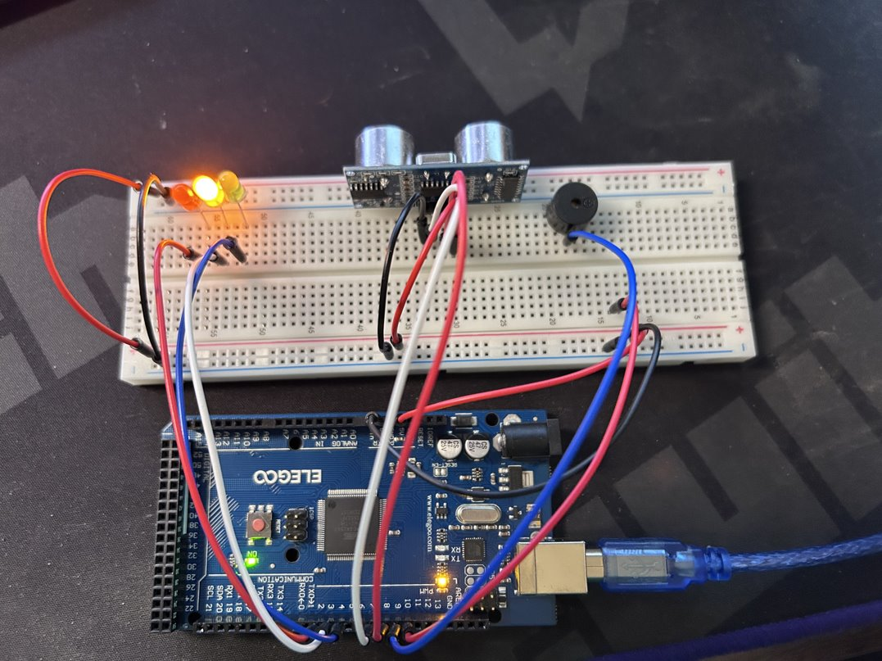
Circuit with yellow LED on (picture)​

Slide 19
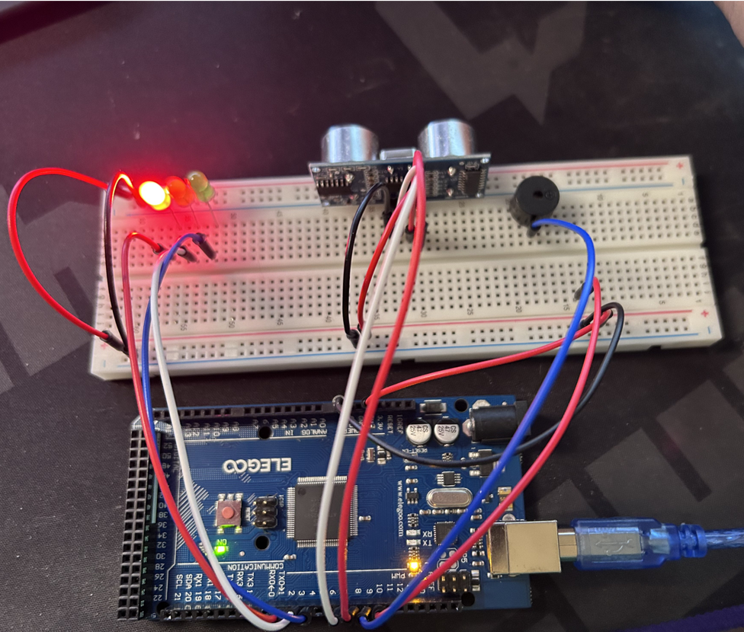
Circuit with red LED on (picture)​

Slide 20
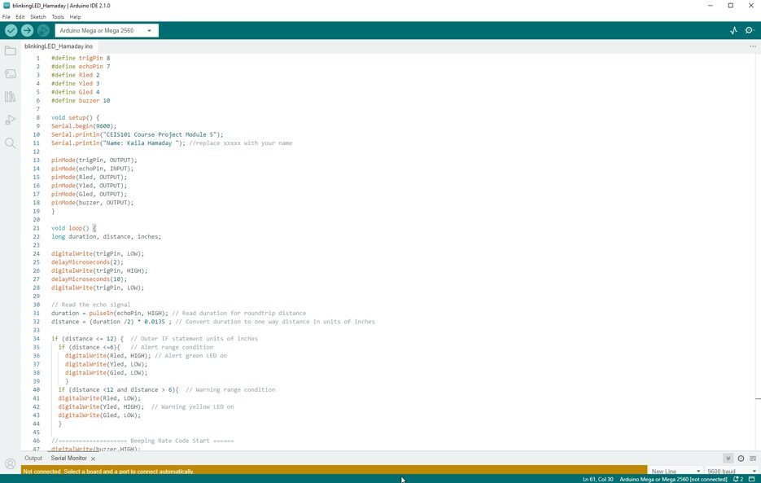
Arduino Code (screenshot)​

Slide 21
Plot of data (graph from Excel)​

Slide 22
Adding Automated light to smart home security system

Slide 23
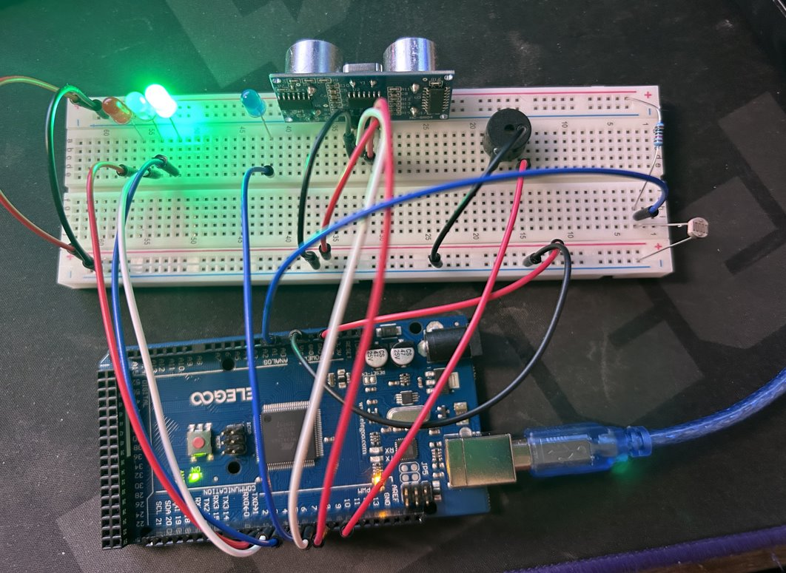
Circuit with automated LED off (picture)​

Slide 24
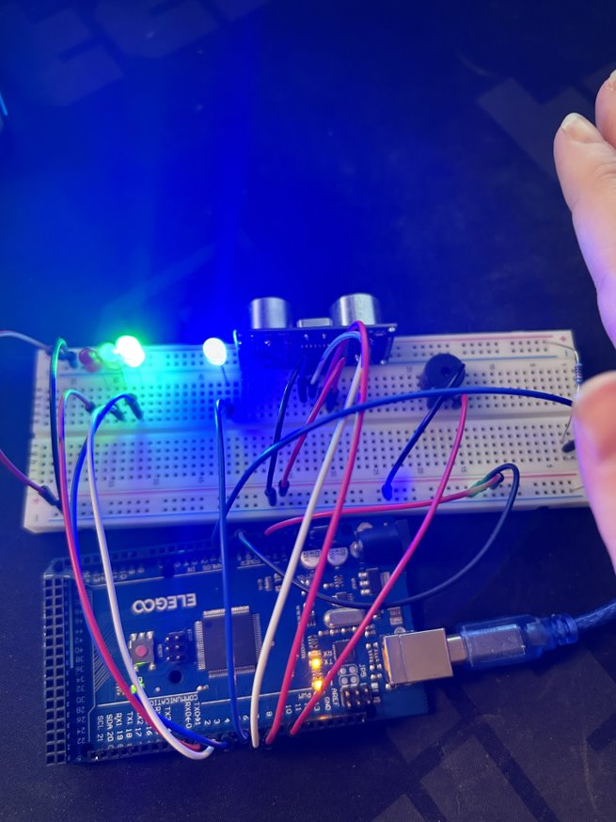
Circuit with automated LED on (picture)​

Slide 25
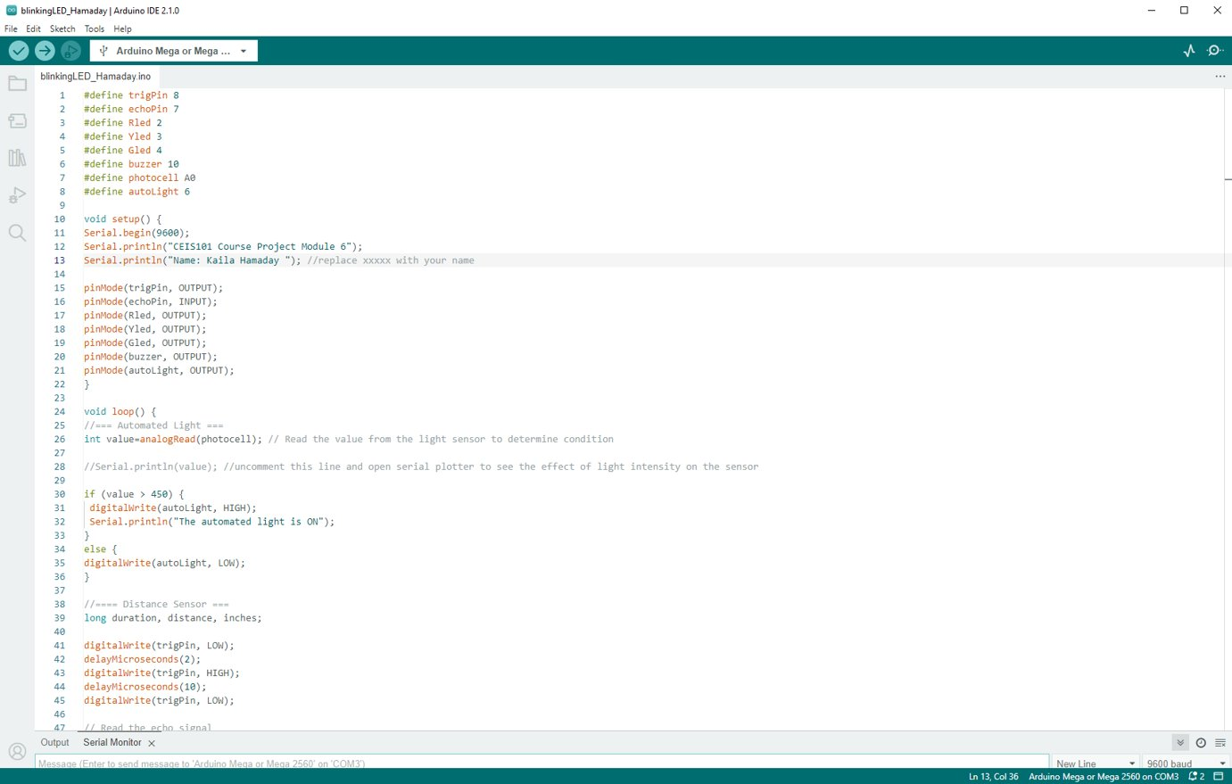
Arduino Code (screenshot)​

Slide 26
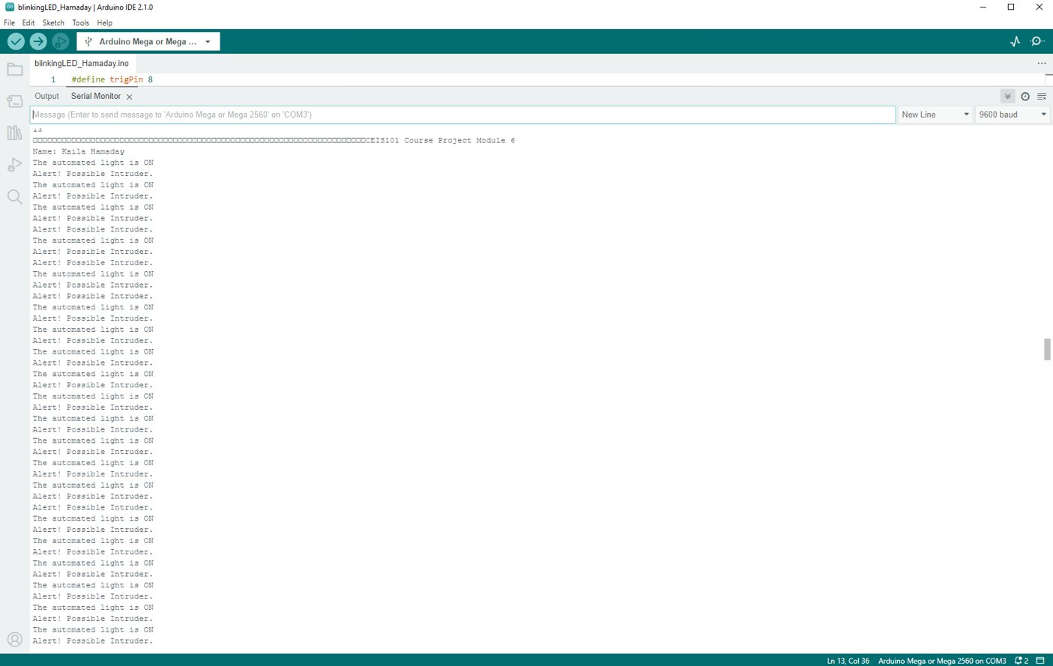
Serial Monitor (screenshot)​

Slide 27
Challenges
Some of the challenges that came up where:
A few times during the modules I would forget to upload the code, so it wouldn't work and then I would start troubleshooting and figure out I didn't upload the code!
At one point I had accidentally unplugged one of the wires for the door sensor, and it wasn't working.

Slide 28
Career Skills Acquired
Hardware / Device knowledge
Coding / Programming
Understanding of IoT systems and devices
Basic business intelligence and data analytic knowledge
Automation
Security Awareness
Networking / Connectivity knowledge

Slide 29
Project Conclusion
At first, I didn't understand how this project would help me with understanding IoT devices. In fact, I didn't have a huge understanding of them at all. After doing this project, I realize that I was wrong, and this was a great project to understand the world of IoT.
In this project, we had to follow many steps to create a security system. We also added automated LED lights and a door sensor with alarm.
I learned what an Arduino was, as well as a breadboard and all the different components that would have been used. I also learned how one device can be used for many different projects. I am excited as this brings me closer to my career in cybersecurity!

