Slide 1
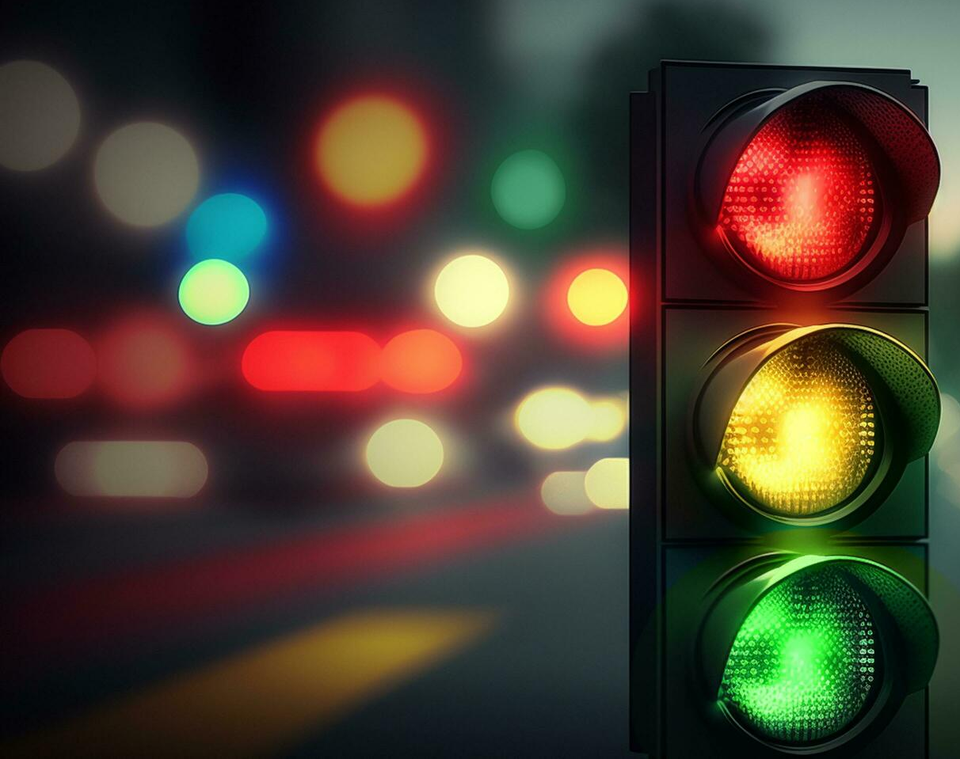
CEIS 114
Final Project
By: Kaila Hamaday
Creating a Multiple Traffic Light Controller with a Cross Walk and an Emergency Buzzer with secured IoT Control via Web

Slide 2

Introduction
The purpose of this project was to develop a Multiple Traffic Light Controller with a Cross Walk and an Emergency Buzzer with secured IoT Control via Web We built the system with our IoT Tech Core Kit and programming with the Arduino IDE.
The smart traffic controller will encompass multiple devices:
ESP32 Board
LEDs (red, yellow, green, blue)
Mini Router
Buzzer
Button
LCD Panel

Slide 3
Project Preparation

Slide 4
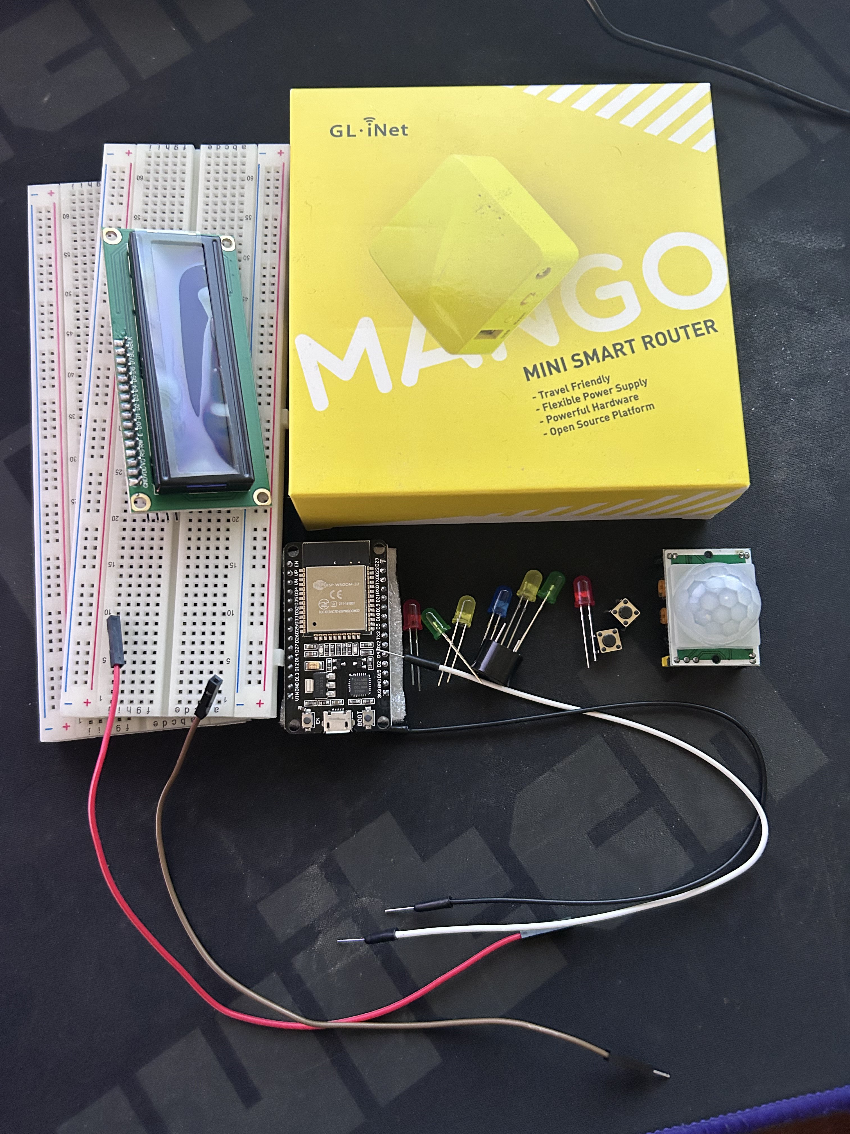
Inventory (Picture)
ESP 32 Board
Colored LEDs: Red, Yellow, Green, and Blue
220 Ohm Resistors (optional)
Wires
Breadboard(s)
LCD Unit with I2C Adapter
Active Buzzer
Mini Router
Push Button(s)
PIR Motion Sensor

Slide 5
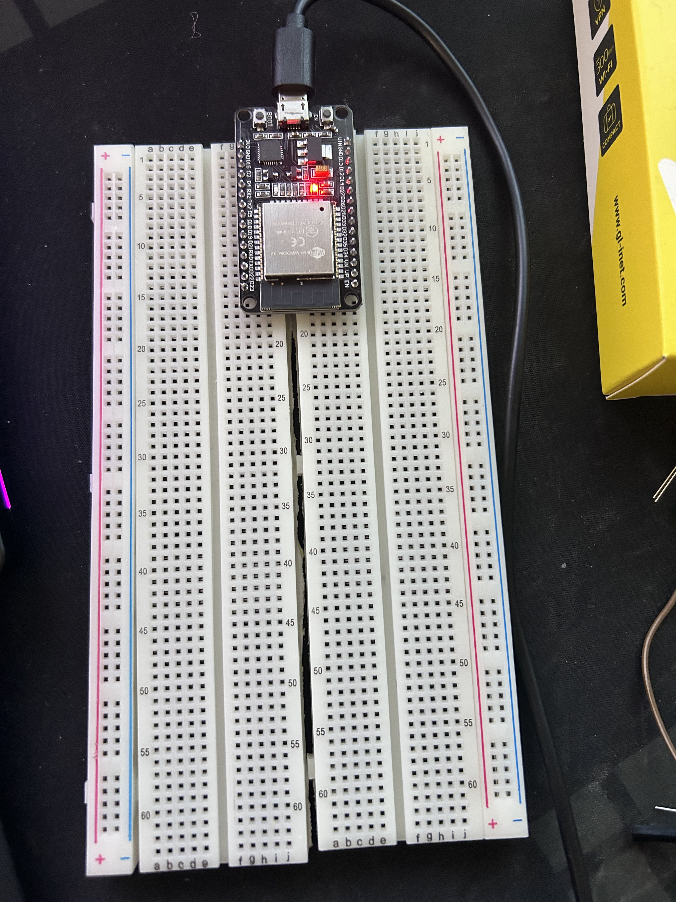
ESP32 (Picture)
Microcontroller mounted and powered ON

Slide 6
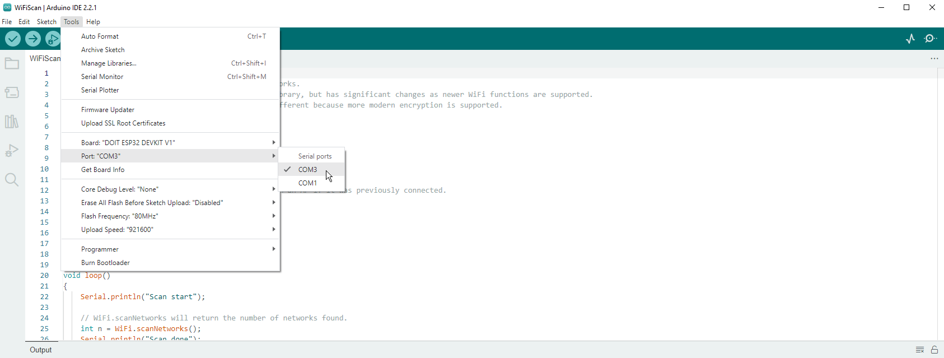
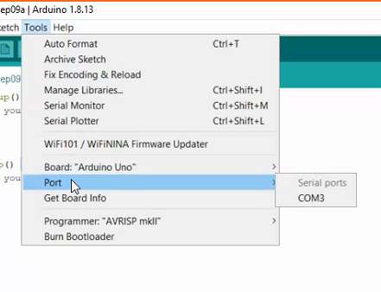
Installation of Arduino IDE
Screenshot of Arduino IDE with Port selected from Tools menu.
Example

Slide 7
Creating the Traffic Controller

Slide 8
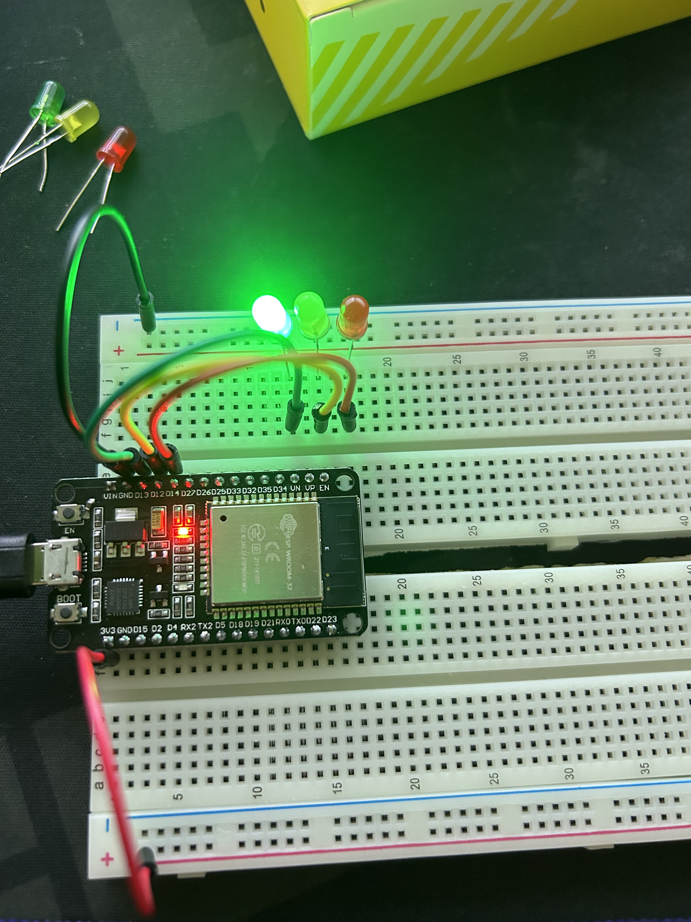
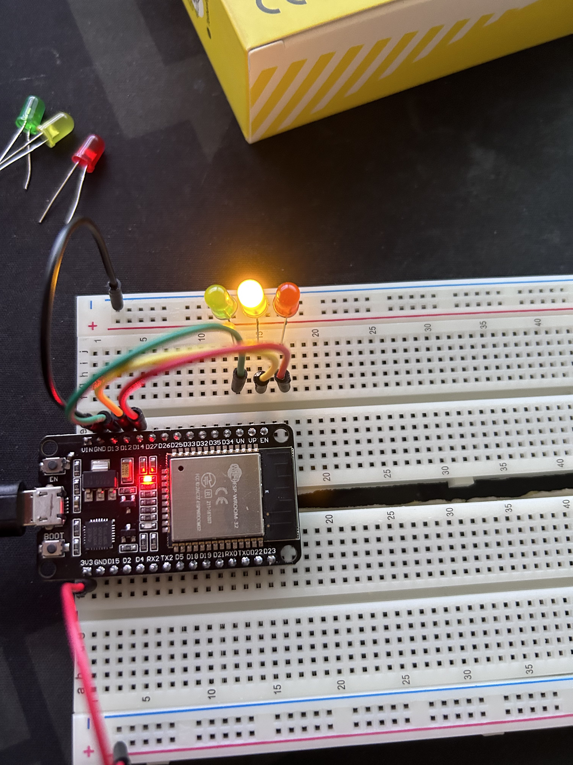
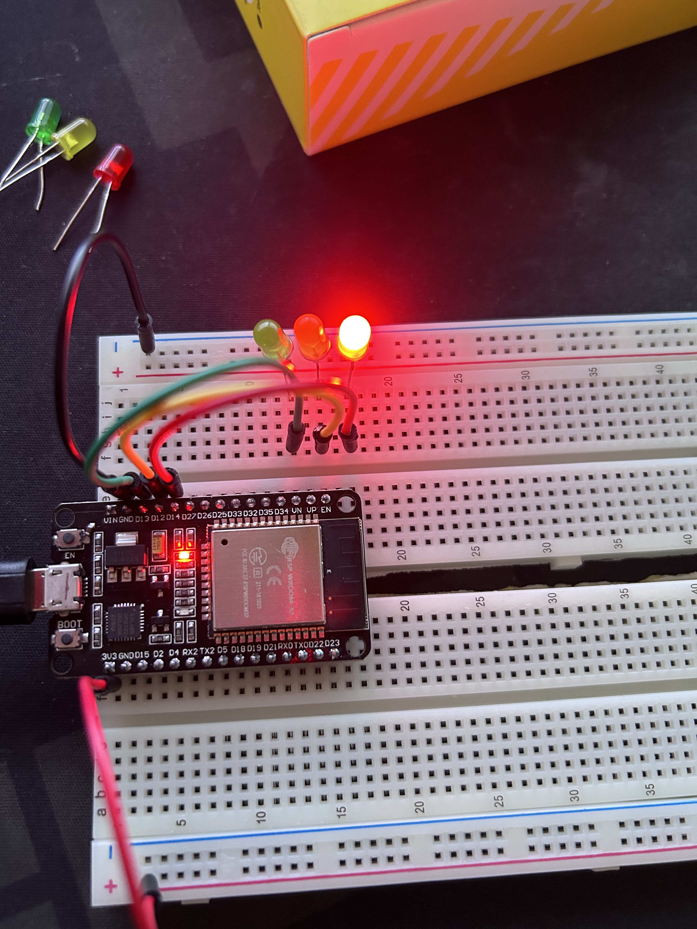
Picture of circuit with working LEDs
ESP 32 Board
Colored LEDs: Red, Yellow and Green
220 Ohm Resistors (optional)
Wires
Breadboard

Slide 9
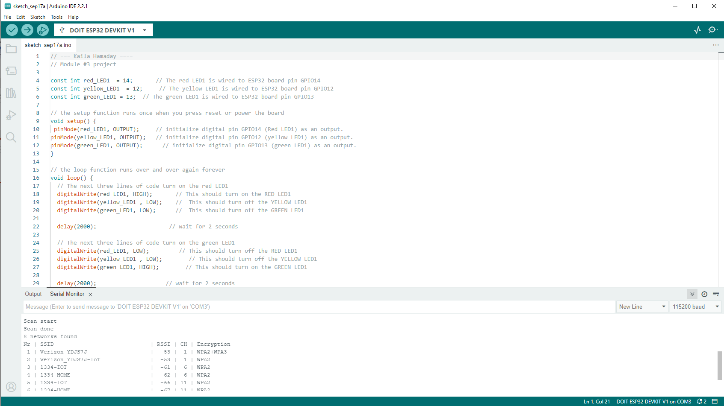
Screenshot of code in Arduino IDE
Screenshot of code in Arduino IDE showing your name in the comment

Slide 10
Adding Multiple Traffic Lights

Slide 11
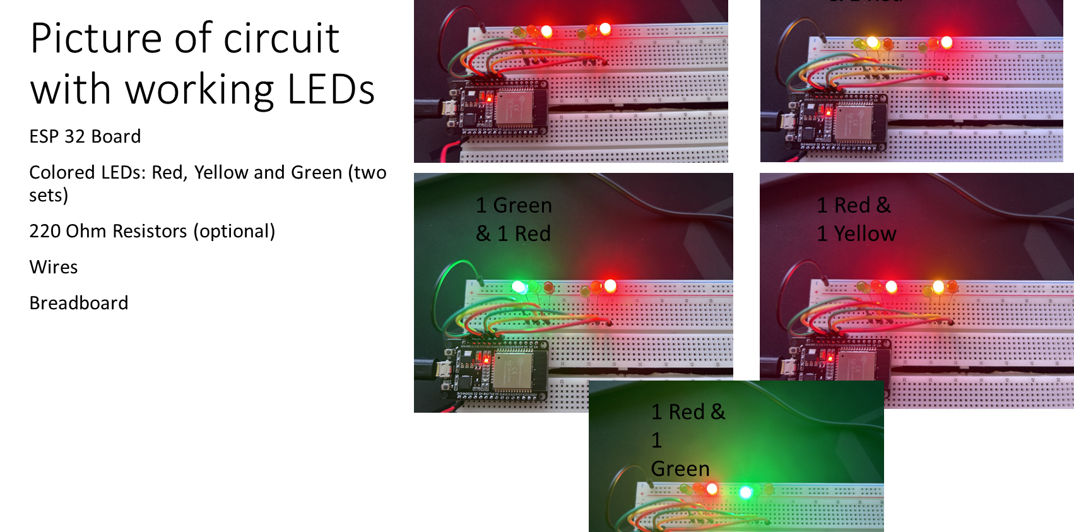

Slide 12
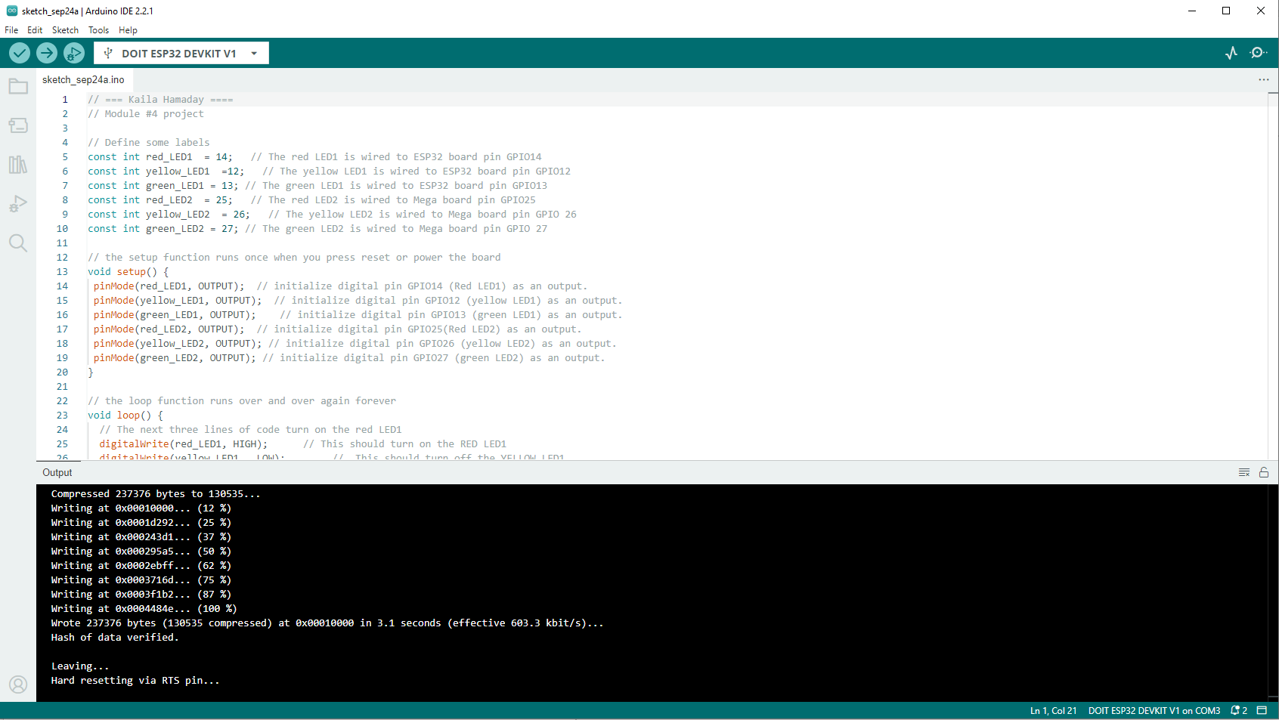
Screenshot of code in Arduino IDE
Screenshot of code in Arduino IDE showing your name in the comment

Slide 13
Adding Crosswalk button

Slide 14
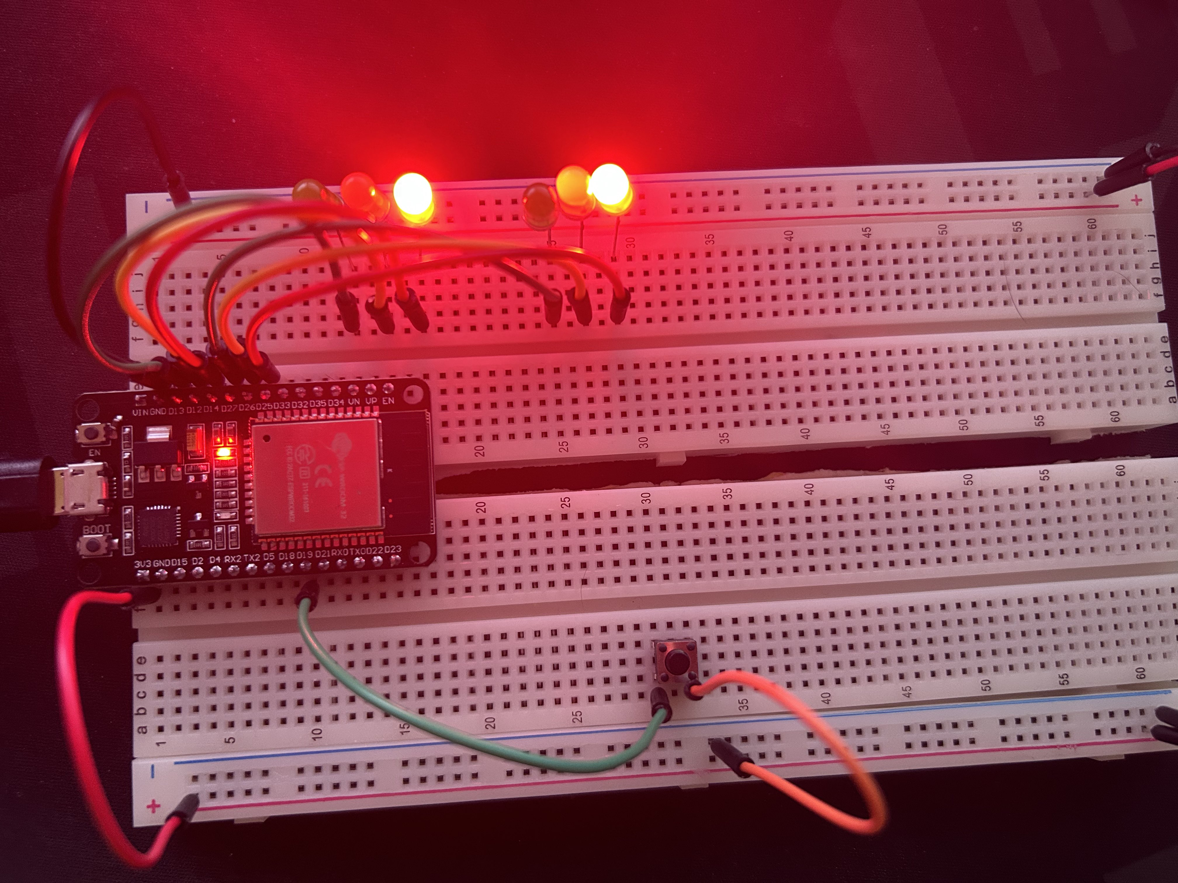
Picture of circuit with working LEDs
ESP 32 Board
Colored LEDs: Red, Yellow and Green (two sets)
220 Ohm Resistors (optional)
Push Button
Wires
Breadboard

Slide 15
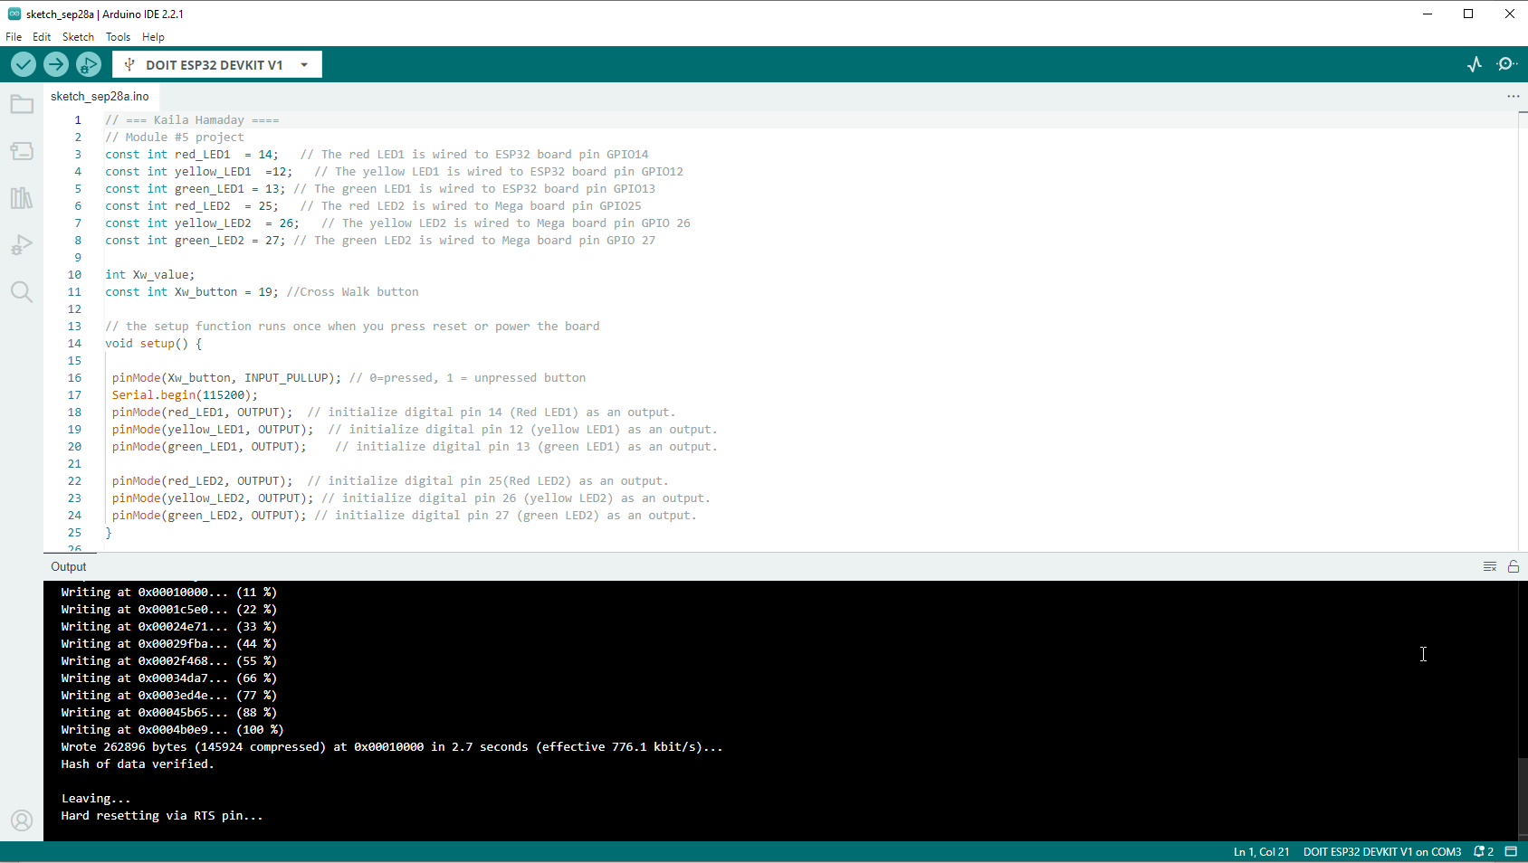
Screenshot of code in Arduino IDE
Screenshot of code in Arduino IDE showing your name in the comment

Slide 16
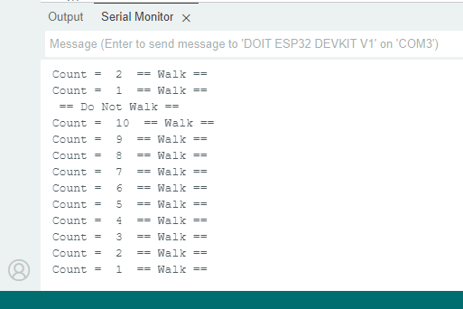
Screenshot of Serial Monitor in Arduino IDE
Screenshot of output in Serial Monitor

Slide 17
Adding an Emergency Buzzer & LCD Display

Slide 18
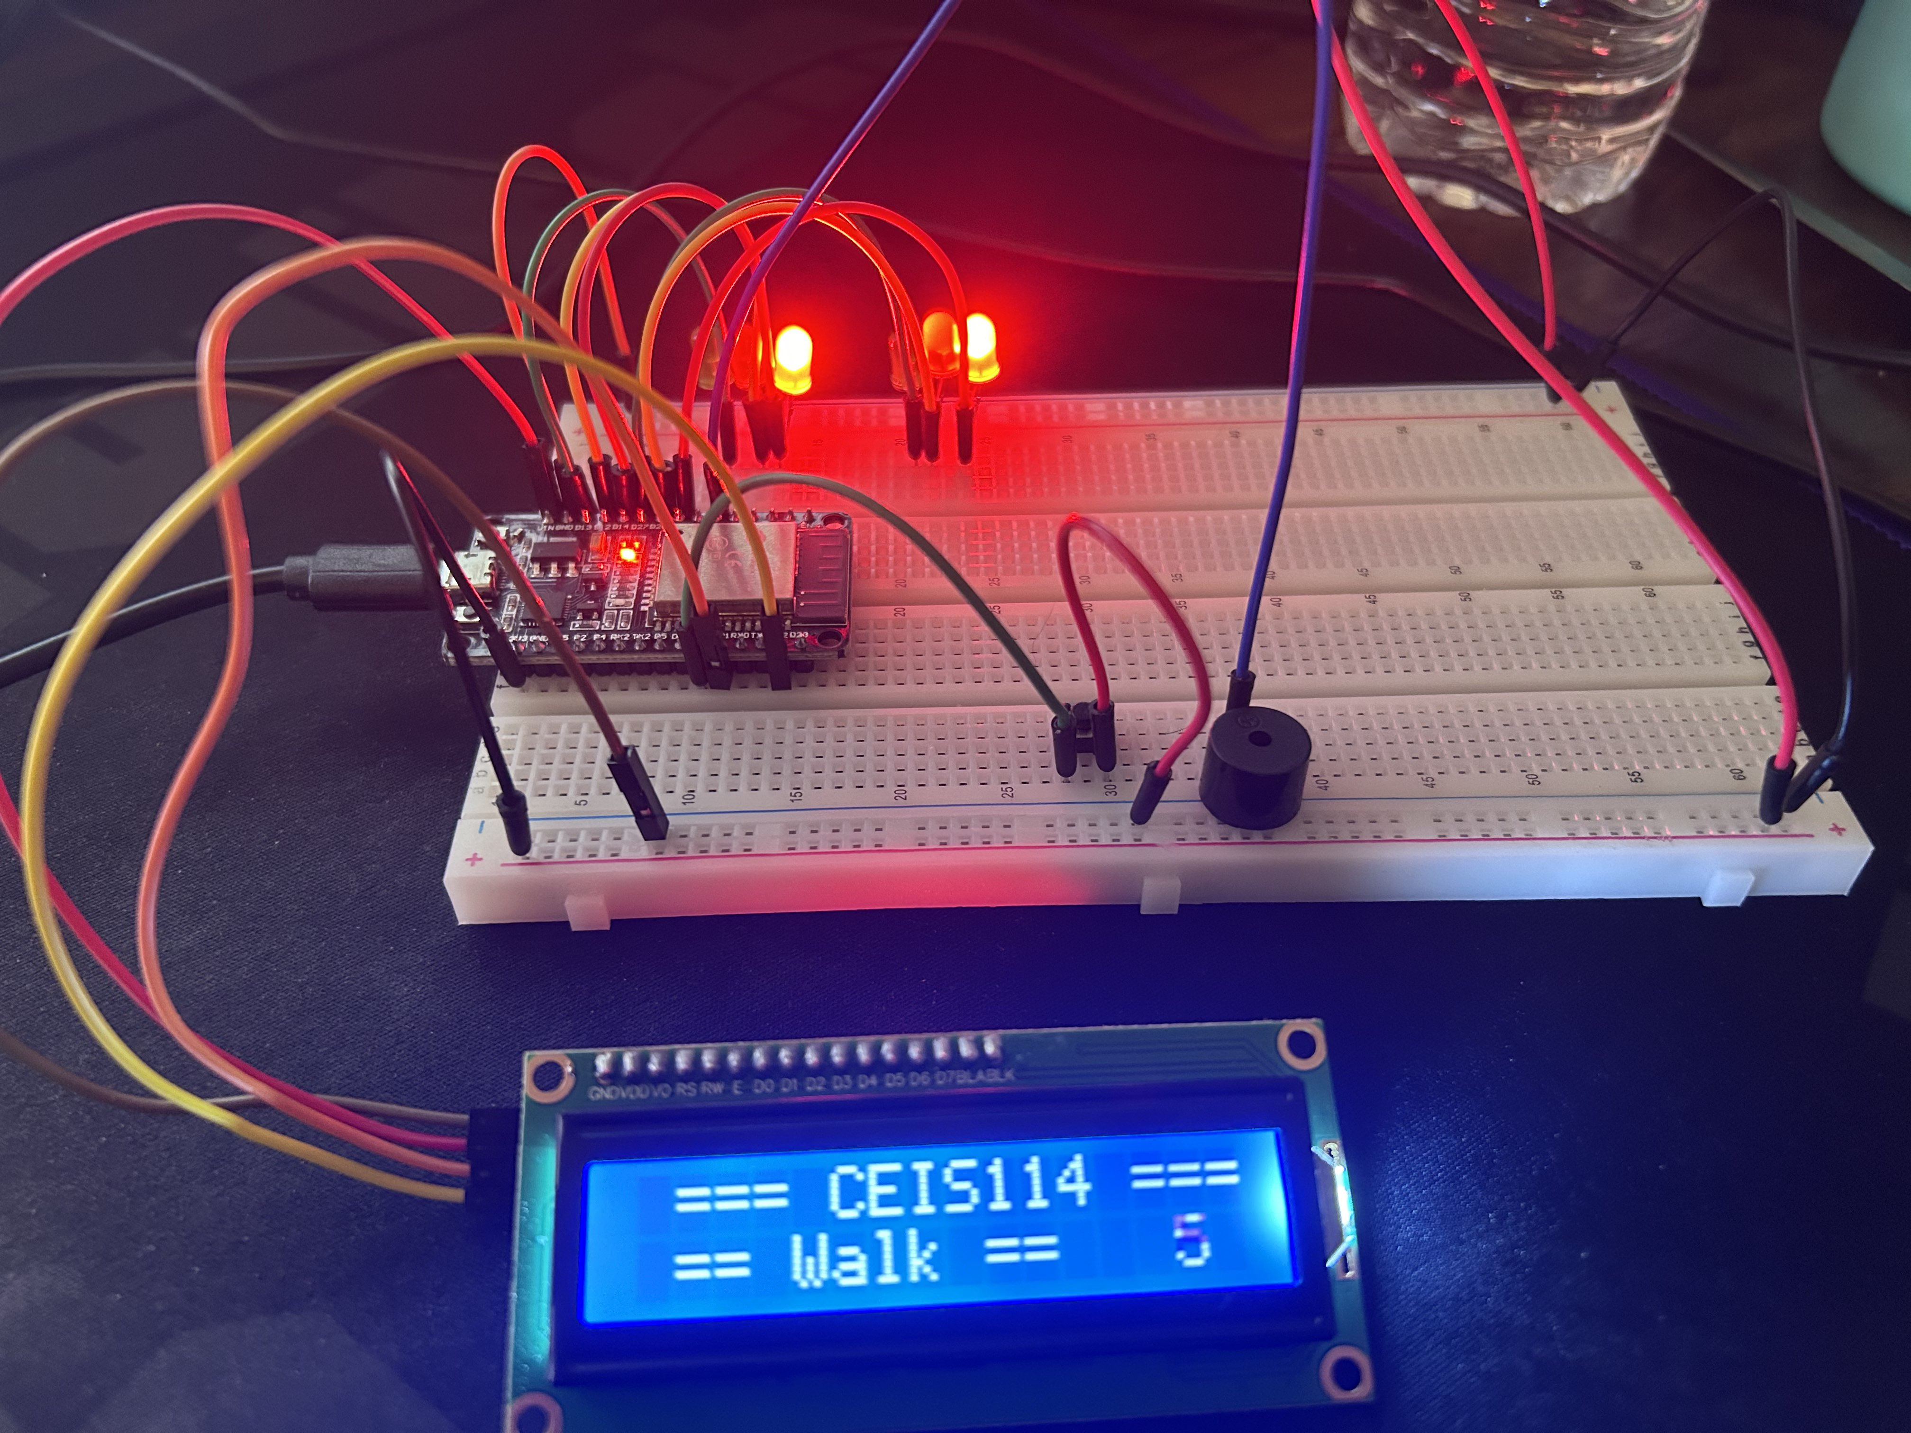
Picture of circuit with working LEDs and LCD display
ESP 32 Board
Colored LEDs: Red, Yellow and Green (two sets)
220 Ohm Resistors (optional)
Push Button
LCD Unit with Message Display
Wires
Breadboard

Slide 19
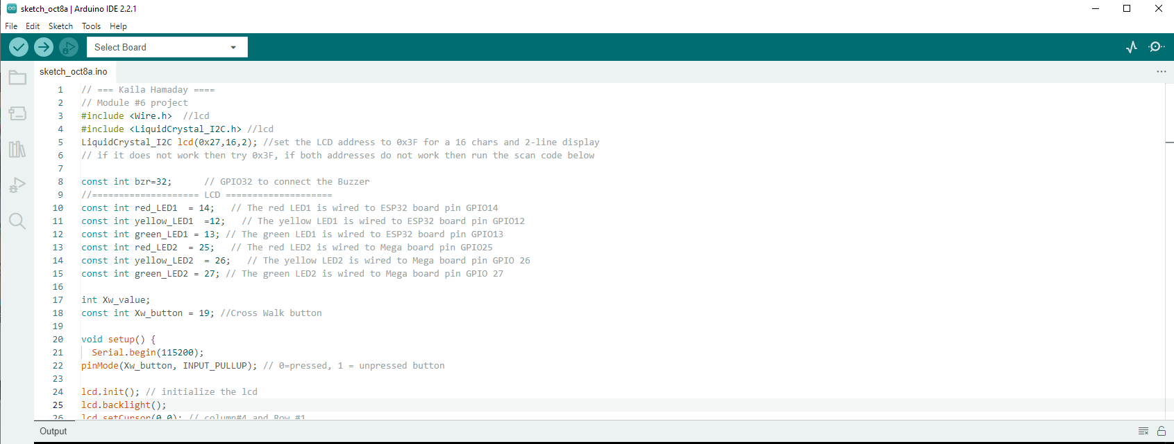
Screenshot of code in Arduino IDE
Screenshot of code in Arduino IDE showing your name in the comment

Slide 20
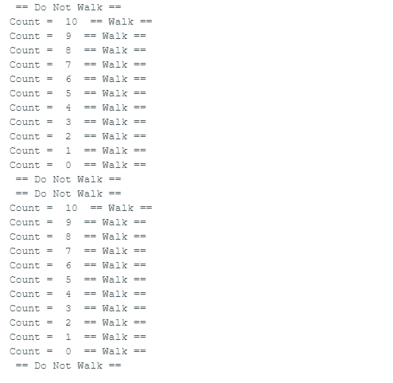
Screenshot of Serial Monitor in Arduino IDE
Screenshot of output in Serial Monitor

Slide 21
Adding Remote Emergency Control

Slide 22
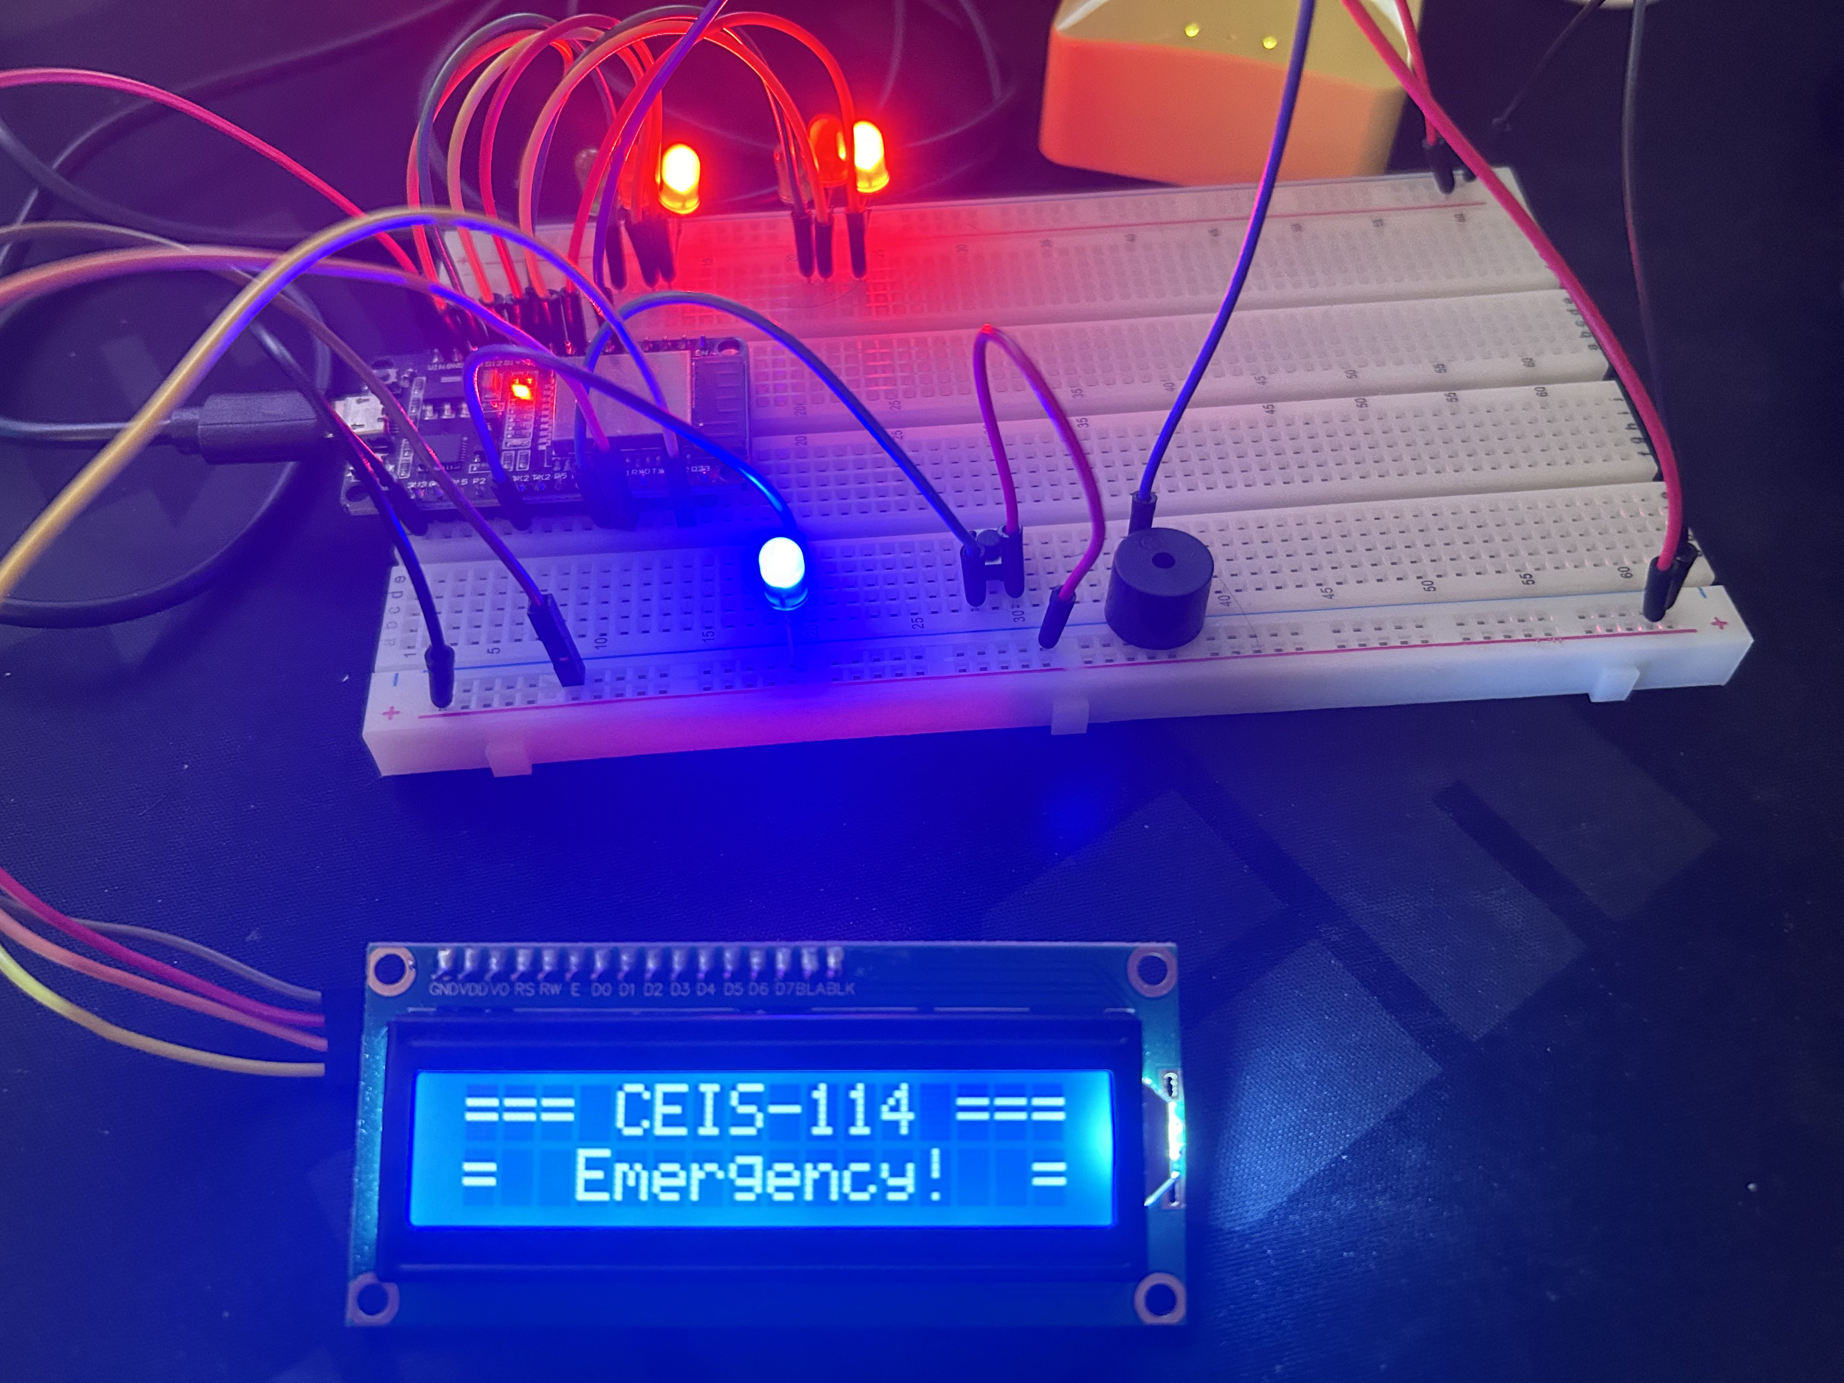
Picture of circuit with working LEDs and LCD display when Emergency button is pressed. (Building/Operation)
ESP 32 Board
Colored LEDs: Red, Yellow and Green (two sets) - 2 Red Lights ON
One Blue LED – Emergency Light ON
220 Ohm Resistors (optional)
Push Button
LCD Unit
Buzzer
Wires
Breadboard

Slide 23
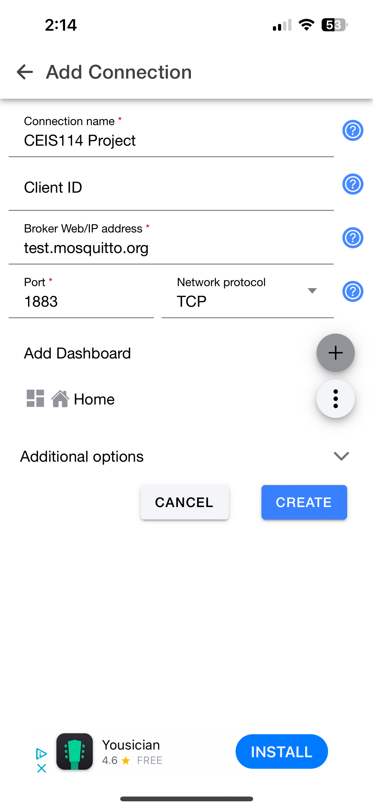
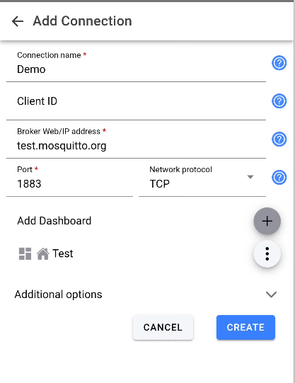
Screenshot/Picture of your APP Connection Name

Slide 24
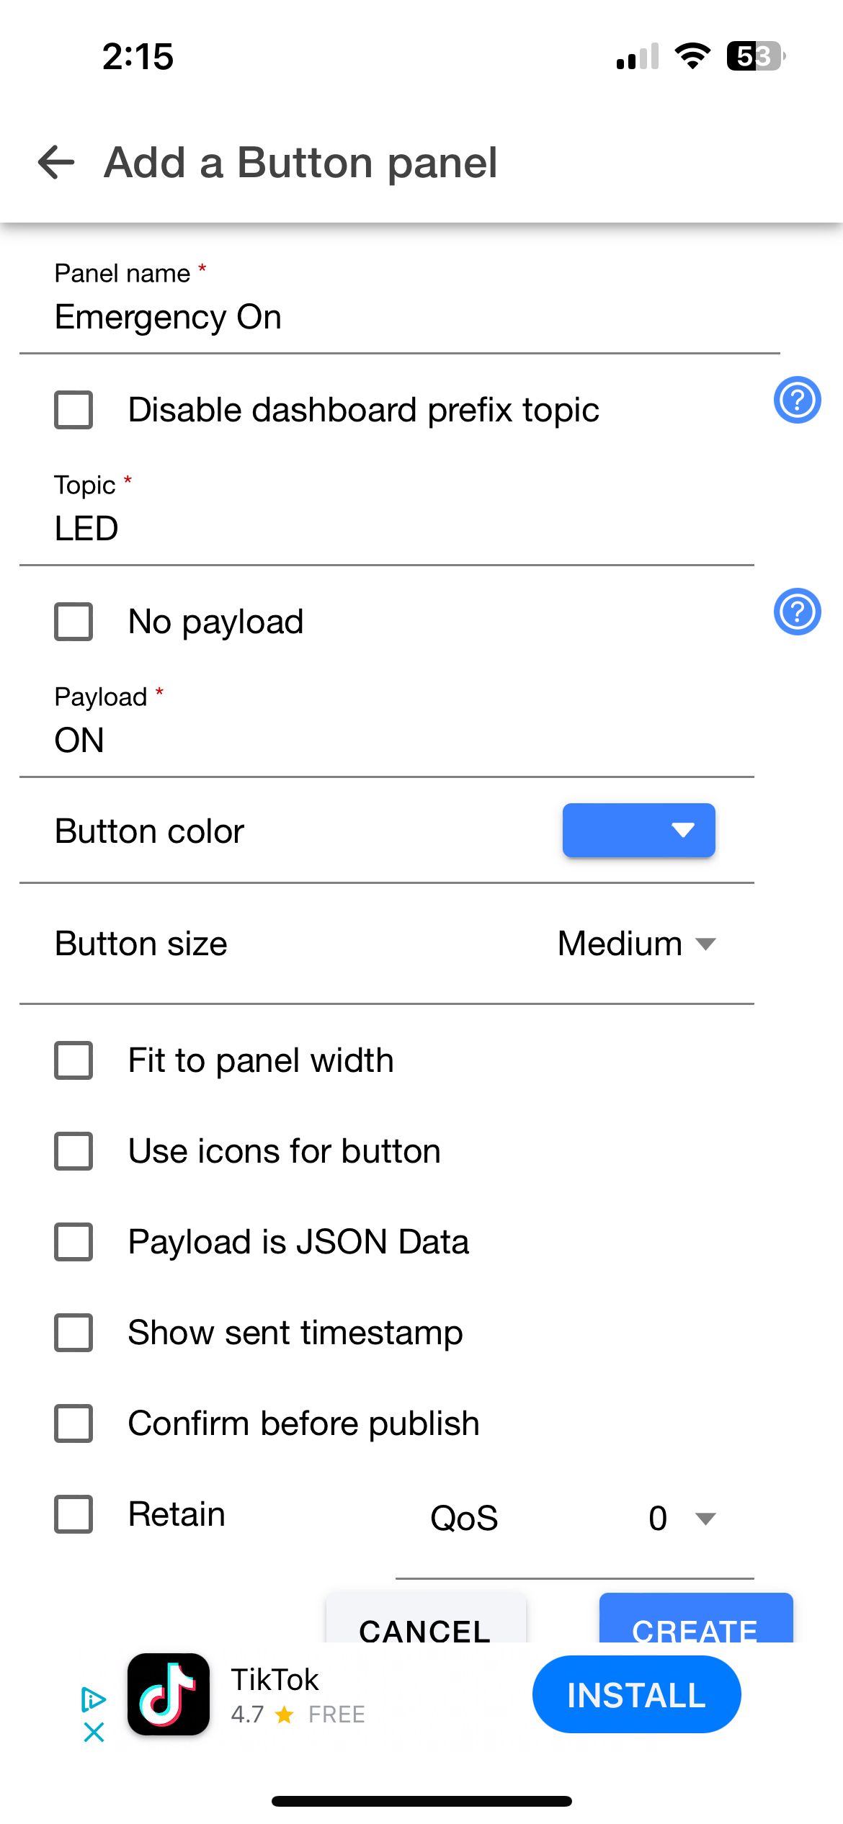
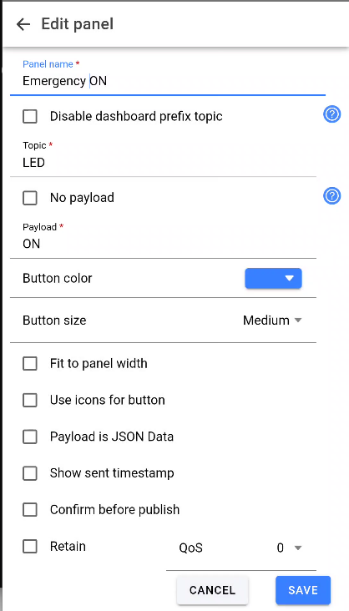
Screenshot/Picture of your Emergency ON Panel

Slide 25
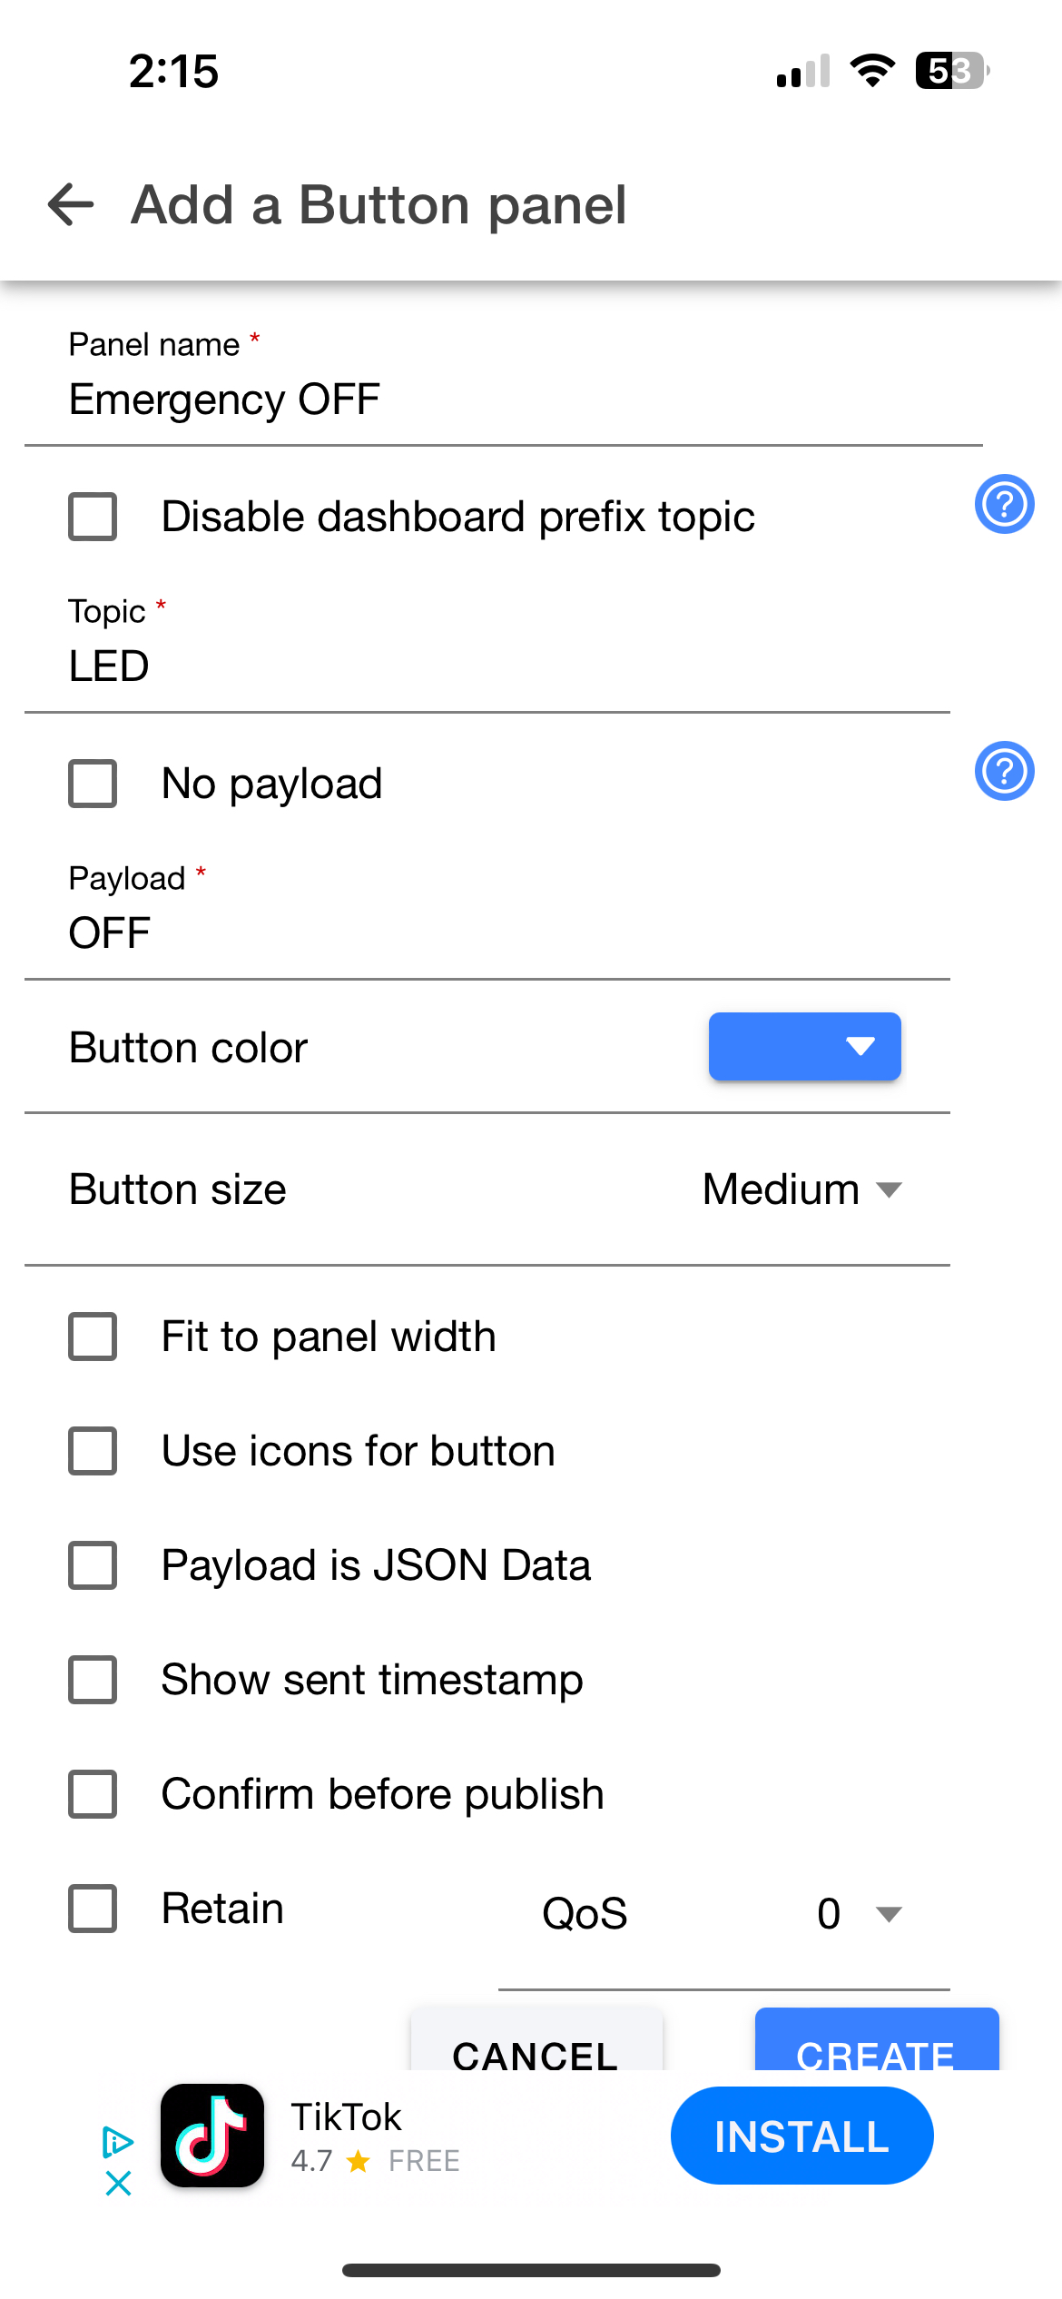
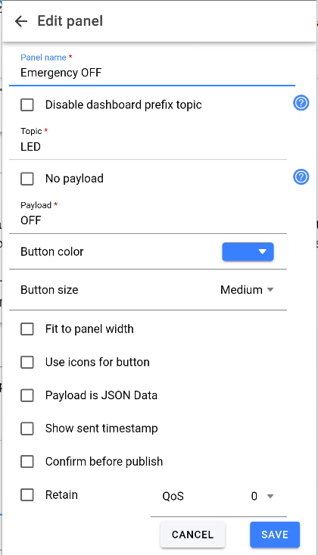
Screenshot/Picture of your Emergency OFF Panel

Slide 26
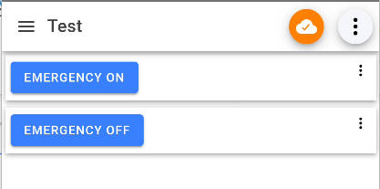
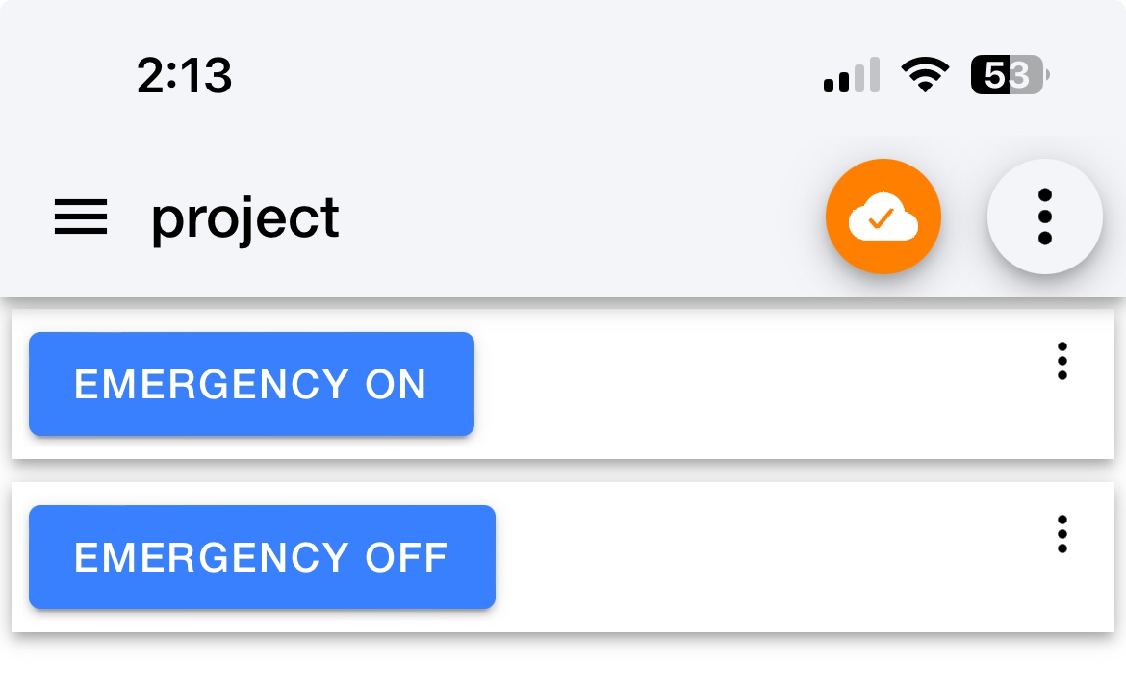
Screenshot/Picture of your Dashboard

Slide 27
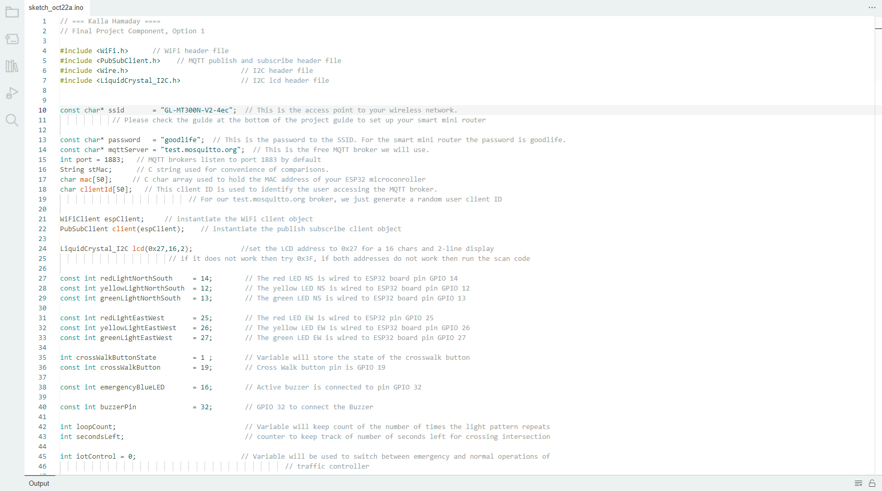
Screenshot of code in Arduino IDE (Testing)
Screenshot of code in Arduino IDE showing your name in the comment

Slide 28
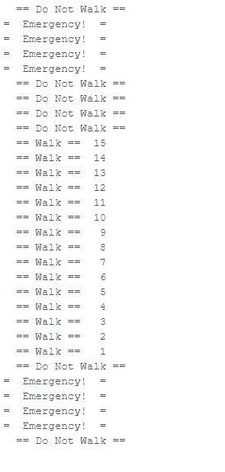
Screenshot of Serial Monitor in Arduino IDE (Testing)
Screenshot of output in Serial Monitor showing the messages:
DO NOT WALK
EMERGENCY
WALK

Slide 29
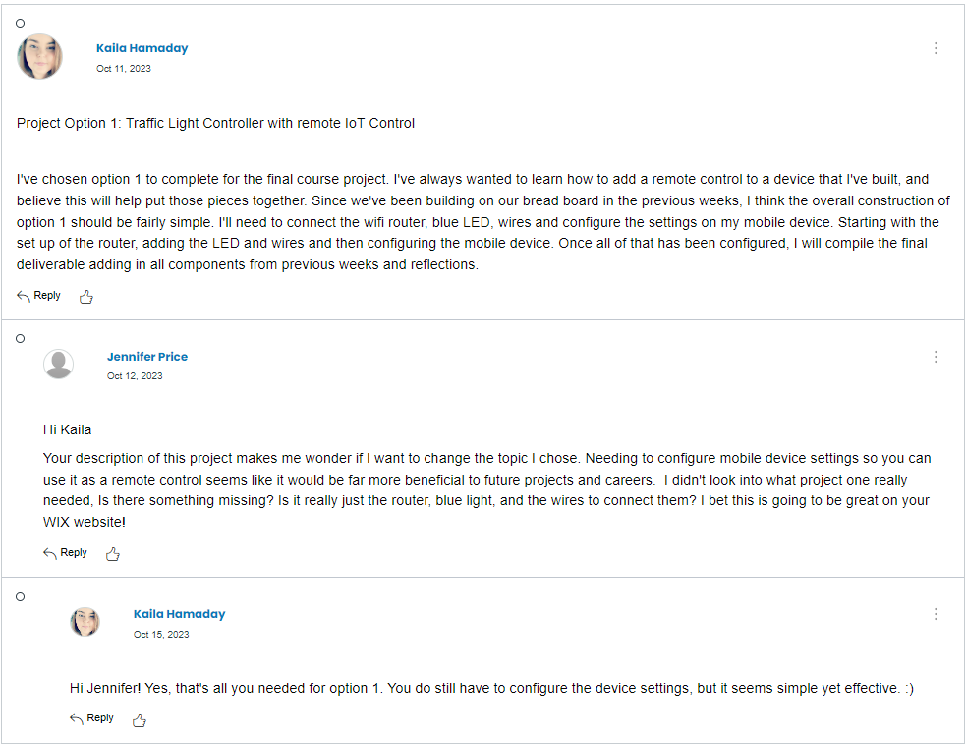
My Group Discussion Post

Slide 30
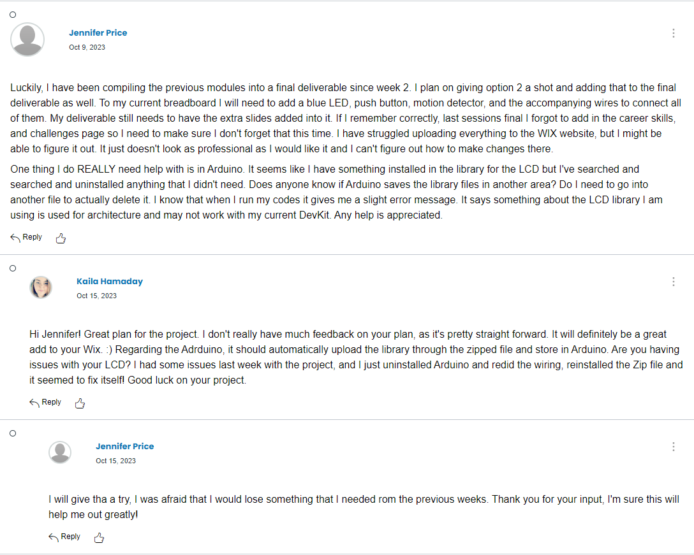
Group Discussion
Jennifer had great points to her project. I explained to her that I didn't have feedback, but rather provided her some help with the Zip Libraries used in Arduino.

Slide 31
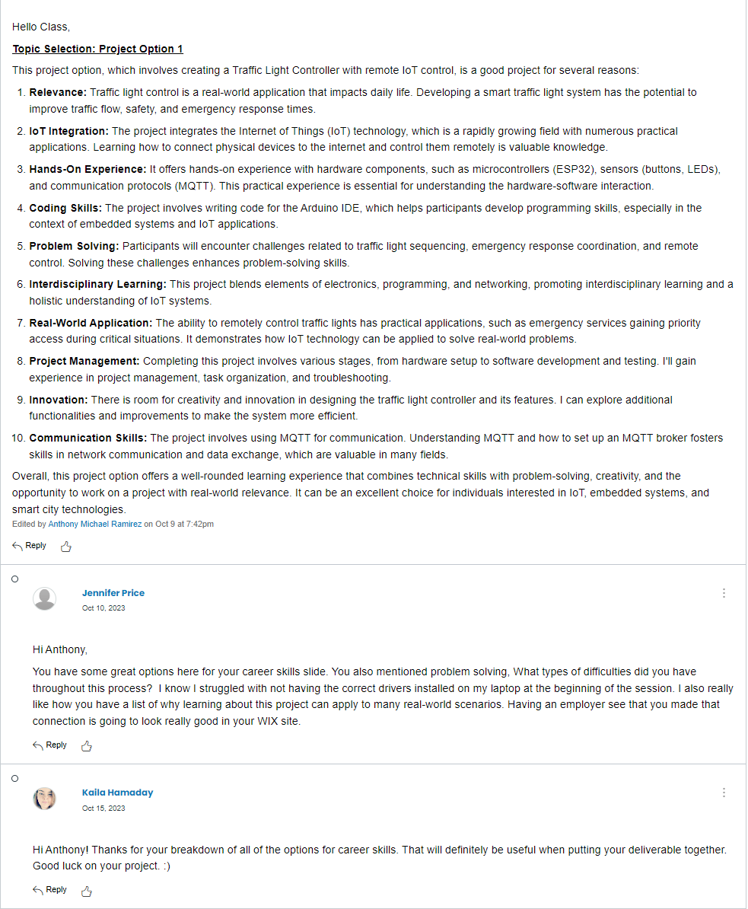
Group Discussion
Anthony provided career skills they would have gained from the project. Which, Jennifer posed some good questions to, and I agreed with her that they had a good overview of career skills gained from this project.

Slide 32
Challenges
Some of the challenges faced were:
A few times I forgot to either verify the sketch or upload it, so when I went to test the build, it didn't work correctly. I had to then verify and upload and it worked
On the final project, there was a space on the SSID in the code, which I didn't notice at first, which caused the program to not run successfully. I removed this space and it uploaded correctly.

Slide 33
Career Skills
Hardware / Device knowledge
Planning
Automation
Networking / connectivity knowledge
Understanding IoT systems and devices

Slide 34
Conclusions
At first, I didn't understand how this project would help me with understanding digital devices. I had a general understanding of what they were due to everyday life, but I never thought of a traffic light as such.
In this project, we had to follow many steps to create an automated traffic controller with crosswalk and emergency controller. We also added automated LED lights and a LCD display for the crosswalk.
I built on my previous knowledge of the Arduino, as well as a breadboard and all the different components that would have been used. I also learned how one device can be used for many different projects. I am excited as this brings me closer to my career in cybersecurity!

